Slide 1
Climate Engineering Teaching Module Lesson 1 – Collaborative Design Thinking
Ben Kravitz¹, Paul Goddard¹, and Adam Scribner² 1.Department of Earth and Atmospheric Sciences 2. The School of Education
INDIANA UNIVERSITY

Slide 2
Design a Technology to Slow Global Warming
Objective

Slide 3
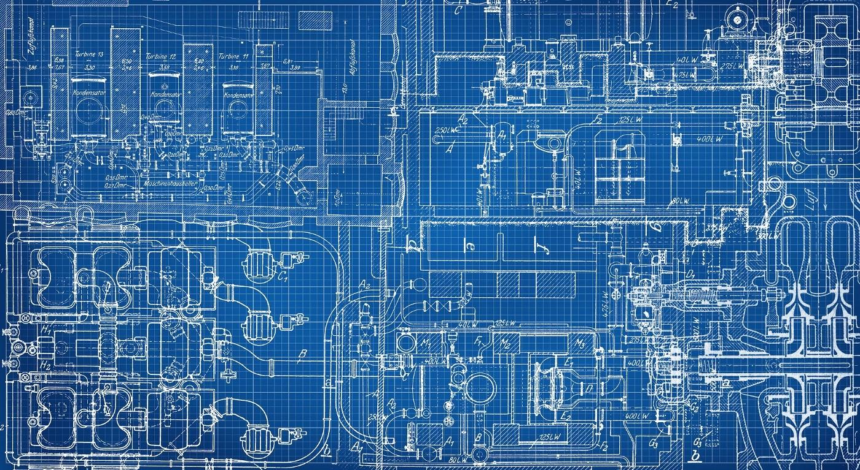
Climate engineering is the deliberate modification of an environmental system that impacts Earth’s climate in order to reduce the negative impacts of global warming.

Slide 4
Climate engineering is the deliberate modification of an environmental system that impacts Earth’s climate in order to reduce the negative impacts of global warming, but...
What is global warming and climate change?
How do we know it is occurring?
What are these environmental systems you speak of?
You want me to fix global warming?!?!

Slide 5
Climate change in ten words
It’s real
It’s us
It’s bad
Scientists agree
There’s hope
Tony Leiserowitz

Slide 6
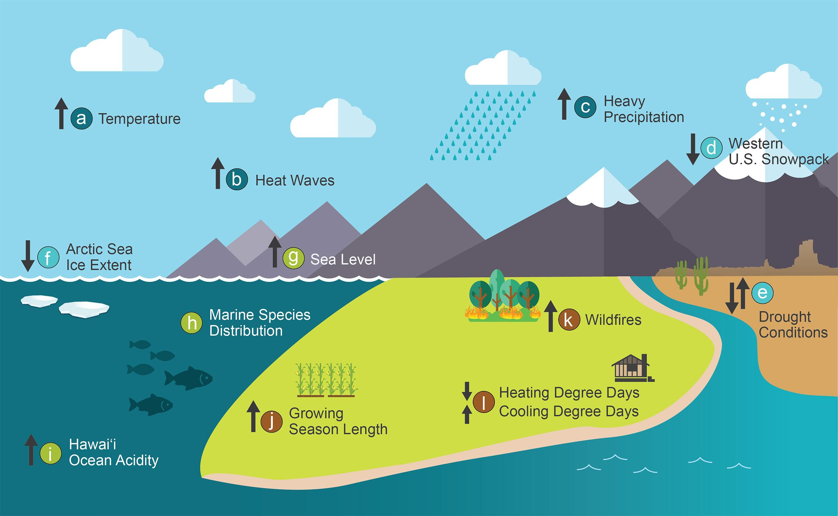
Evidence of Climate Change
4th National Climate Assessment
(5th NCA just released!)

Slide 7
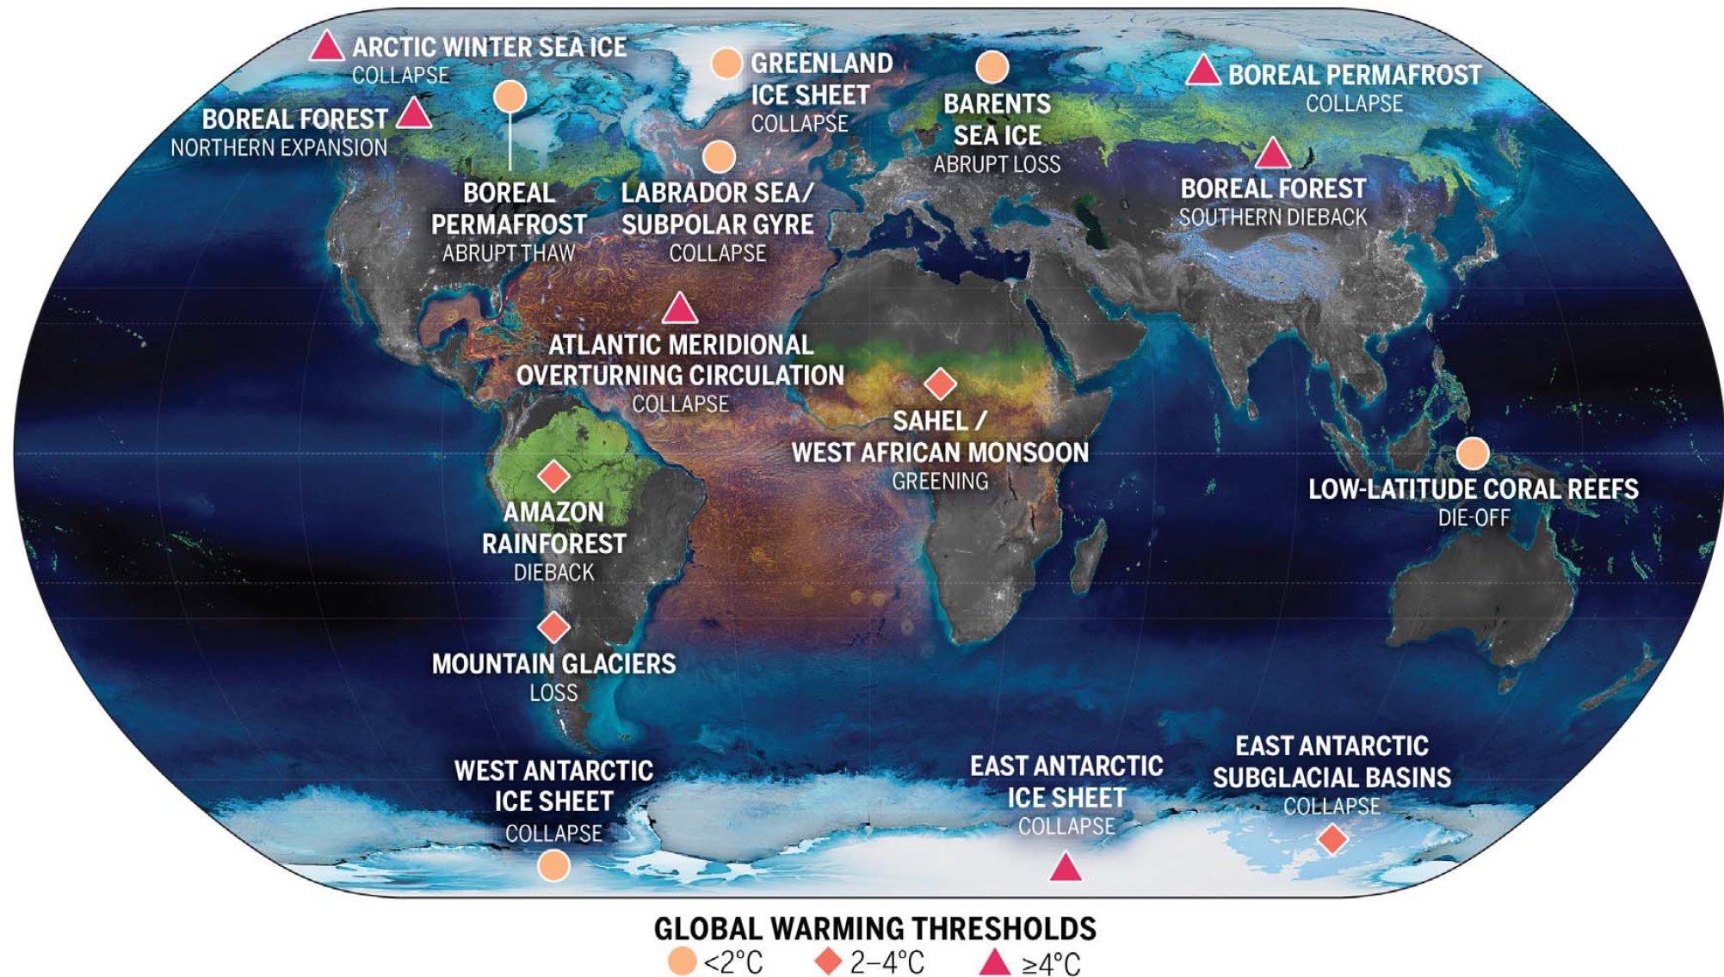
Nearing Tipping Points
McKay et al. (2022)

Slide 8
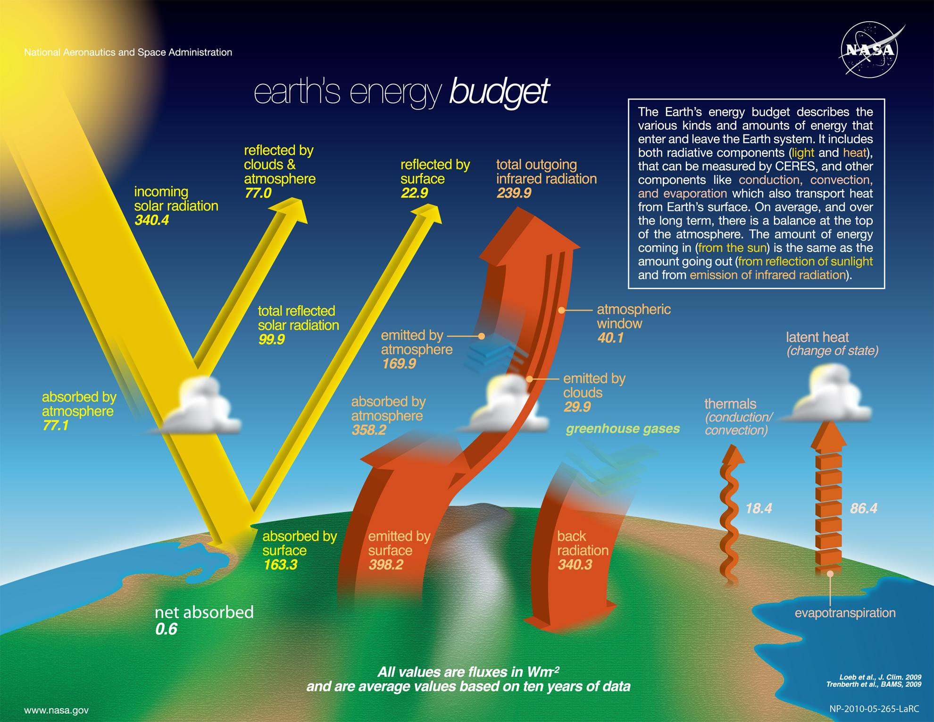
Global Warming Simplified:
Energy going in is greater than the energy going out

Slide 9
+
>
+
Global Warming Simplified:
Energy going in is greater than the energy going out

Slide 10
+
>
+
Global Warming Simplified:
Energy going in is greater than the energy going out

Slide 11
Climate Engineering is about developing technologies to reverse this inequality
>
+
+

Slide 12
Climate Engineering is about developing technologies to reverse this inequality by…
>
+
+
Think about how to increase the right side of the equation
Reflection of incoming sunlight
At the Surface?
In the Atmosphere?
In Space?
Permit more infrared radiation (heat) to escape to space
How to open this “window”?

Slide 13
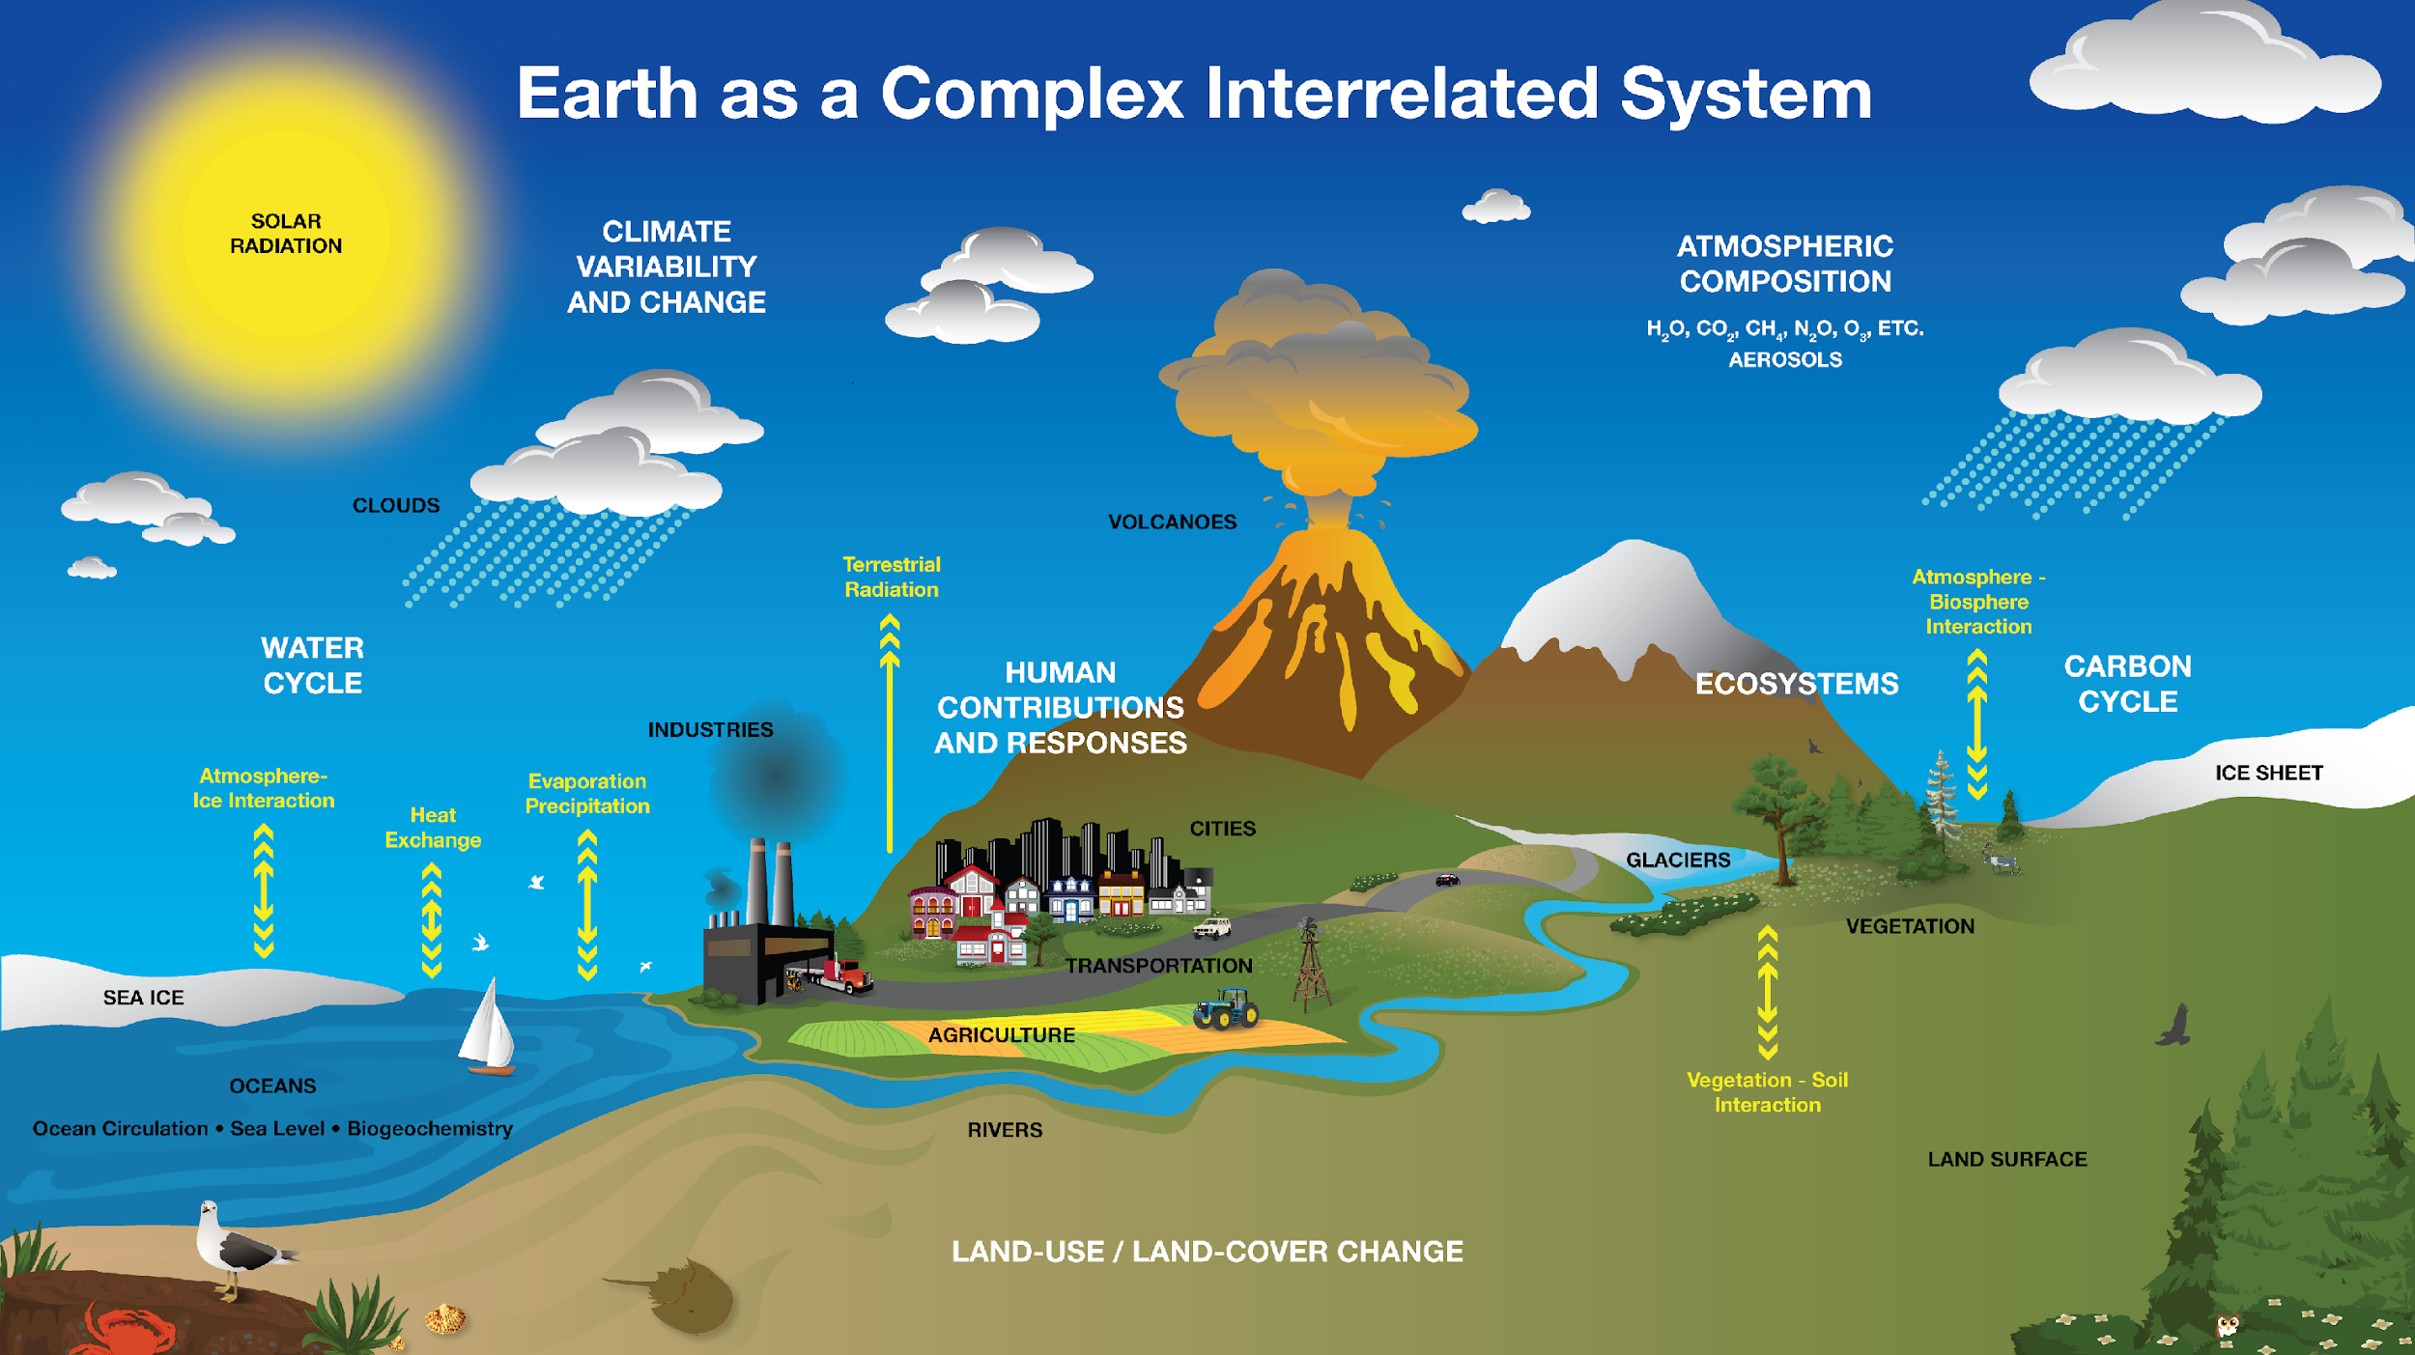
Climate Engineering is about developing technologies to reverse this inequality by modifying a part of the climate system
NASA

Slide 14
Write as many (wild!) ideas as possible in 3 minutes.
Can you think of ways to modify these systems to slow global warming (increase the RHS of the equation??
Incoming
solar radiation
>
Total reflected incoming radiation
+
Total outgoing infrared radiation
NASA
*Catherine

Slide 15
Now, as a small group write (wild!) ideas for 3 minutes
Can you think of ways to modify these systems to slow global warming (increase the RHS of the equation??
Incoming
solar radiation
>
Total reflected incoming radiation
+
Total outgoing infrared radiation
NASA

Slide 16
+
Incoming
solar radiation
>
Total reflected incoming radiation
Total outgoing infrared radiation
What ideas does AI have? - Ask ChatGPT:
“Create 10 wild ideas that fit the category of geoengineering to stop global warming”
Then ask ChatGBT: “But, more wild” to get some sensational ideas
NASA

Slide 17
Mind Map
Organize group and individual sticky notes on large sheet of paper or wall.
Category 1
Category 2
Design a Solution for Global Warming
Category 3
Category 4

Slide 18
Mind Map
Organize group and individual sticky notes on large sheet of paper or wall.
Carbon Uptake
Emission Reduction
Example Categories
Design a Solution for Global Warming
Sunlight Reduction
Miscellaneous

Slide 19
Collaborative design is when people think and brainstorm as team with a shared design goal.
Collaborative Design

Slide 20
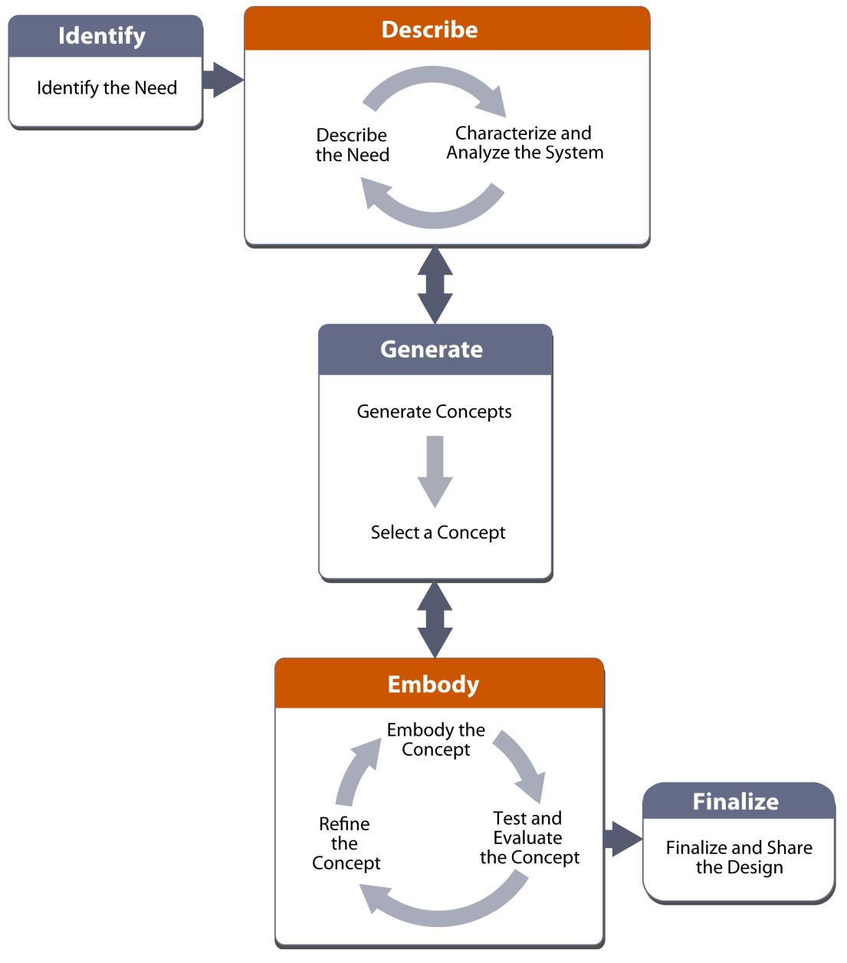
The Engineering Design Process can be Complex

Slide 21
The Engineering Design Process can be Complex.
Concept Generation

Slide 22
Concept Sketching
CONCEPT 1
CONCEPT 2
CONCEPT 3
Notes:
Concept drawings or sketches are drawings, often freehand, that are used by designers such as architects, engineers and interior designers as a quick and simple way of exploring initial ideas for designs. Concept drawing - Designing Buildings

Slide 23
Concept Sketching
Individually… Draw an upside-down “Y” on paper
Sketch 3 ideas in the 3 spaces on your paper using one colored pencil (10 min)

Slide 24
As a group… Pass your paper to the person to your right.
Sketch more design details on their paper using your colored pencil (2-3 min for each rotation).
Repeat until you have added to everyone else’s papers.
Concept Sketching

Slide 25
This lesson introduced and developed ideas for engineering solutions to global warming and climate change. In the next lesson we will learn about a specific climate engineering design that is currently being researched by scientists and engineers.
Prepare for Lesson 2

Slide 26
Questions/Comments/Thoughts/Ideas welcome!
Paul Goddard pgoddard@iu.edu
Ben Kravitz bkravitz@iu.edu
Adam Scribner

