Slide 1
Climate Engineering Teaching Module Fall 2023
Paul Goddard¹, Ben Kravitz¹, Adam Scribner², Catherine Peterson³, Kirstin Milks³ 1.Department of Earth and Atmospheric Sciences 2. The School of Education 3. MCCSC BHSS
INDIANA UNIVERSITY

Slide 2
Students will learn:
Physical science is just one dimension of climate change
Pros and Cons of Climate Engineering relative to global warming
Variety of knowledge and skills are needed
(climate science and engineering are important, but not exclusive)

Slide 3
Project Highlights and Plans
Five “complete” Climate Engineering lessons (aligned to standards, materials, activities)
Climate Change and Engineering
Social Sciences and Communication/Argumentation
Three Fall and Two Summer Science Workshops
Implemented by MCCSC and Kokomo HS Teachers … others?
Presentations at IU ERI, HASTI, ‘23 AGU Fall Meeting, ‘24 GRC on Geoengineering
NSF Discovery Research preK-12 Grant. Proposal submitted Nov ‘23.
Focus on Teacher Learning (Content Knowledge, Classroom Implementation, …)
Create new Climate Engineering lessons (adaptable, diverse subjects, …)
4-yr project, 3 teacher cohorts (~50 Indiana teachers)
Next: Publications, more classrooms, widen distribution, add and improve lessons

Slide 4
Climate engineering is the deliberate modification of the environment that impacts Earth’s climate in order to reduce the negative impacts of global warming.
Why Teach & Learn?
Current carbon emission mitigation efforts and pledges are not enough to avoid tipping points (McKay et al., 2022) and on pace for nearly +3˚C (5˚F) by 2100 (UN Emissions Gap Report, 2023)
This generation of students will see these impacts unless…
These students will also have the power to inform policy, elect officials, and work in science, engineering, and politics to alter the course of climate change
Climate Engineering is being considered to combat climate change
We want to help create an informed electorate and citizenry

Slide 5
Introduction to the 5 Lessons
Lesson 1 is about the basic concept of climate engineering. Students will have the opportunity to work cooperatively, to think big, and to design like engineers to solve climate issues.
Lesson 2 is an experiment based on a climate engineering technology being researched today (Marine Cloud Brightening). Students will explore how a cloud’s components can be modified to change its brightness.
Lesson 3 goes back to the students’ design with elevated criteria and constraints. Based on Lesson 1 & 2, students will improve their designs and develop an engineering blueprint to illustrate their ideas.
Lesson 4 gives students the opportunity to think about the social, ethical, economic, and political aspects of climate issues. They will role play as United Nation representatives to decide and negotiate their country’s climate strategies and stance on climate engineering.
Lesson 5 is the culminating event of demonstrating students' final project. A framework with tips on how to facilitate students’ presentations can be found in the lesson plan.

Slide 6
Agenda
Project Website: https://go.iu.edu/4BPh
(listed at the top of the first page in your binders)
What Climate Engineering looks like (Lesson 1 activity)
Intro to Climate Engineering and Research + Q and A (video and discussion)
Morning Break
How Marine Cloud Brightening works (Lesson 2)
Development and Presentations of student designs (Lessons 3 & 5)
Lunch Break
Social, Ethical, Economic, Political dimensions of Climate Engineering (Lesson 4 Model UN)
Classroom Implementation Strategies

Slide 7
Design a Technology to Slow Global Warming
Lesson 1 Objective

Slide 8
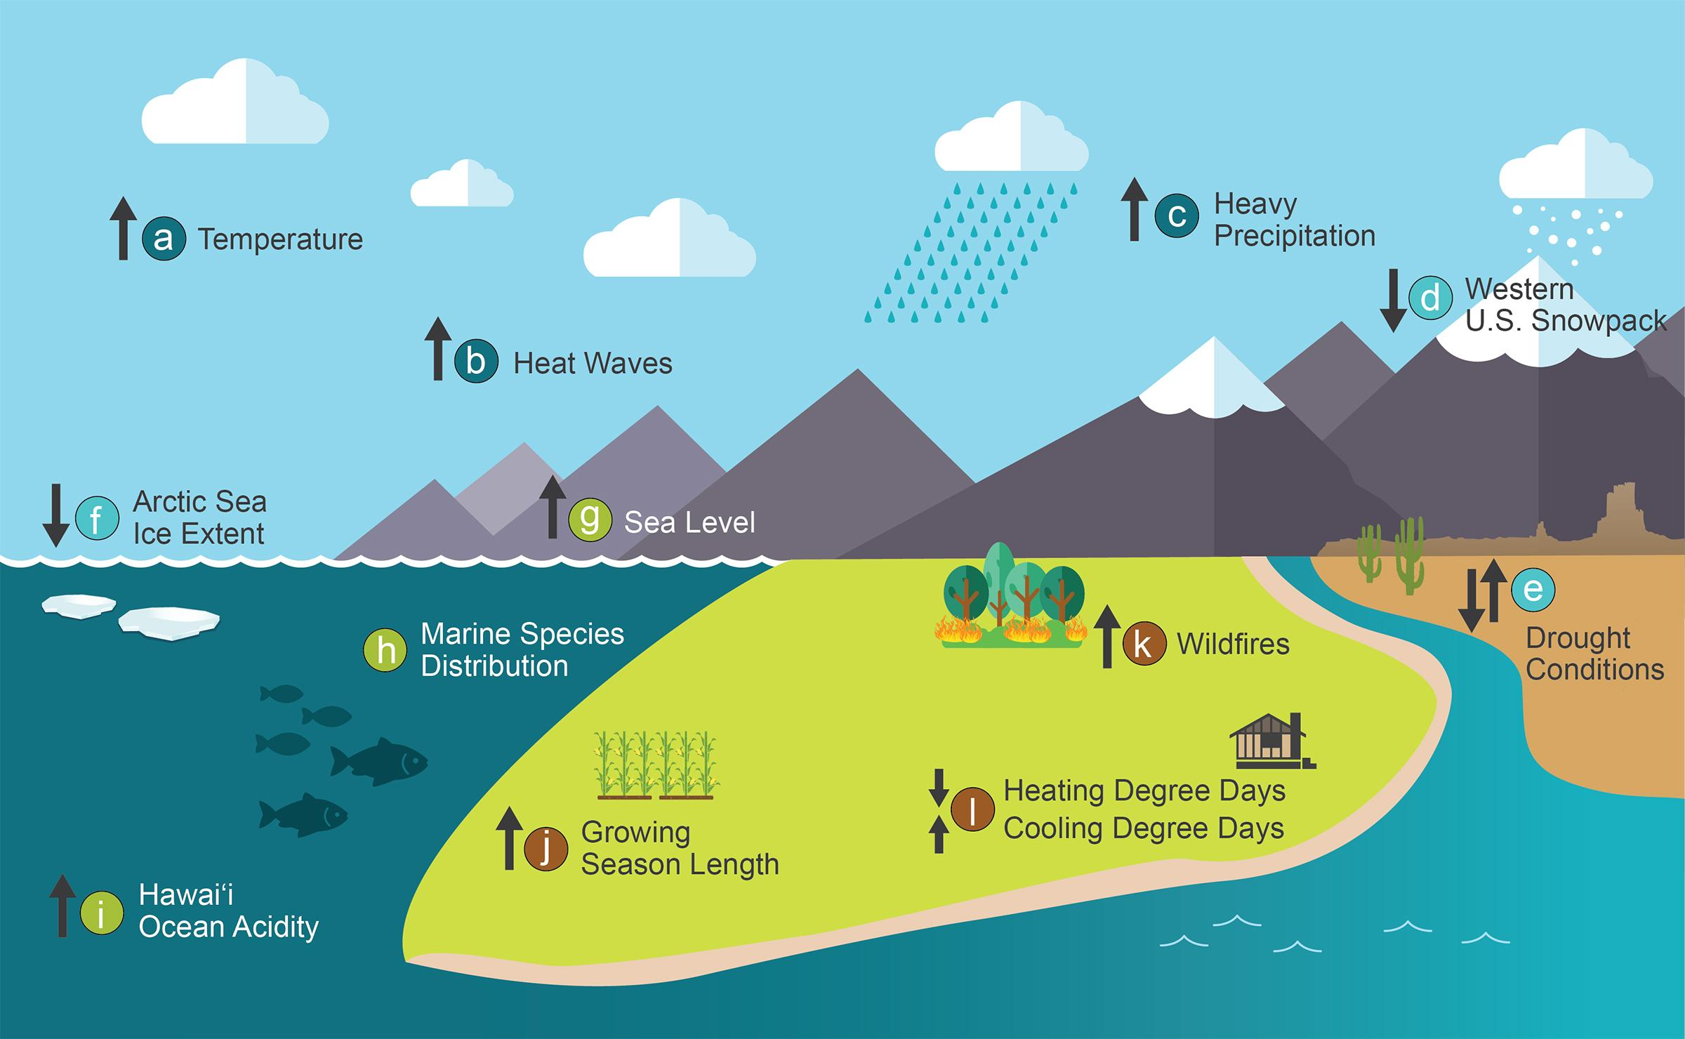
Evidence of Climate Change
4th National Climate Assessment
(5th NCA just released!)

Slide 9
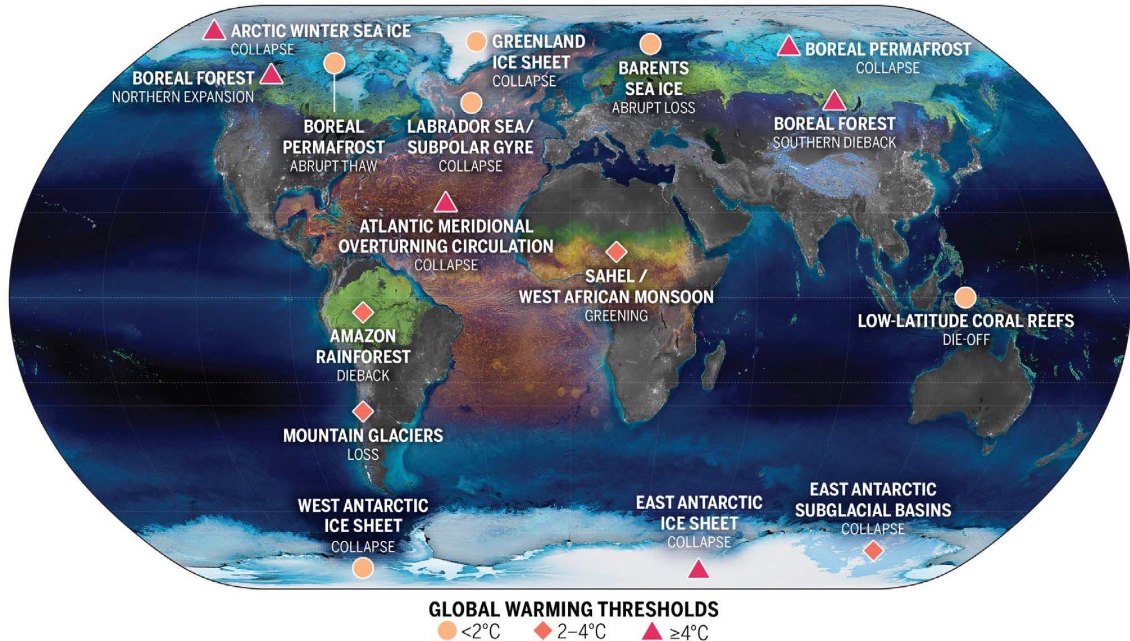
Nearing Tipping Points
McKay et al. (2022)

Slide 10
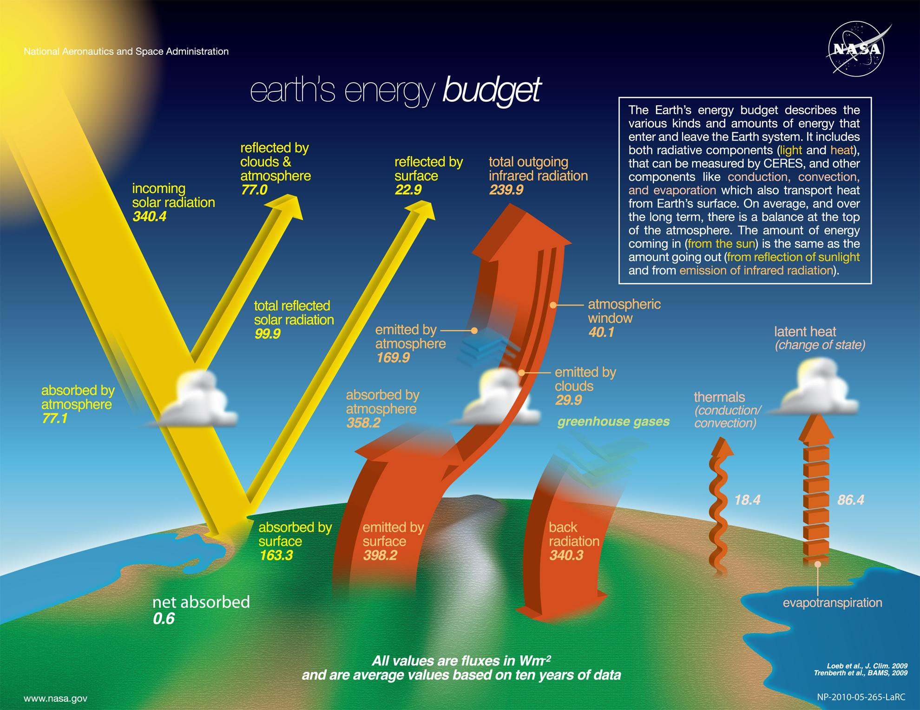
Global Warming Simplified:
Energy going in is greater than the energy going out

Slide 11
Global warming (1)
>
+
+
Global Warming Simplified:
Energy going in is greater than the energy going out

Slide 12
Global warming (2)
>
+
+
Global Warming Simplified:
Energy going in is greater than the energy going out

Slide 13
Global warming (3)
Climate Engineering is about developing technologies to reverse this inequality
>
+
+

Slide 14
Global warming (4)
Climate Engineering is about developing technologies to reverse this inequality
>
+
+
Think about how to increase the right side of the equation
Reflection of incoming sunlight
At the Surface?
In the Atmosphere?
In Space?
Permit more infrared radiation (heat) to escape to space
How to open this “window”?

Slide 15
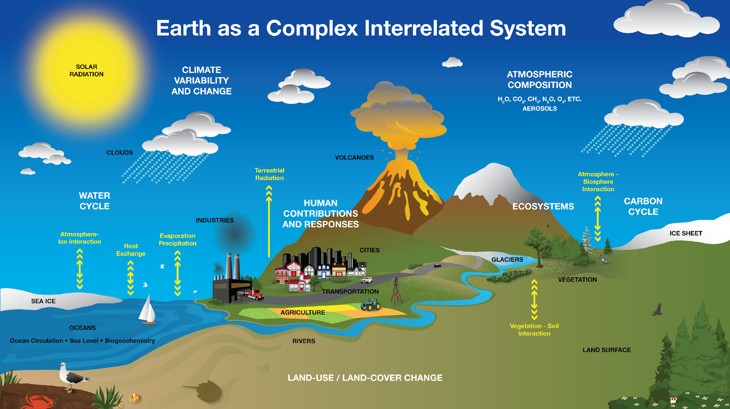
Climate engineering
Climate Engineering is about developing technologies to reverse this inequality by modifying a part of the climate system
NASA

Slide 16
Climate engineering (2)
>
Total reflected incoming radiation
Total outgoing infrared radiation
Can you think of ways to modify these systems to slow global warming (increase the RHS of the equation??
Incoming
solar radiation
+
Write as many (wild!) ideas as possible in 3 minutes.
NASA

Slide 17
Climate engineering (3)
Total reflected incoming radiation
Total outgoing infrared radiation
Can you think of ways to modify these systems to slow global warming (increase the RHS of the equation??
Incoming
solar radiation
>
+
Now, as a small group write (wild!) ideas for 3 minutes
NASA

Slide 18
Climate engineering (4)
Incoming
solar radiation
>
Total reflected incoming radiation
+
Total outgoing infrared radiation
What ideas does AI have? - Ask ChatGPT:
“Create 10 wild ideas that fit the category of geoengineering to stop global warming”
Then ask ChatGBT: “But, more wild” to get some sensational ideas.
NASA

Slide 19
Mind Map
Organize group and individual sticky notes on large sheet of paper or wall.
Category 1
Category 2
Design a Solution for Global Warming
Category 3
Category 4

Slide 20
Mind Map (2)
Organize group and individual sticky notes on large sheet of paper or wall.
Carbon Uptake
Emission Reduction
Example Categories
Design a Solution for Global Warming
Sunlight Reduction
Miscellaneous
*Catherine

Slide 21
Concept Sketching

Slide 22
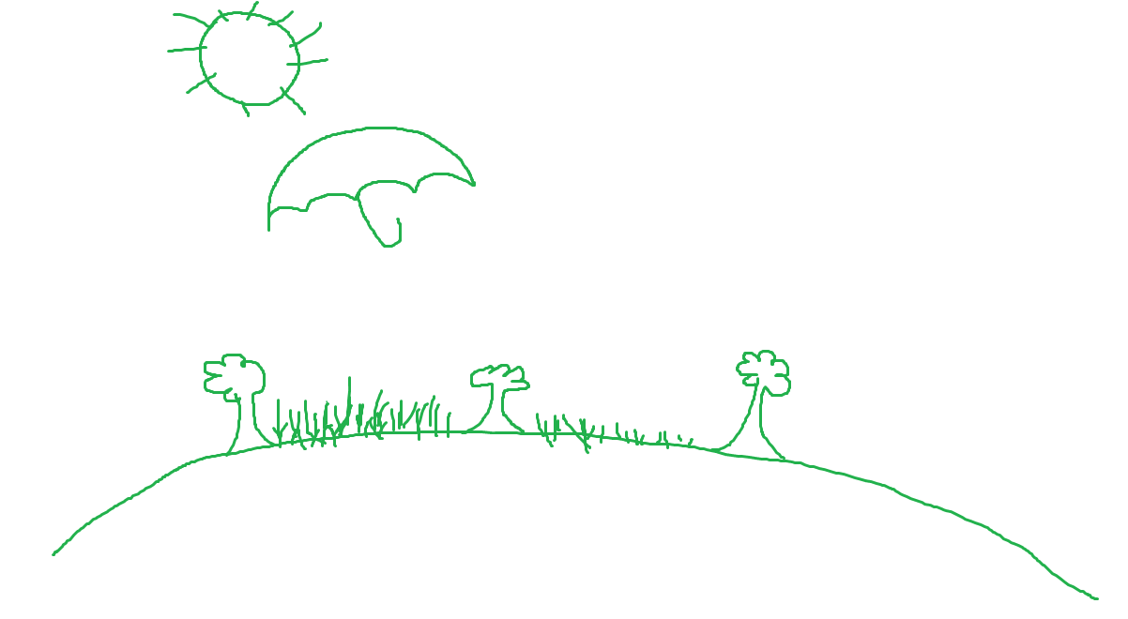
Concept Sketching (2)
Student 1

Slide 23
Concept Sketching (3)
Student 1
Student 2

Slide 24
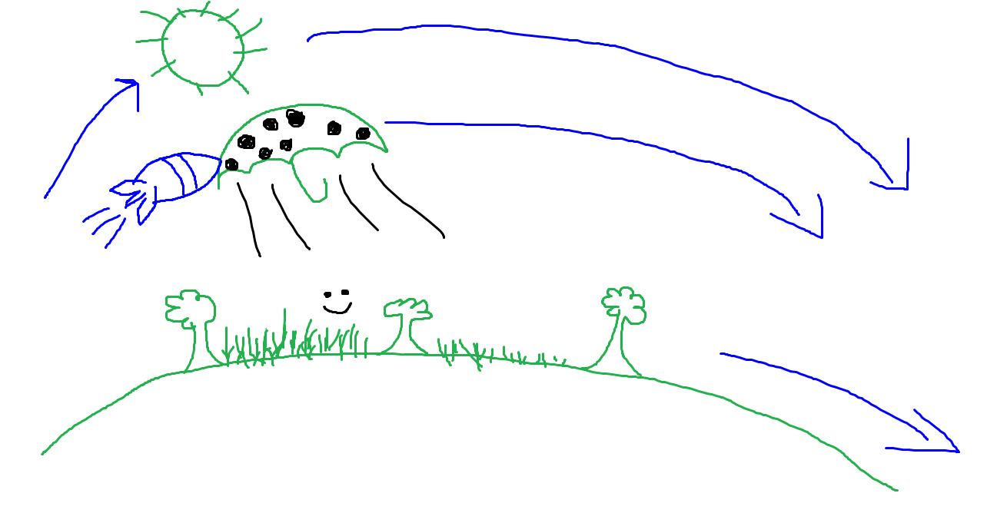
Concept Sketching (4)
Student 1
Student 2
Student 3
*Catherine

Slide 25
This lesson introduced and developed ideas for engineering solutions to global warming and climate change while utilizing “Activity Before Content” The activity surfaces student learning and participation Their designs will be further developed in Lesson 3 and presented in Lesson 5
Summary

Slide 26
Climate Engineering Introduction https://go.iu.edu/4RqA
Q & A to Follow
Feedback Forms

Slide 27
Agenda (1)
Project Website: https://go.iu.edu/4BPh
(listed at the top of the first page in your binders)
What Climate Engineering looks like (Lesson 1 activity)
Intro to Climate Engineering and Research + Q and A (video and discussion)
Morning Break
How Marine Cloud Brightening works (Lesson 2)
Development and Presentations of student designs (Lessons 3 & 5)
Lunch Break
Social, Ethical, Economic, Political dimensions of Climate Engineering (Lesson 4 Model UN)
Classroom Implementation Strategies

Slide 28
Design an Experiment to Brighten Clouds
Lesson 2 Objective

Slide 29
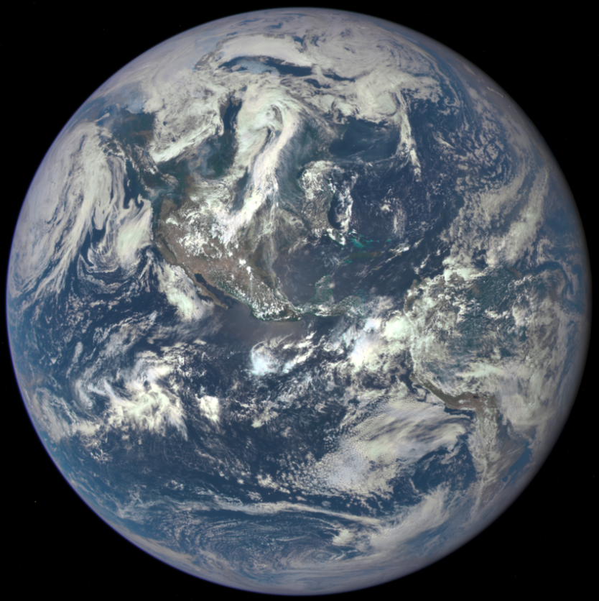
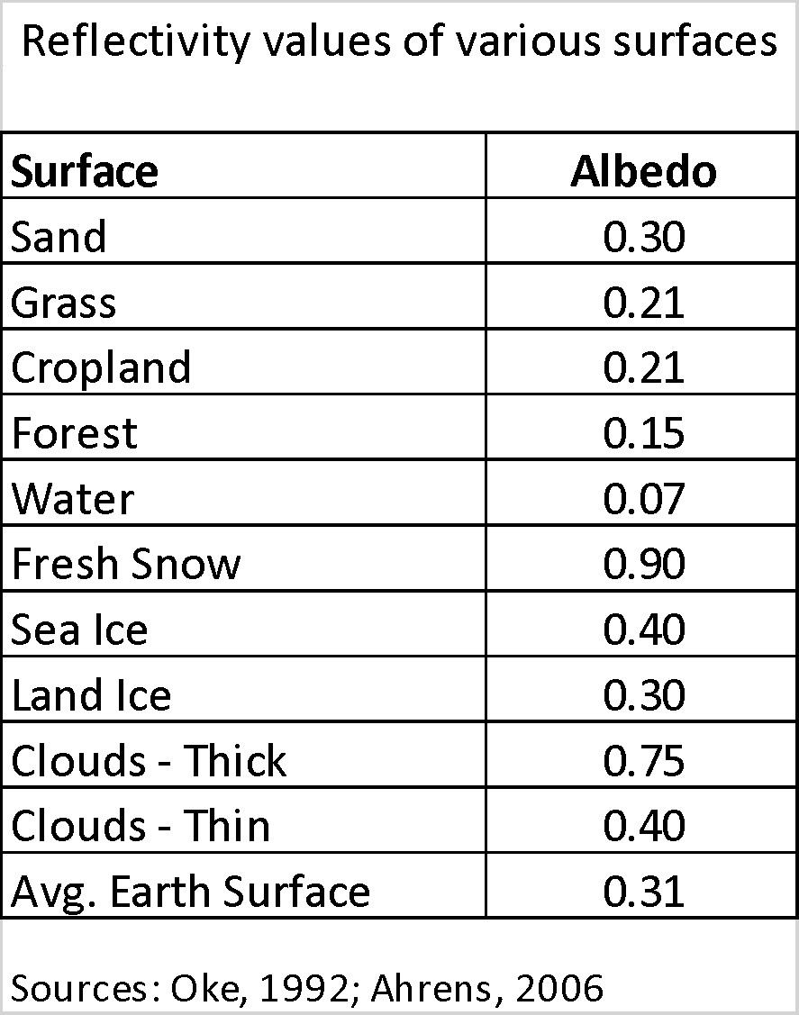
Research Question:
Can we engineer brighter clouds?
67% of the Earth’s surface is covered by clouds
Image Credit: NASA

Slide 30
Components of a Cloud
Vapor
Clouds are made from water vapor condensing on very small aerosol particles, called cloud condensing nuclei, or CCN.
Definition: An aerosol is a very small particle suspended in air

Slide 31
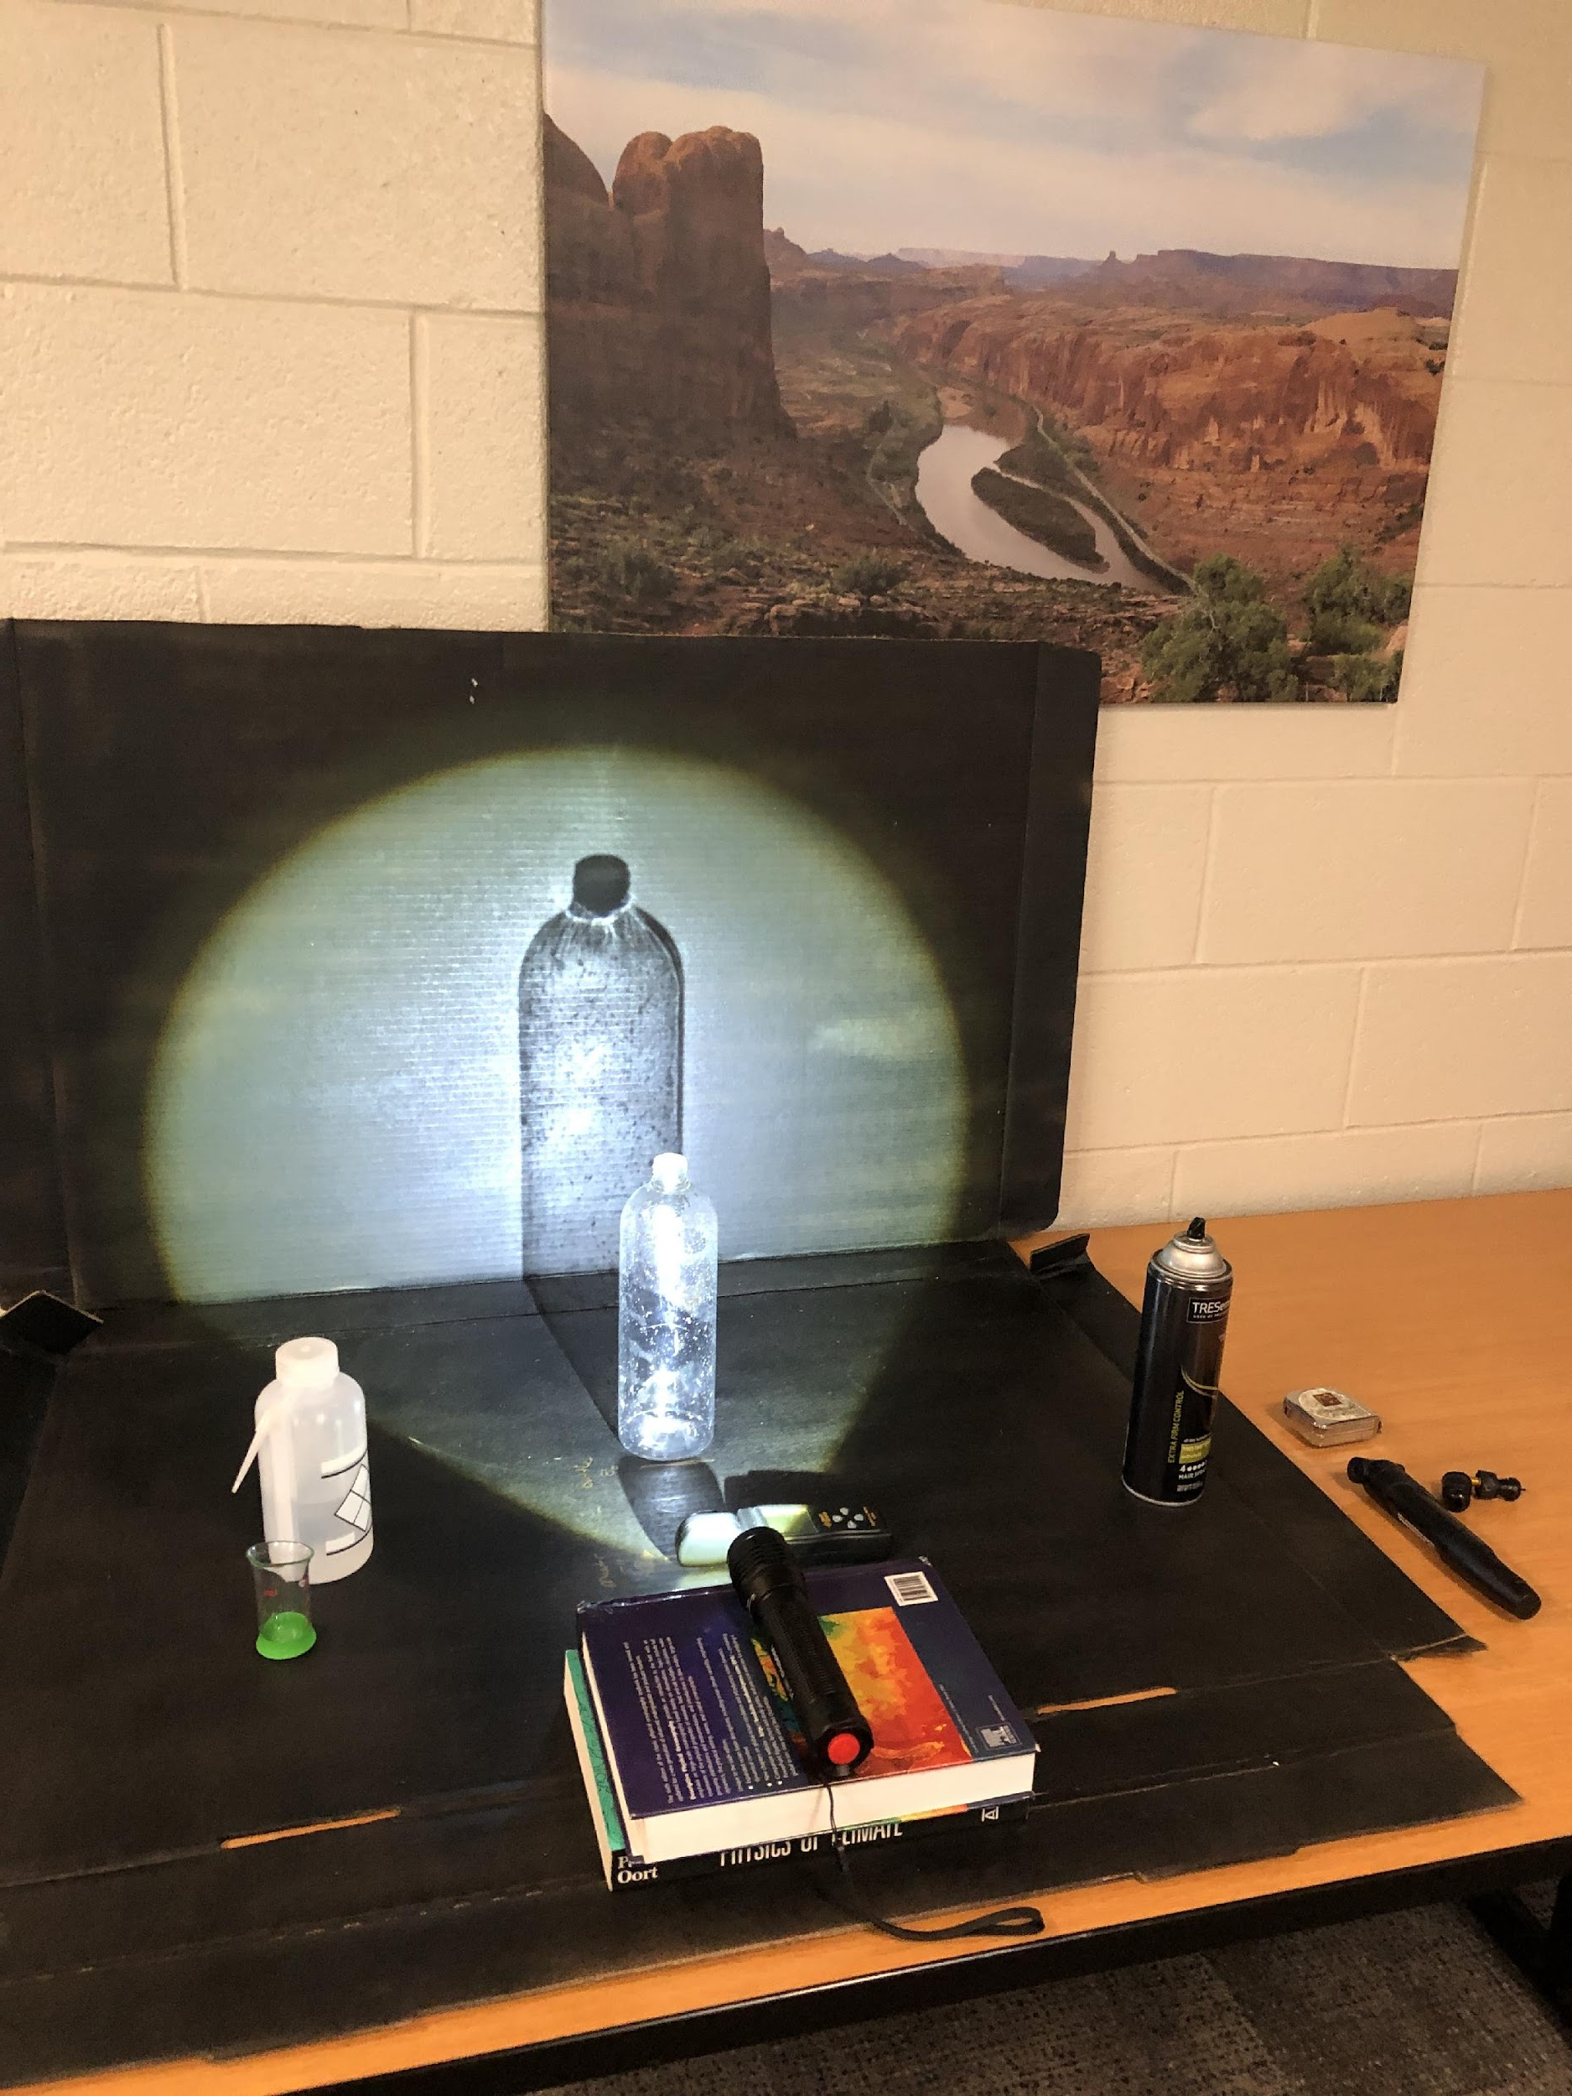
Experimental Design & Methods

Slide 32
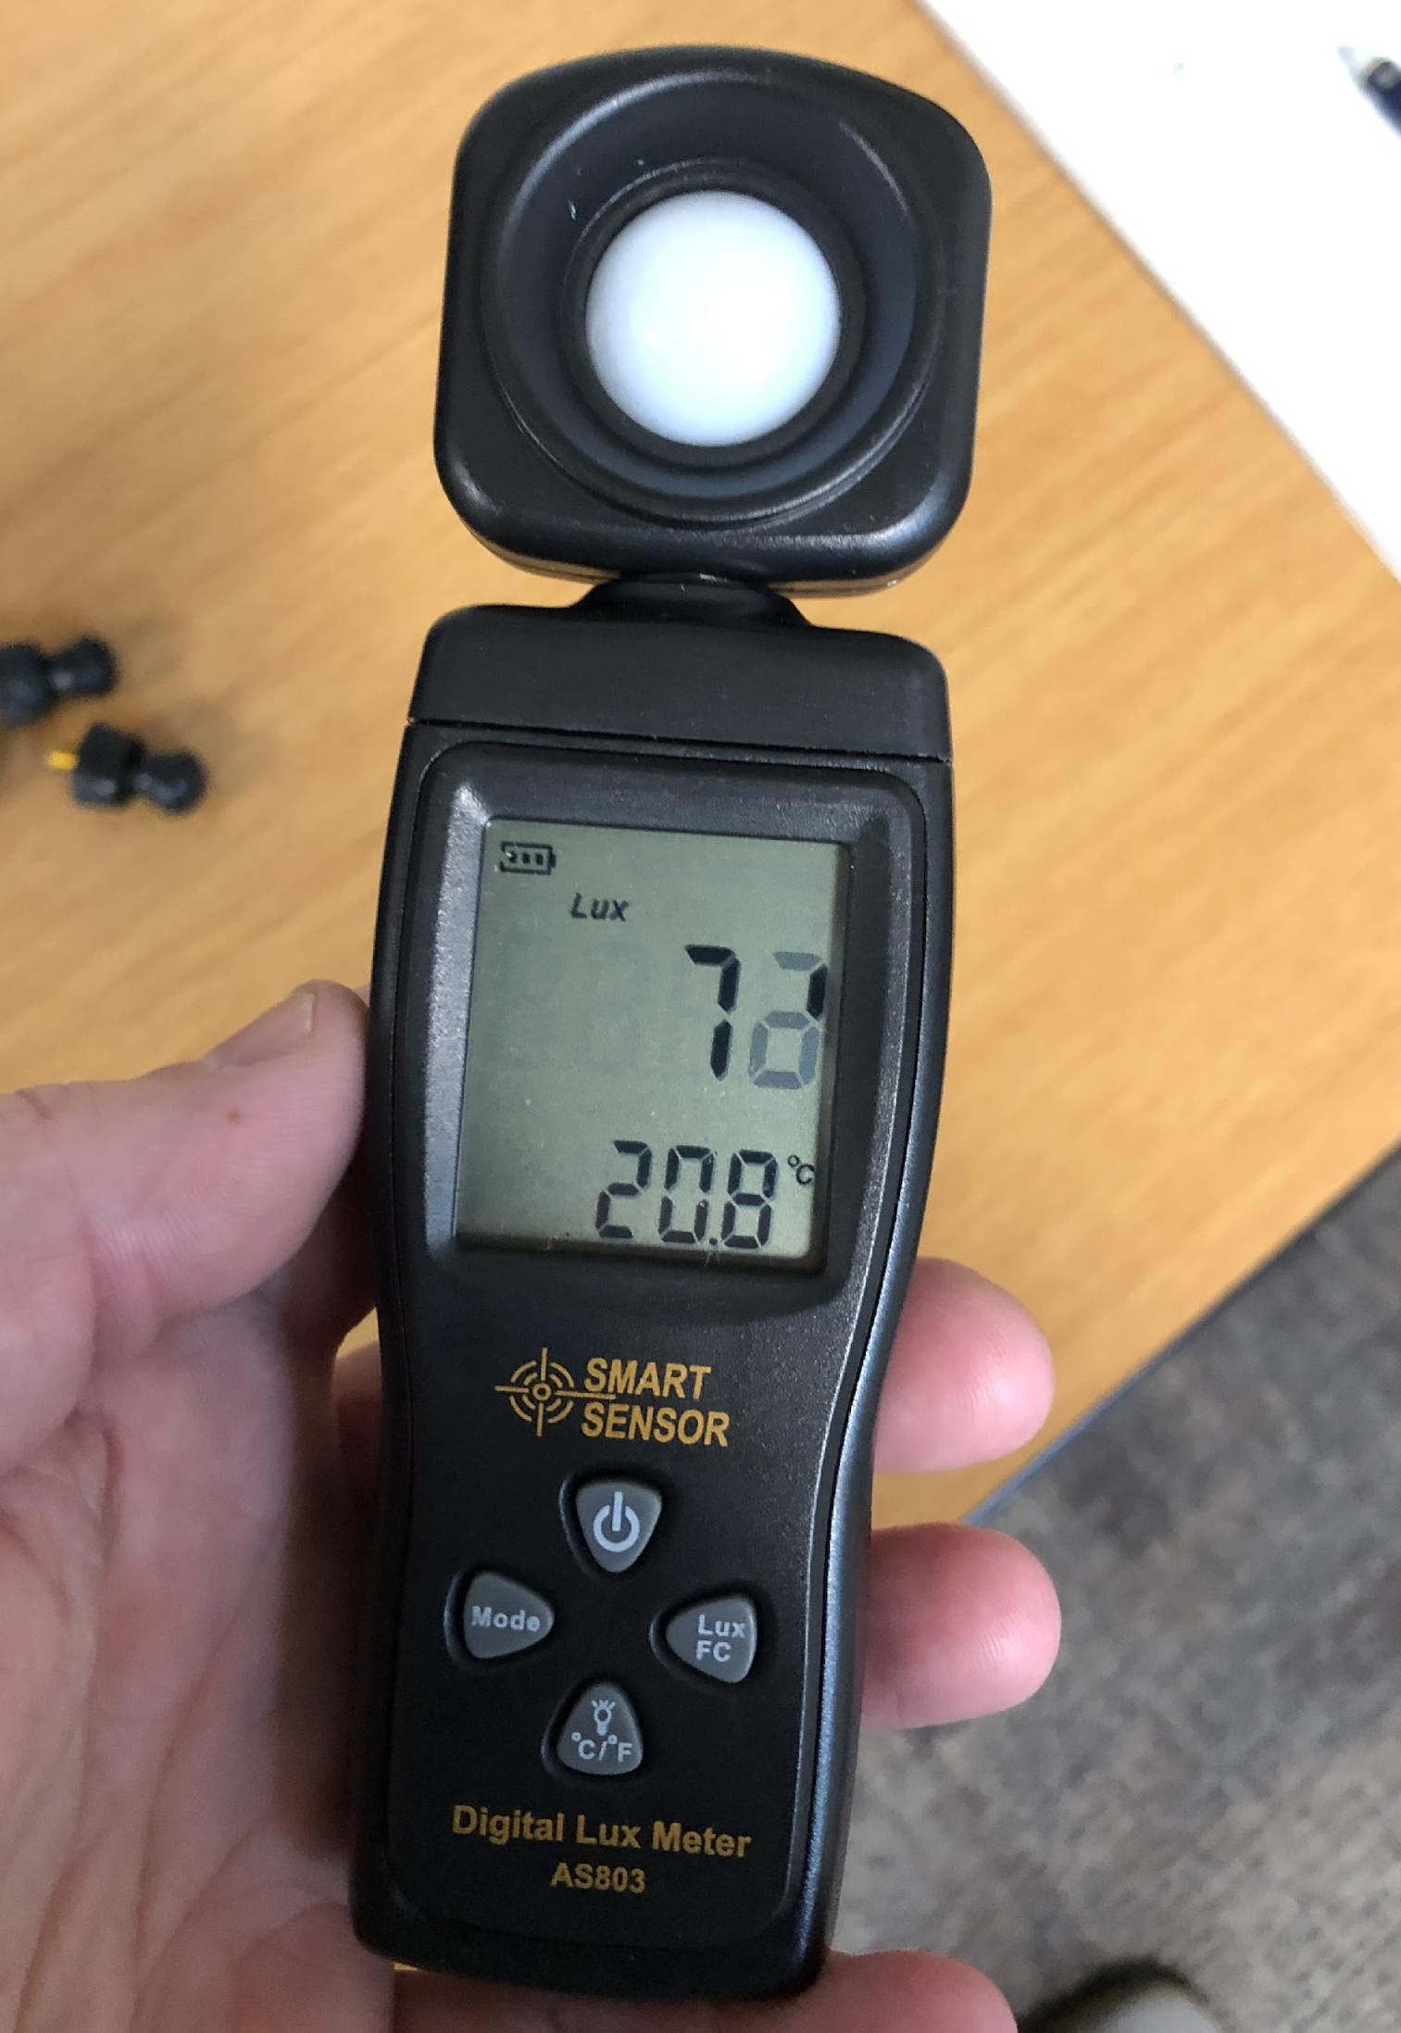
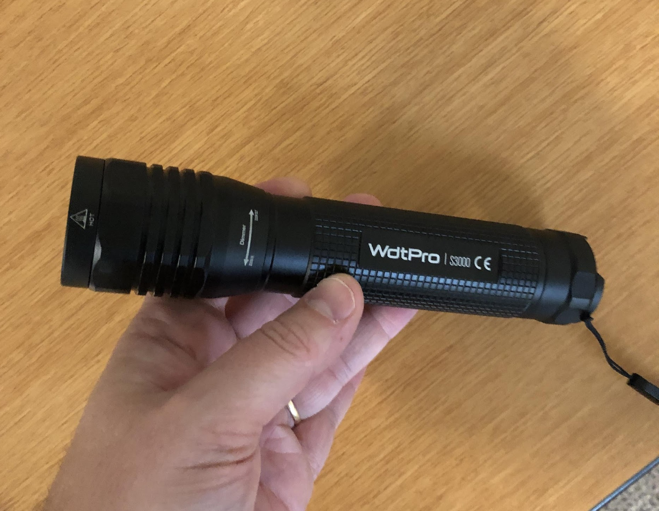
Experimental Design & Methods (2)
Aerosol hairspray
Water & measurable units
Clear 1-liter plastic bottles
Lux meter
Light source

Slide 33
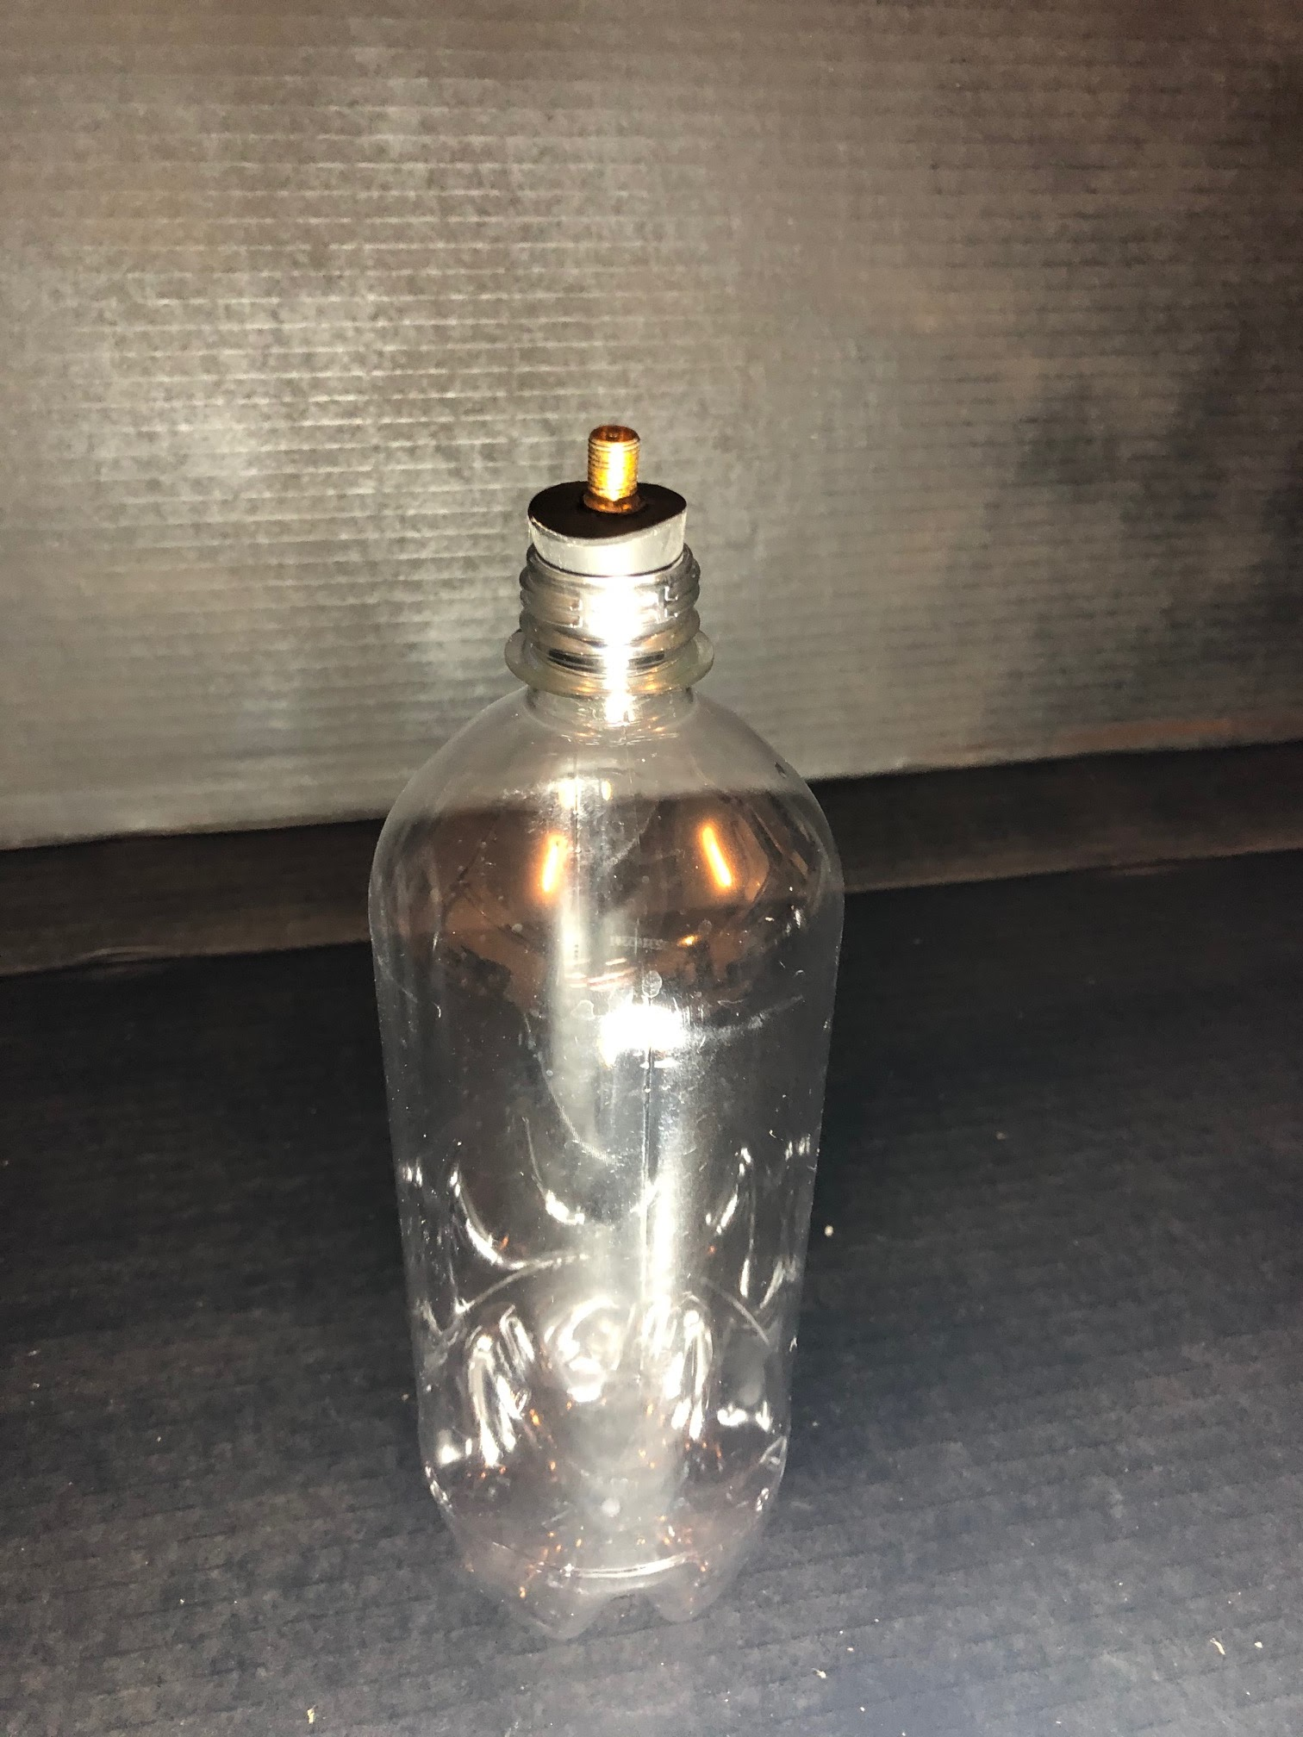
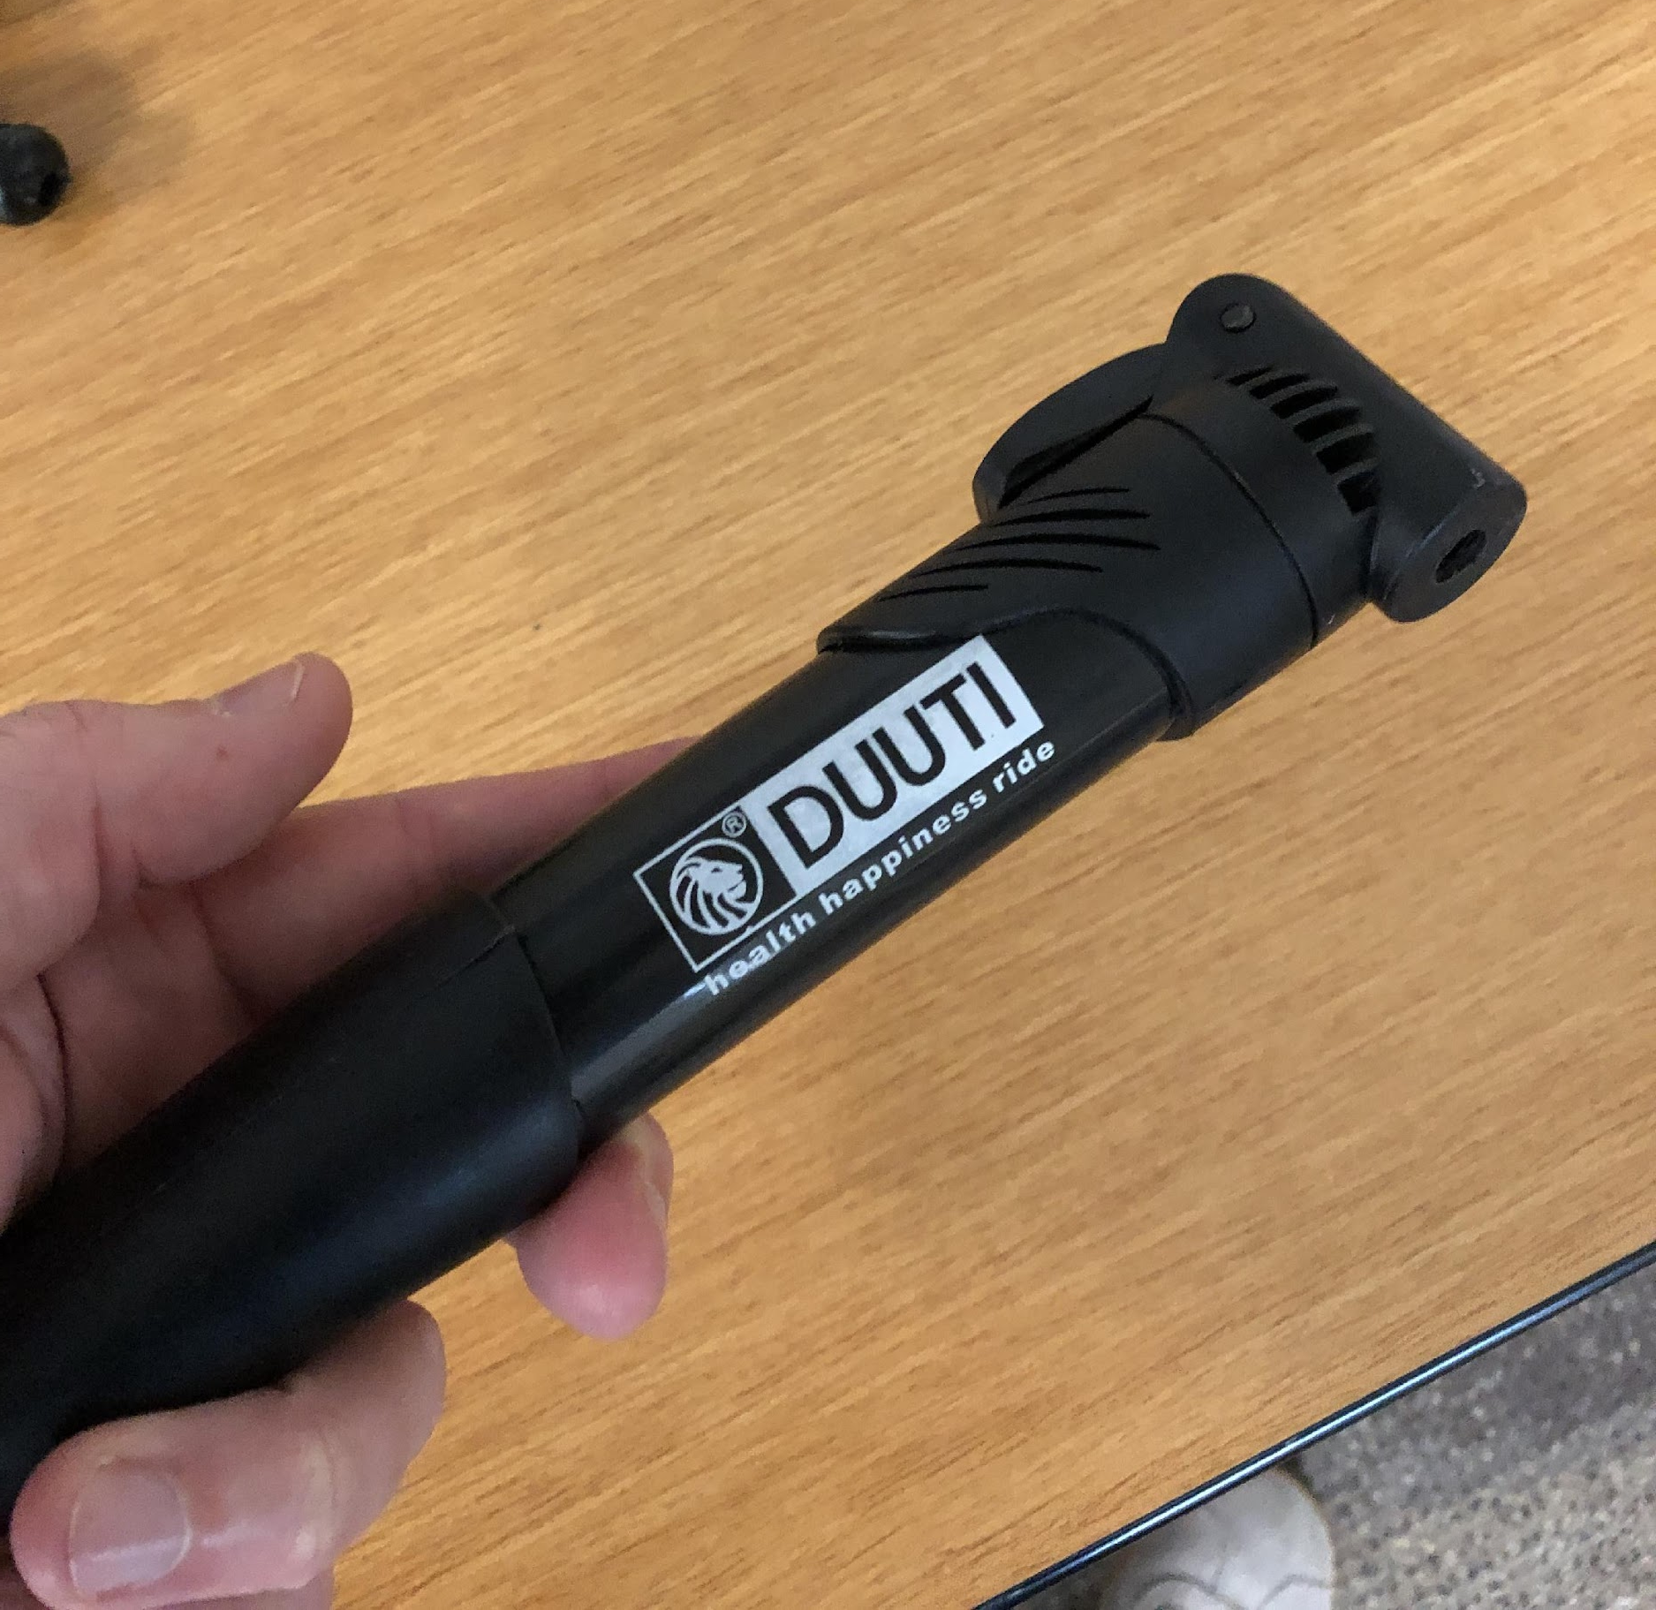
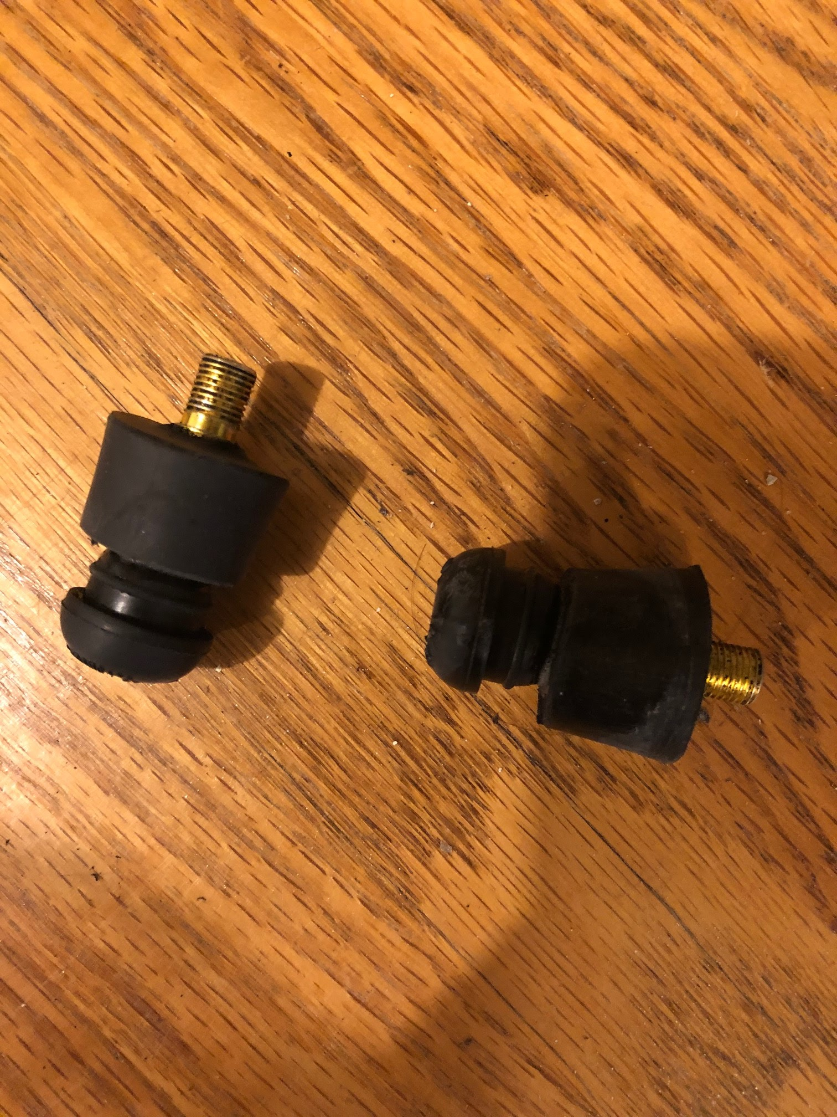
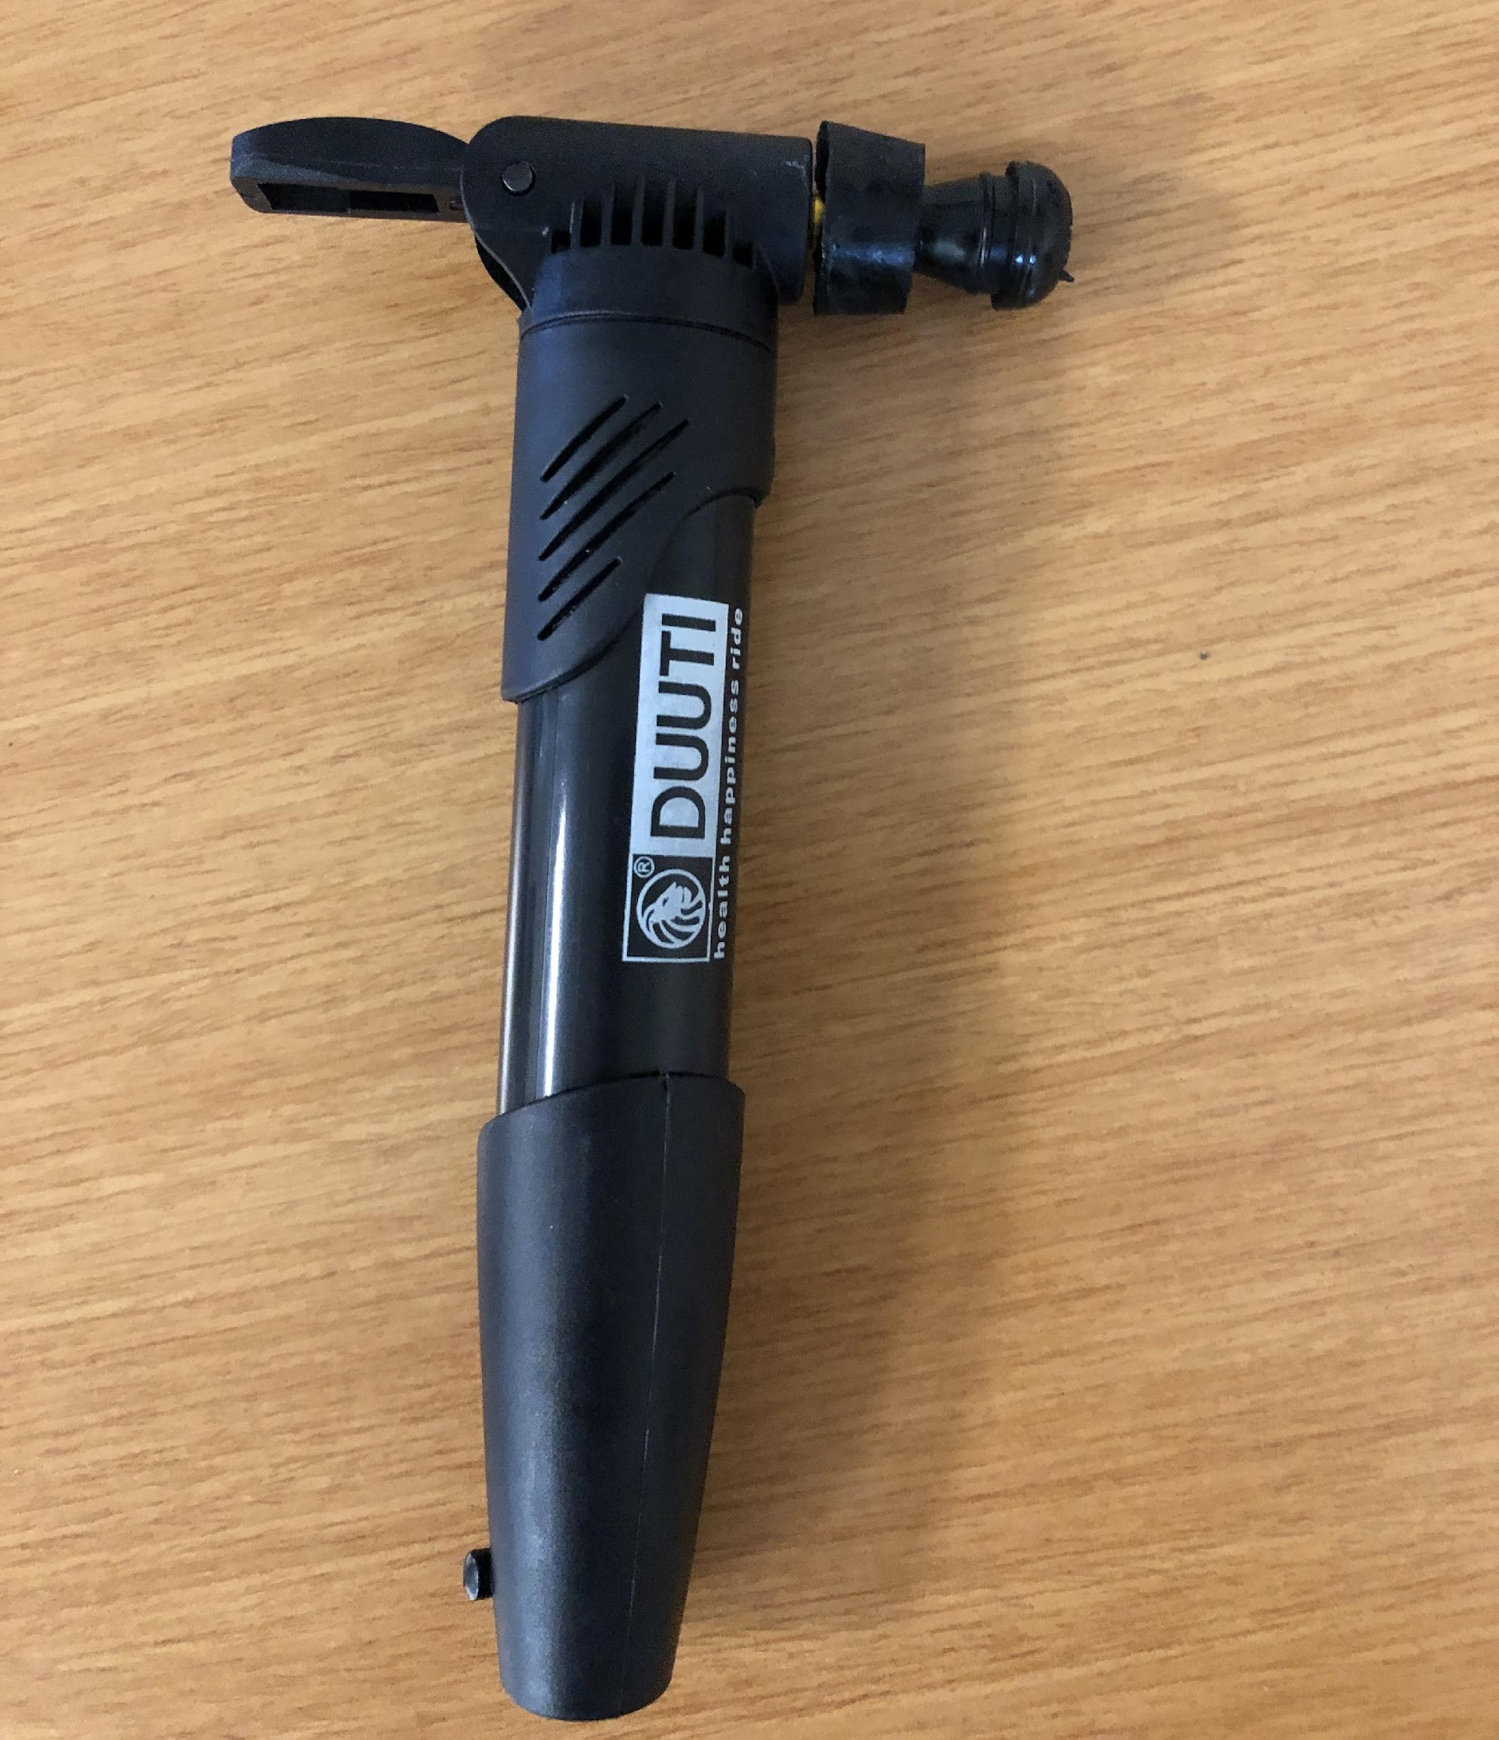
Experimental Design & Methods (3)
Picture of plug in the bottle
Hand air pump
Picture of hand air pump with valve plug attached
Rubber stopper & valve plug

Slide 34
Experimental Design & Methods (4)
“Fizz Keeper”
Picture of fizz keeper on the bottle

Slide 35
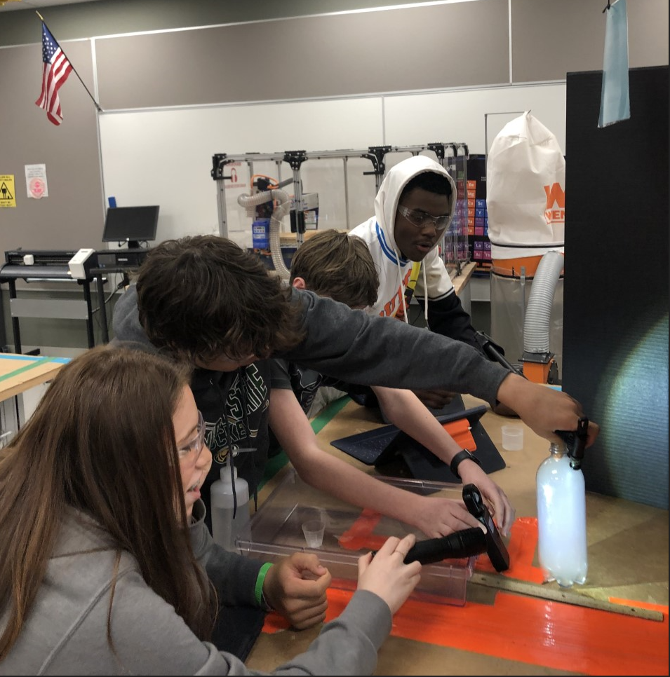
Experimental Runs
… science at work
Videos provided in Teacher Resources
Tri-North MS

Slide 36
Record Data
Record the lux meter reading for each trial on the worksheet
Experiment Two use 10 sprays of hairspray
Experiment One: Low-Aerosol Environment 3 Sprays of Hairspray
 | Lux Meter Reading (lx)
Trial # | Bottle w/ Cloud | Bottle w/o Cloud | Difference
1
2
3
4
5
6
7
8
9
10
Experiment Two: High-Aerosol Environment 10 Sprays of Hairspray
 | Lux Meter Reading (lx)
Trial # | Bottle w/ Cloud | Bottle w/o Cloud | Difference
1
2
3
4
5
6
7
8
9
10

Slide 37
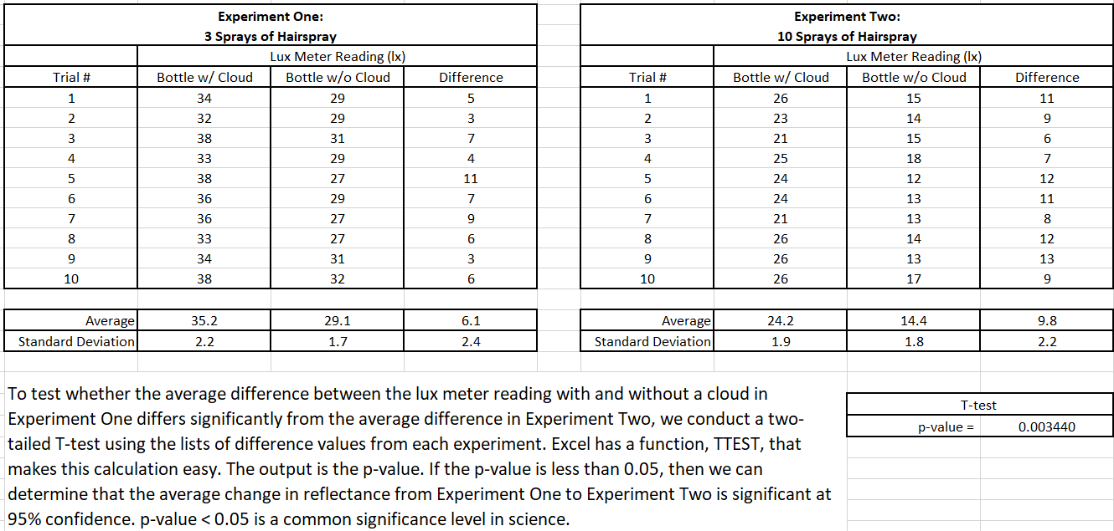
Record Data (Sample Data)

Slide 38
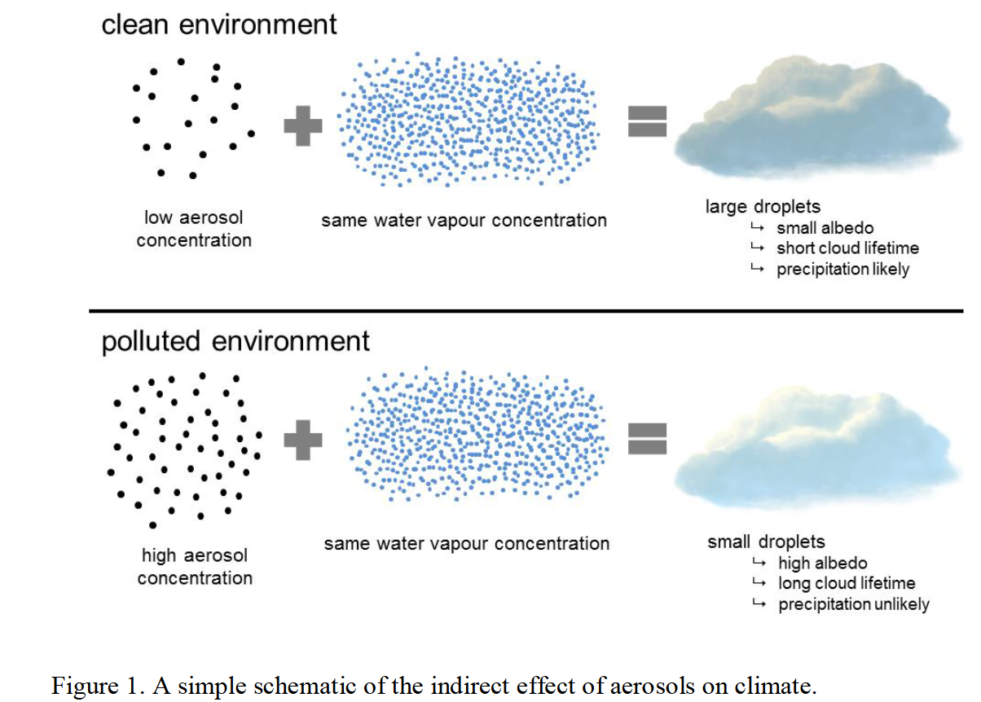
Cloud condensing nuclei
The greater the number of cloud condensing nuclei (sea salt aerosols), the greater cloud droplet number, the greater cloud “surface area”, and thus greater reflectively of the cloud.
https://helda.helsinki.fi/bitstream/handle/10138/154682/lifecycl.pdf?sequence=1&isAllowed=y

Slide 39
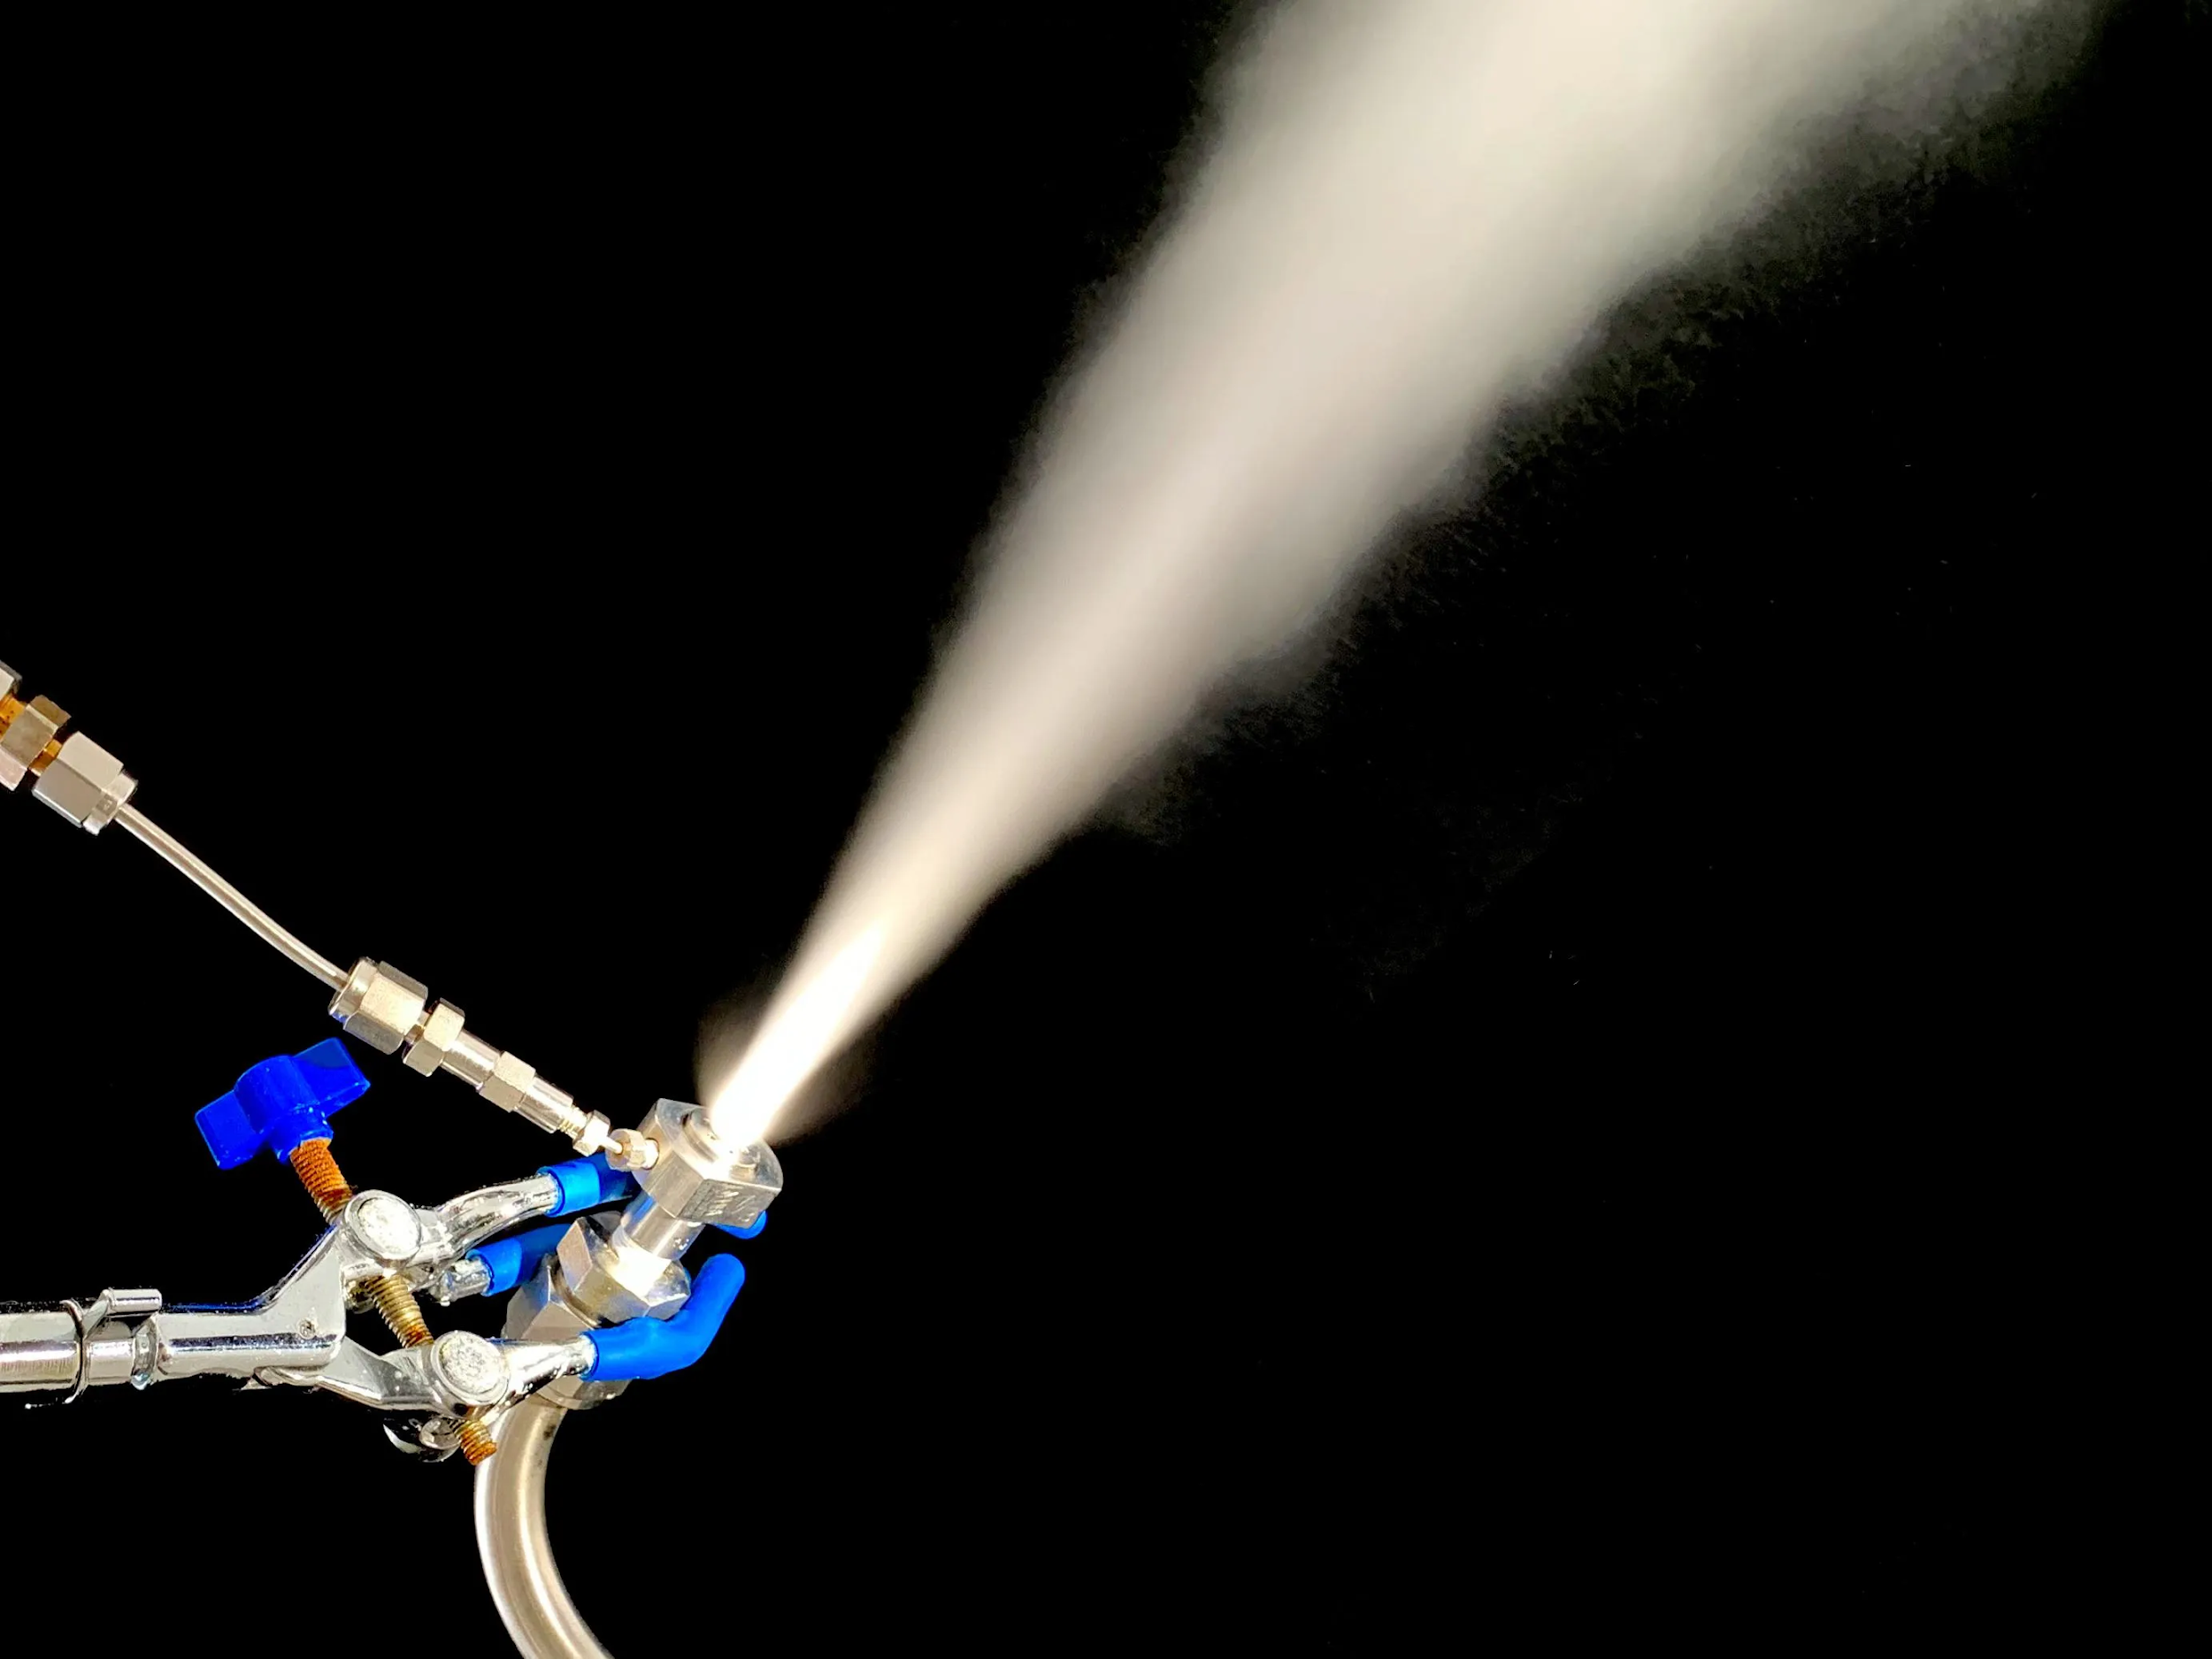
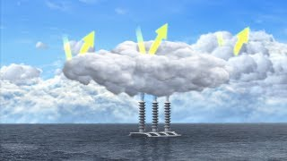
How MCB Could Work:
Sea salt particles act as the aerosols

Slide 40
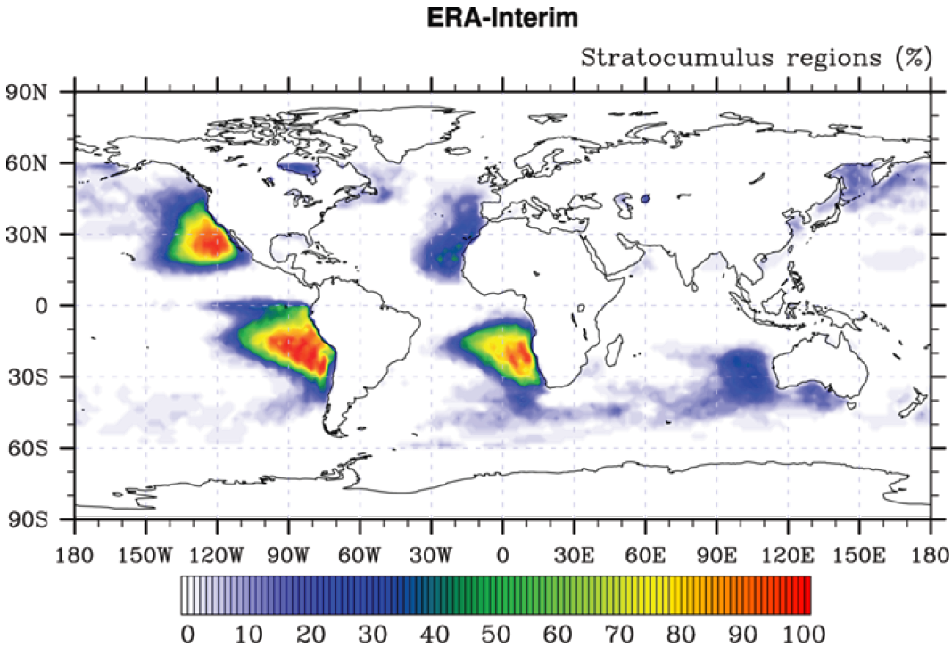
How MCB Could Work (2):

Slide 41
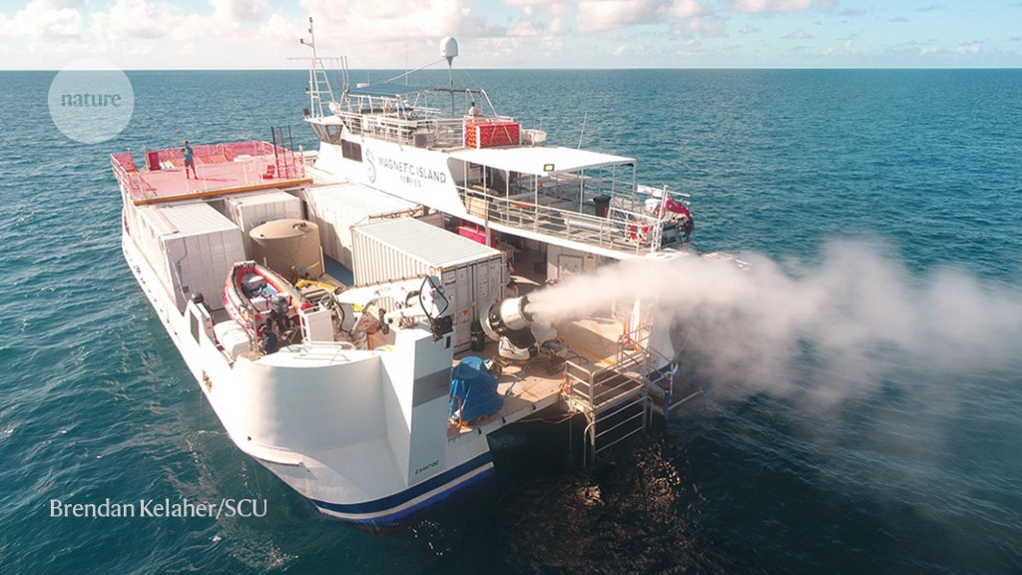
How MCB Could Work (3):

Slide 42
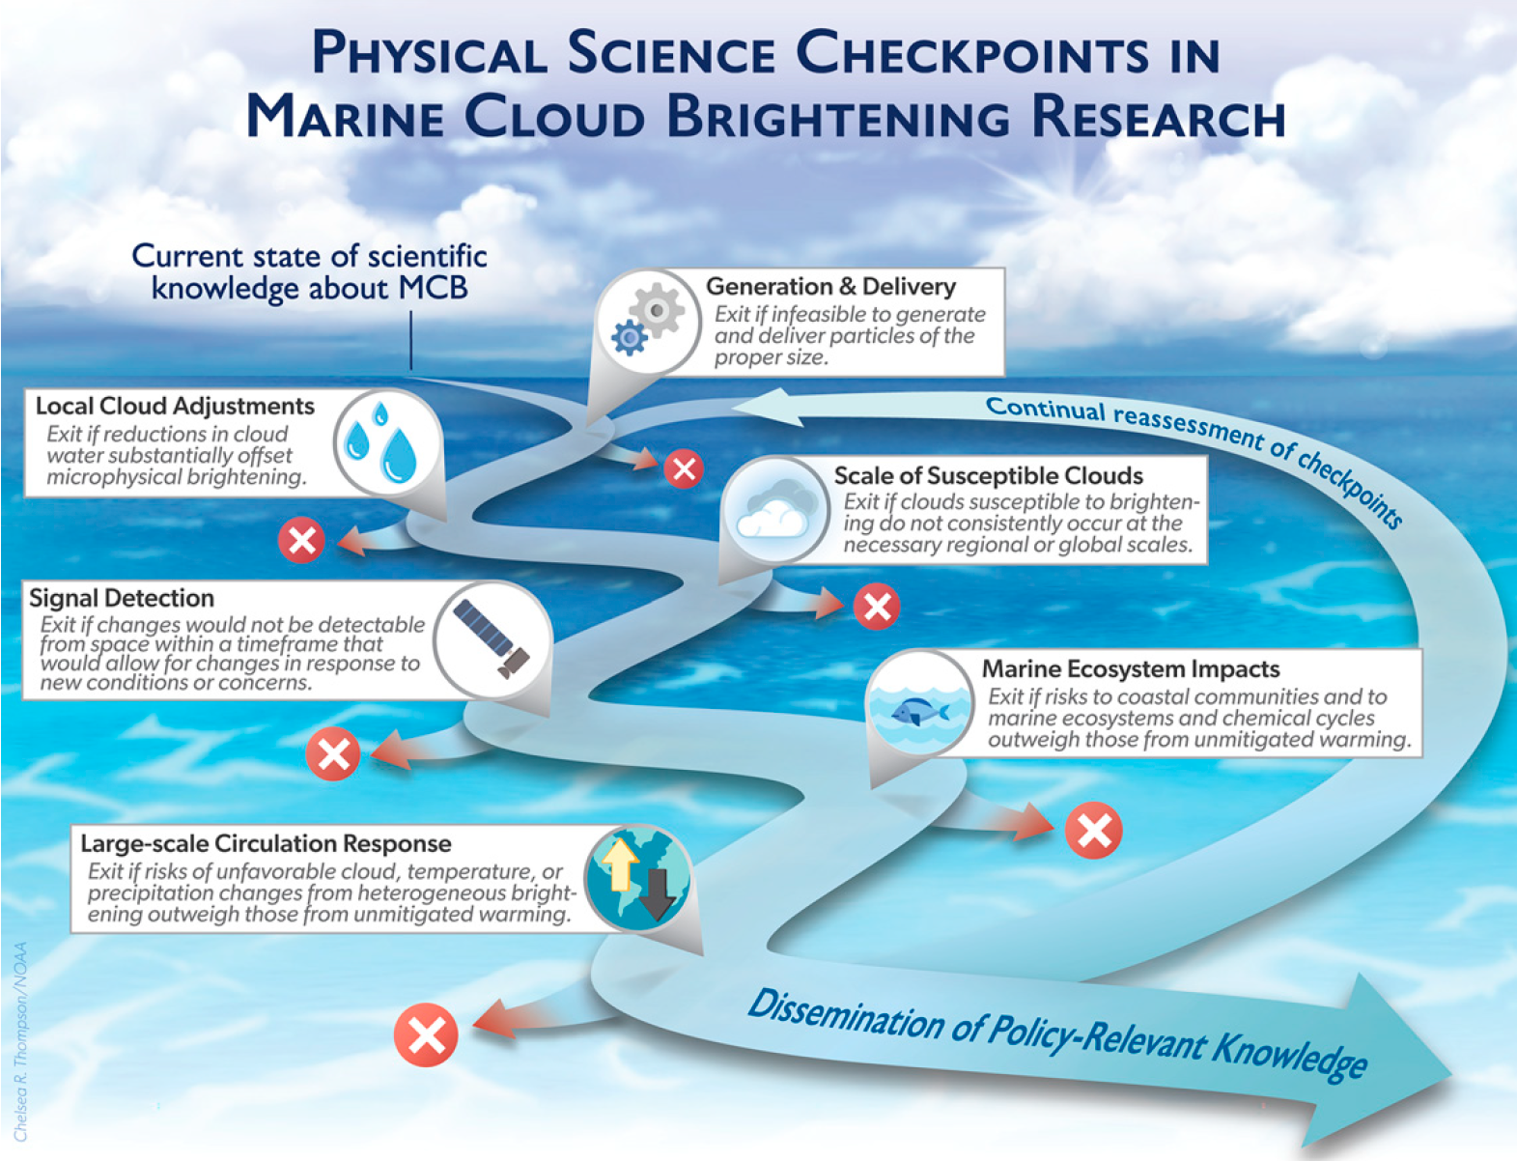
How MCB Could Work (4):
Diamond et al., 2022

Slide 43
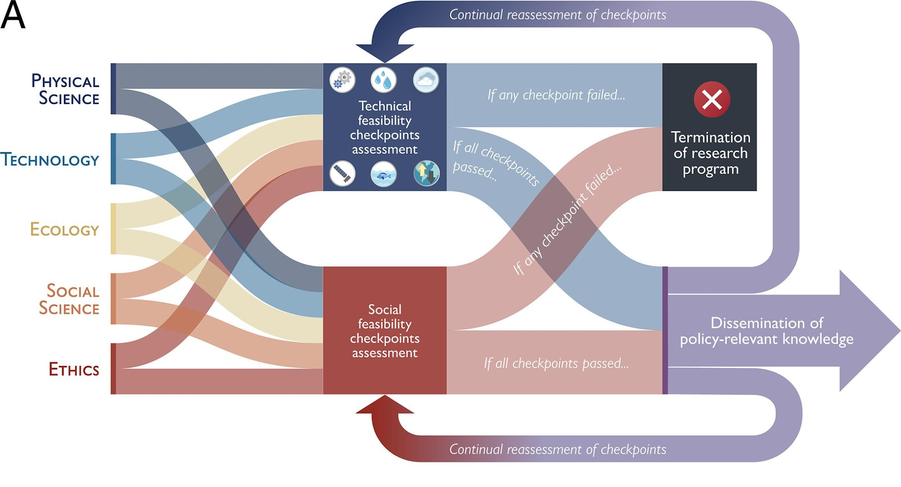
How MCB Could Work (5):
Diamond et al., 2022

Slide 44
From MCB Lesson 2
Limitations:
Cost
Preferred ocean environment (low clouds, low background aerosols, far from land)
Will greatly benefit from global cooperation and support
Does not address increasing atmospheric greenhouse gases nor ocean acidification
Risks:
Regional to global changes in precipitation amounts and patterns
Regional changes to atmospheric and oceanic chemistry
Impacts on biology and ecosystems
Potential for rapid change if abruptly terminated

Slide 45
Conduct a similar exercise regarding SAI with students which will help prepare them to critically evaluate their climate engineering designs
Limitations:
_____________
_____________
_____________
_____________
Risks:
_____________
_____________
_____________
_____________

Slide 46
In summary, Marine Cloud Brightening is a promising climate engineering strategy. Nonetheless, it is important that scientists and engineers continue to research this technology and to address its limitations and risks. In Lesson 3, students improve their climate engineering designs to address their limitations and risks.
Summary

Slide 47
Developing a Blueprint
Lesson 3 Objective

Slide 48
Use the Decision Matrix to help decide which design to further develop. Can you combine features from multiple designs to better meet the criteria? Provide feedback to group members.
Criteria to Consider when Selecting and Revising your Designs | Score 1-5
How well does your design slow global warming and/or climate change? (1 - not well, 5 - very well)
Does your technology modify or work with an environmental/Earth system? (1 - does not, 5 - perfect match)
What is the cost of your technology (consider materials, resources, and upkeep)? (1 - high cost, 5 - low cost)
Does your design scale well (can you test your technology on a small-scale, then expand to large-scale deployment)? (1 - not well, 5 - very well)
Rate the amount of unintended negative consequences of deploying your technology? (1 - many, 5 - few)
Is your design unique? (1 – other students have similar designs, 5 – it’s one-of-a-kind!)
Total (max 30 points)

Slide 49
Create an Engineering Blueprint
The UH-72 performs logistics and support missions within the US for homeland security, disaster response missions, and medical evacuations.
Twin Engines
Main Rotor
Checklist
Title
A descriptive subtitle
Drawings from at least
two perspectives
Label & a Table of features
Label & a Table of the size
Meets all criteria
11’4’’
36’1’’
Cockpit
42’9’’
Tail Rotor
Landing Skids
https://www.bluemoonpatentprints.com

Slide 50
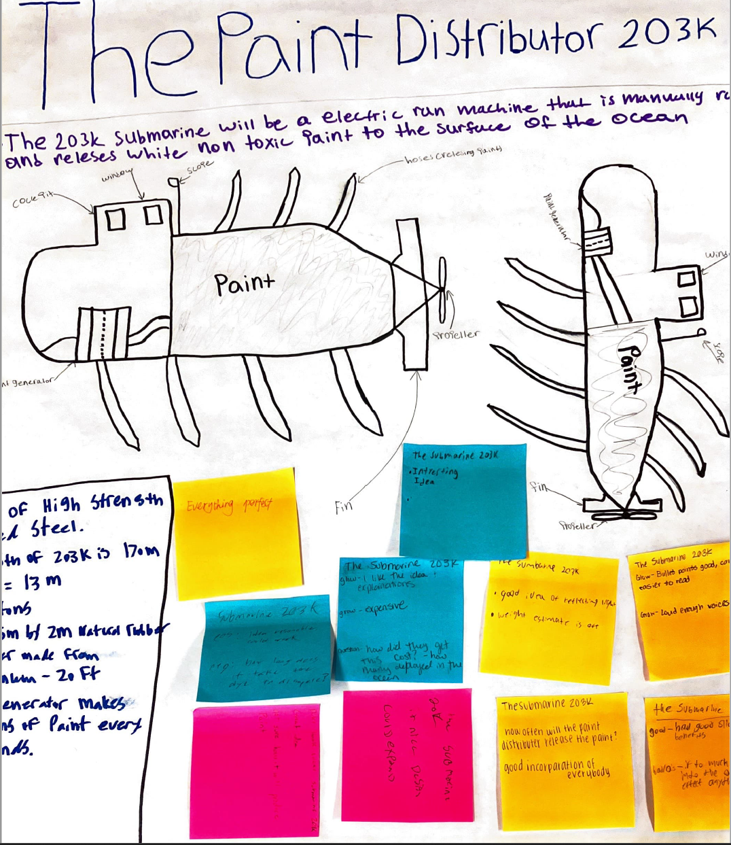
Final Product
Examples from Bloomington South Earth Science Students:

Slide 51
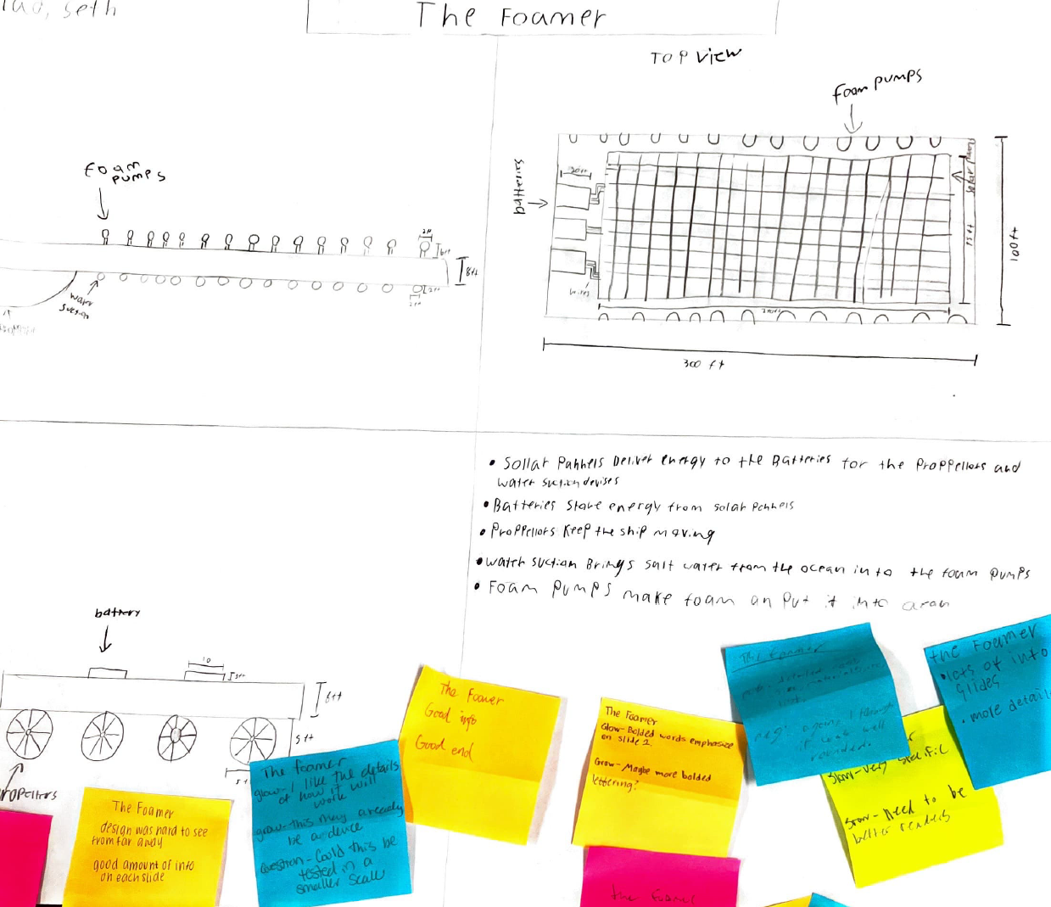
Final Product (2)
Examples from Bloomington South Earth Science Students:

Slide 52
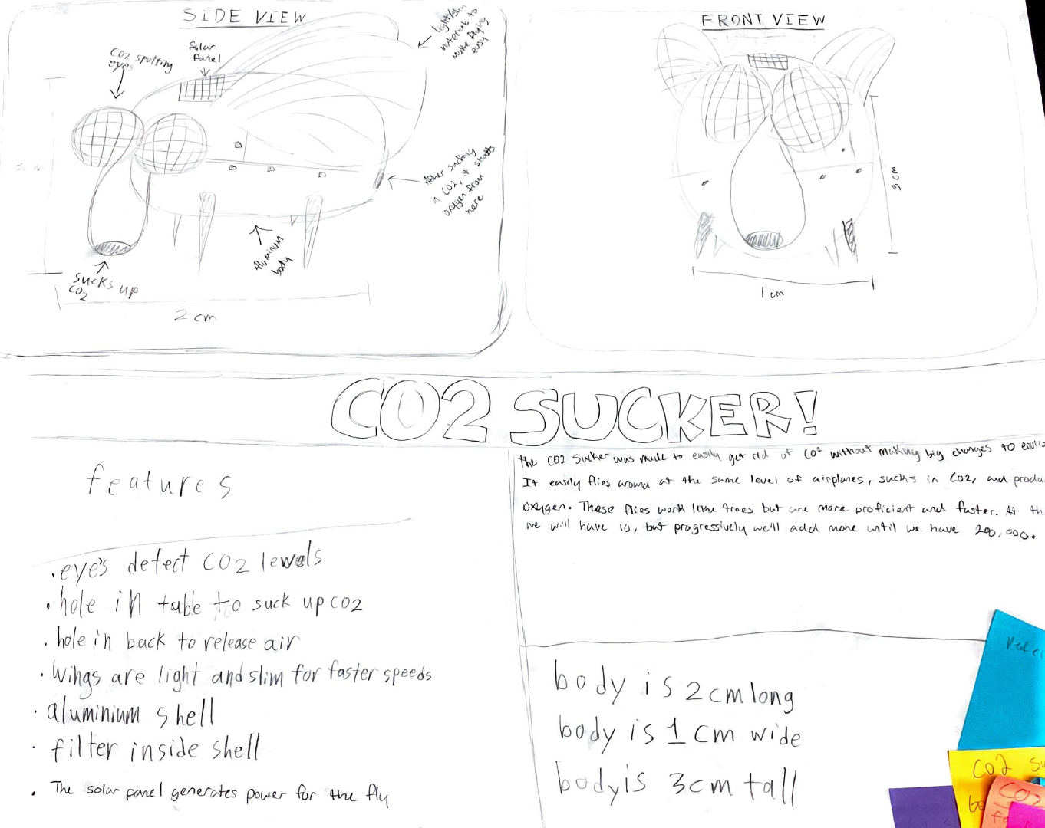
Final Product (3)
Examples from Bloomington South Earth Science Students:

Slide 53
This lesson develops the students’ engineering blueprints to meet specific criteria and considerations. They will present these designs to scientists, engineers, and policy makers in Lesson 5.
Summary

Slide 54
Capstone Presentation
Lesson 5 Objective

Slide 55
Purpose
Engineers and scientists give presentations of their work to a wide variety of audiences.
Students will present their climate engineering design to an audience consisting of climate scientists, engineers, stakeholders, and/or policymakers. This task challenges the students to take their work outside of the classroom, to communicate their designs to a new audience, and to gather feedback from new sources.

Slide 56
Presentation Template
Each group selects one technology to present.
Student 1: Presents the blueprint, features, size, materials and costs
Student 2: Describes how the technology will function to slow global warming and/or climate change
Student 3: Limitations of the design? Regional or Global solution to warming and climate change? Long- or short-term solution?
Student 4: Who benefits? What are the unintended consequences and risks?
Student 5: How should this technology be deployed? By whom? When? Who pays?

Slide 57
Writing Letters to State Politicians
*Catherine

Slide 58
Agenda (2)
Project Website: https://go.iu.edu/4BPh
(listed at the top of the first page in your binders)
What Climate Engineering looks like (Lesson 1 activity)
Intro to Climate Engineering and Research + Q and A (video and discussion)
Morning Break
How Marine Cloud Brightening works (Lesson 2)
Development and Presentations of student designs (Lessons 3 & 5)
Lunch Break
Social, Ethical, Economic, Political dimensions of Climate Engineering (Lesson 4 Model UN)
Classroom Implementation Strategies

Slide 59
Model a United Nations meeting on whether to deploy climate engineering
Lesson 4

Slide 60
“Traditional notions of political sovereignty and models of territorial states protecting fixed boundaries aren’t useful modes of thinking about climate engineering governance.” (Dalby, 2015)

Slide 61
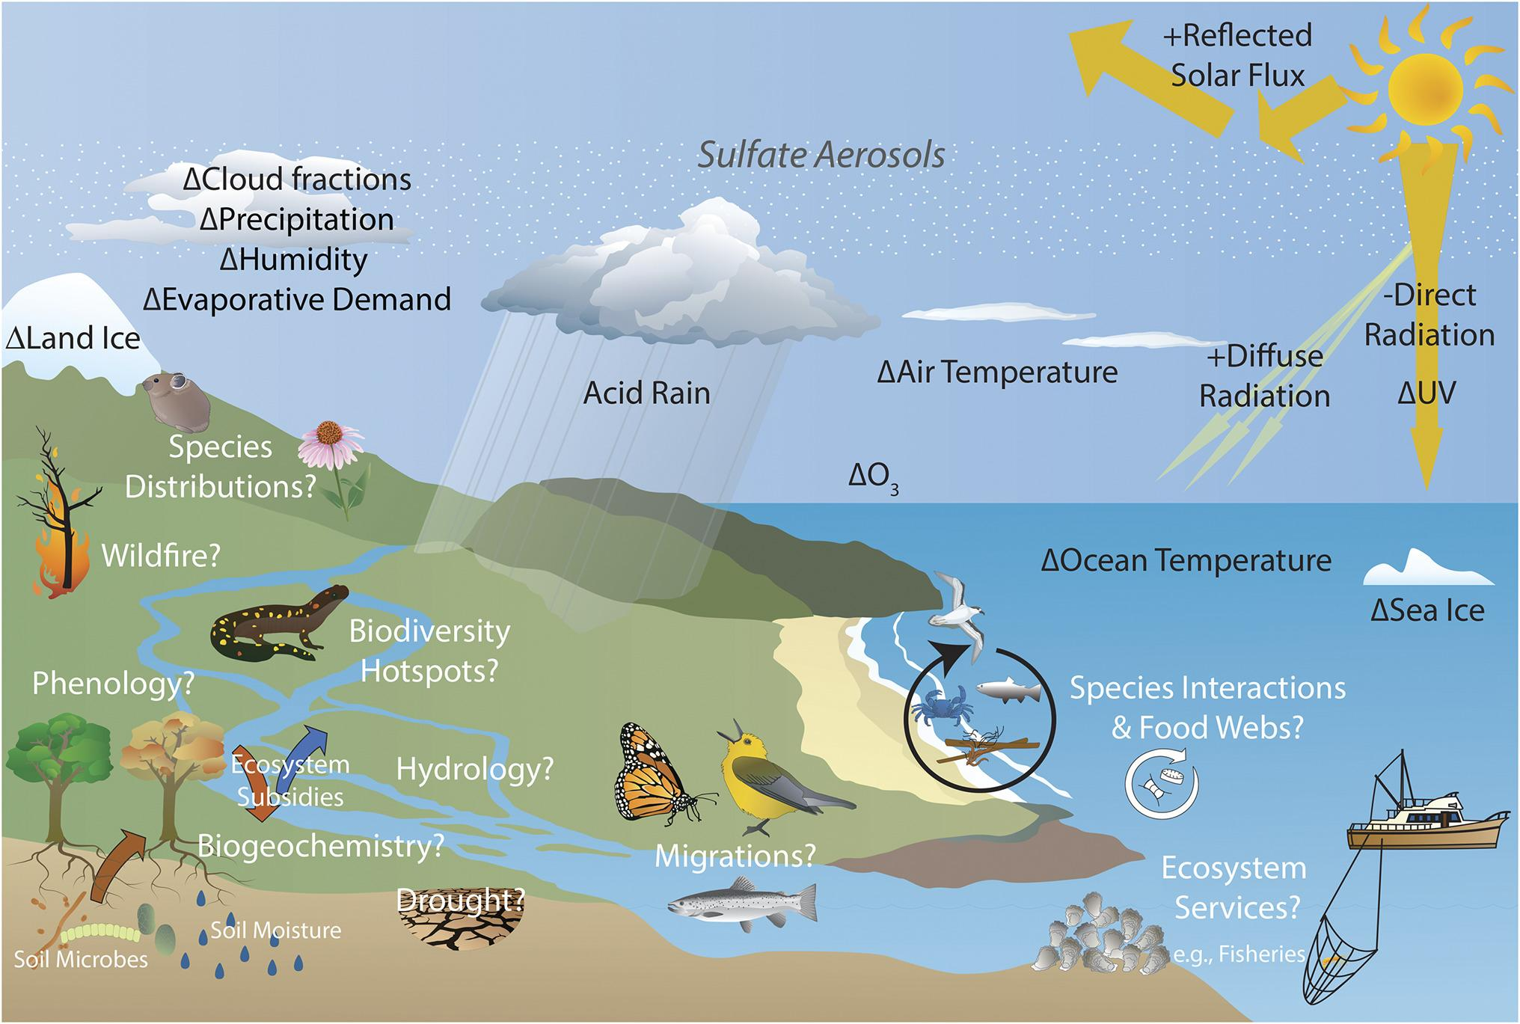
Interconnectedness of the biosphere
“Traditional notions of political sovereignty and models of territorial states protecting fixed boundaries aren’t useful modes of thinking about climate engineering governance.” (Dalby, 2015)
Interconnectedness of the biosphere
Zarnetske et al., 2021
Although some effects of SRM with SAI on the climate are known from certain SAI scenarios (indicated with + for likely increases, − for decreases, Δ to indicate change), the effects of SAI on ecological systems are largely unknown.

Slide 62
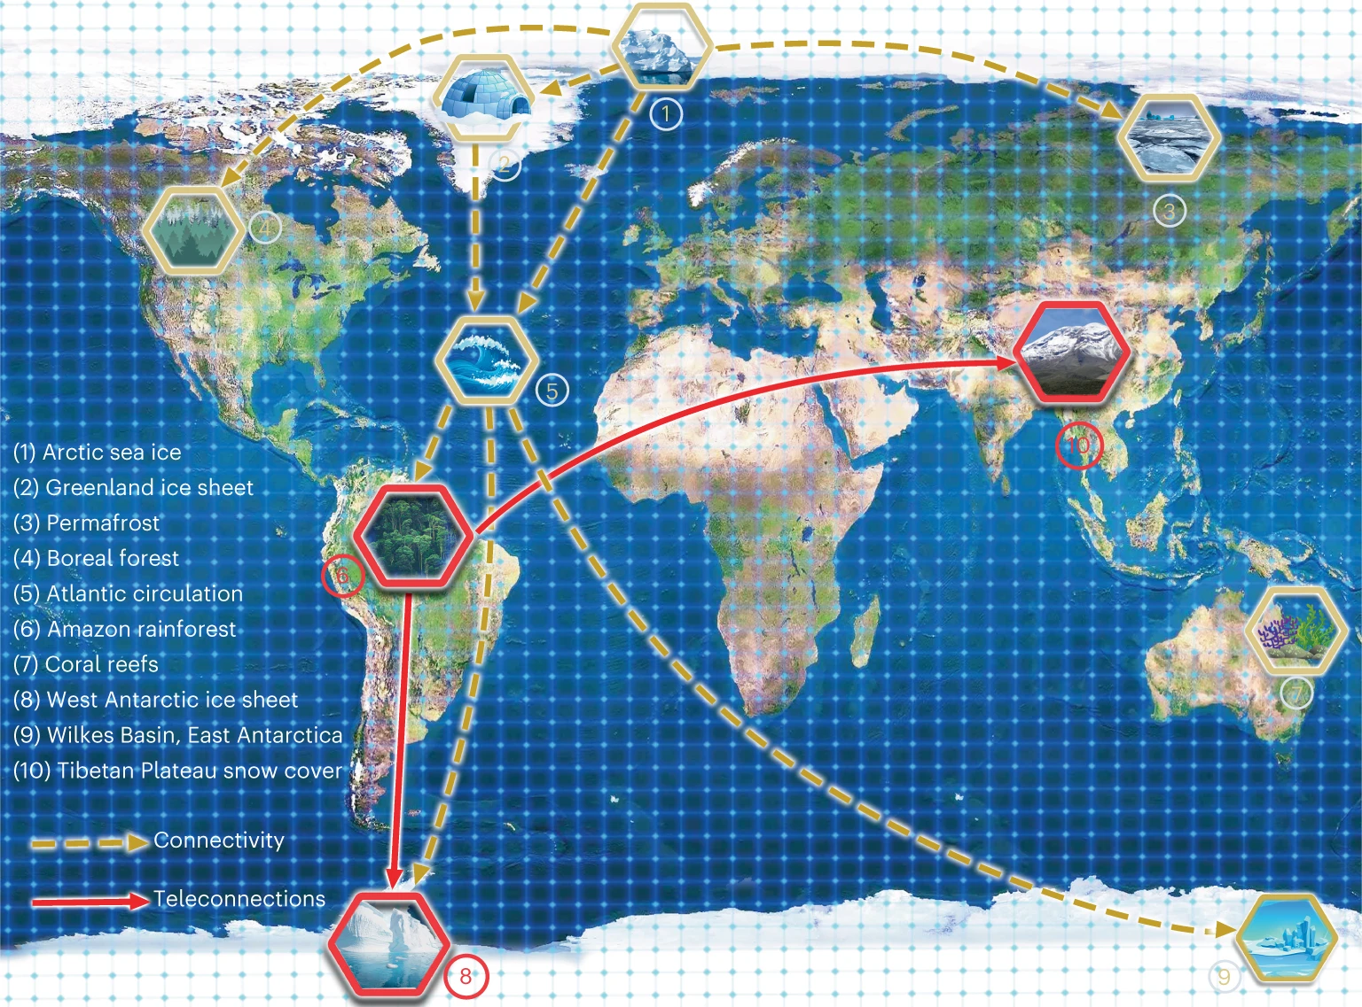
teleconnections
“Traditional notions of political sovereignty and models of territorial states protecting fixed boundaries aren’t useful modes of thinking about climate engineering governance.” (Dalby, 2015)
Teleconnections and coupling between the atmosphere, hydrosphere, and cryosphere
Liu et al. (2023)

Slide 63
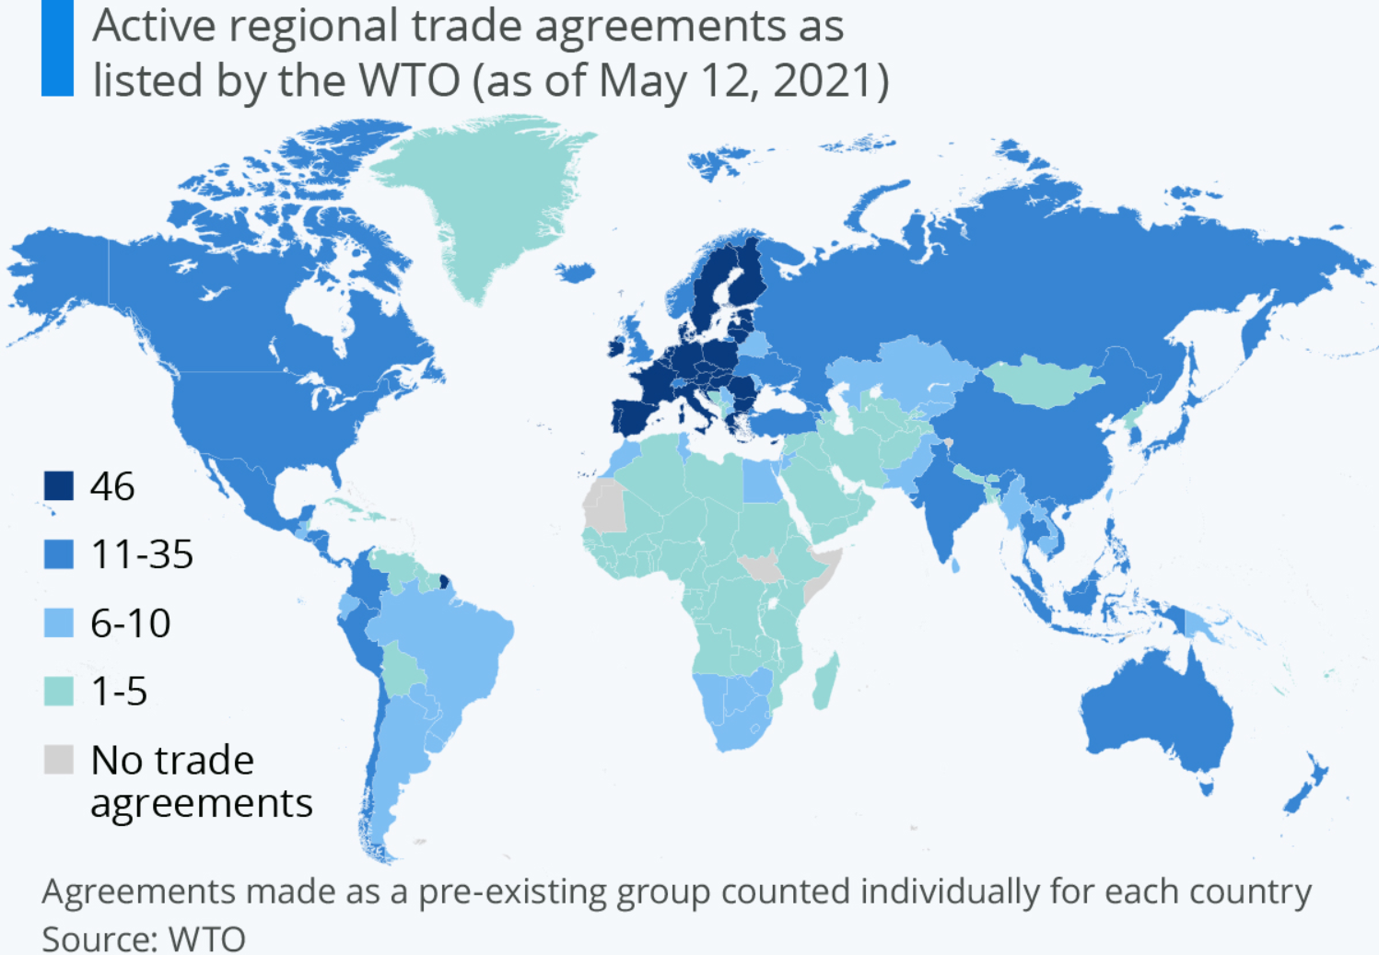
Global economy
“Traditional notions of political sovereignty and models of territorial states protecting fixed boundaries aren’t useful modes of thinking about climate engineering governance.” (Dalby, 2015)
Global economy and trade
Via Statista

Slide 64
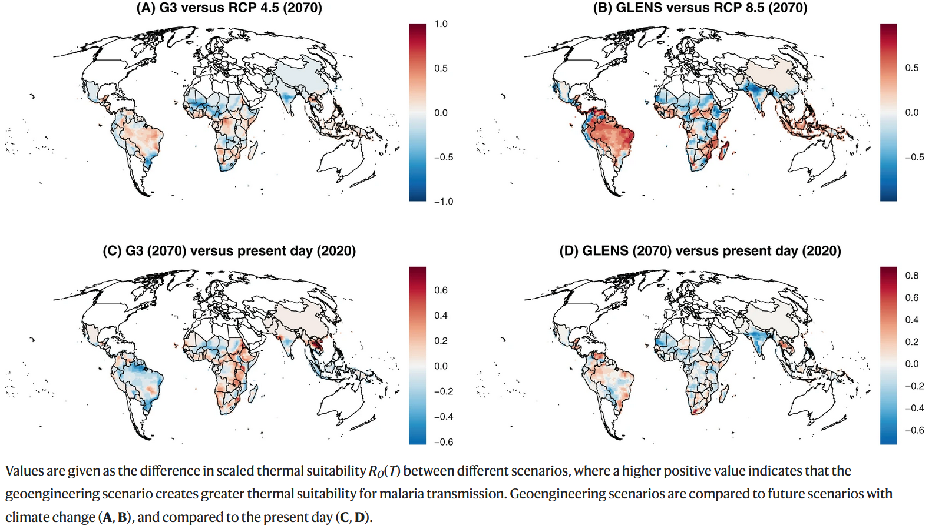
Climate engineering tradeoffs
“Traditional notions of political sovereignty and models of territorial states protecting fixed boundaries aren’t useful modes of thinking about climate engineering governance.” (Dalby, 2015)
Climate engineering tradeoffs (what’s good for ___ ; may not be good for ____ )
Impacts of solar geoengineering on malaria transmission.
Carlson et al. (2022)

Slide 65
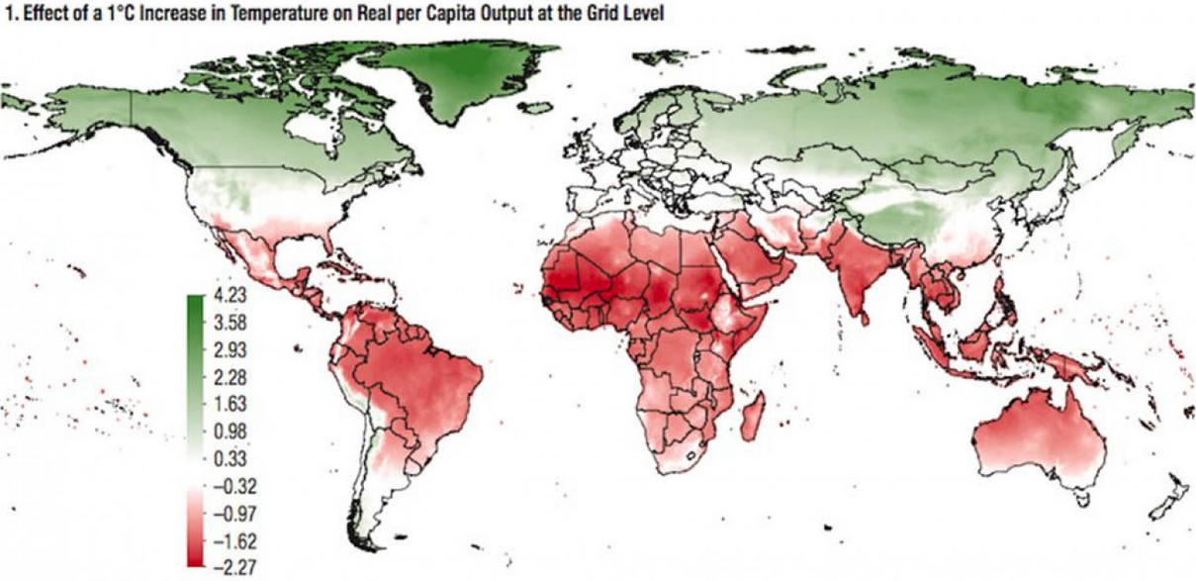
Desire to slow global warming
“Traditional notions of political sovereignty and models of territorial states protecting fixed boundaries aren’t useful modes of thinking about climate engineering governance.” (Dalby, 2015)
Desire to slow global warming is not universal amongst nations
International Monetary Fund (2017)

Slide 66
Oxford principles on geoengineering
Oxford Principles on Geoengineering (Rayner et al., 2013)
(note, these are proposed ideas)
Geoengineering should be regulated as a public good (transparent public oversight)
Those affected by the decision should have a say in the decision
Transparency and availability of geoengineering research plans and research results
Independent assessments of impacts (tricky because of transboundary effects and the definition of “independent”)
Establish governance structure before deployment
Uncoordinated efforts by individual states are likely to be much less effective than coordinated attempts (Dalby, 2015).

Slide 67
Lesson 4: Model UN
*Catherine and Kirstin

Slide 68
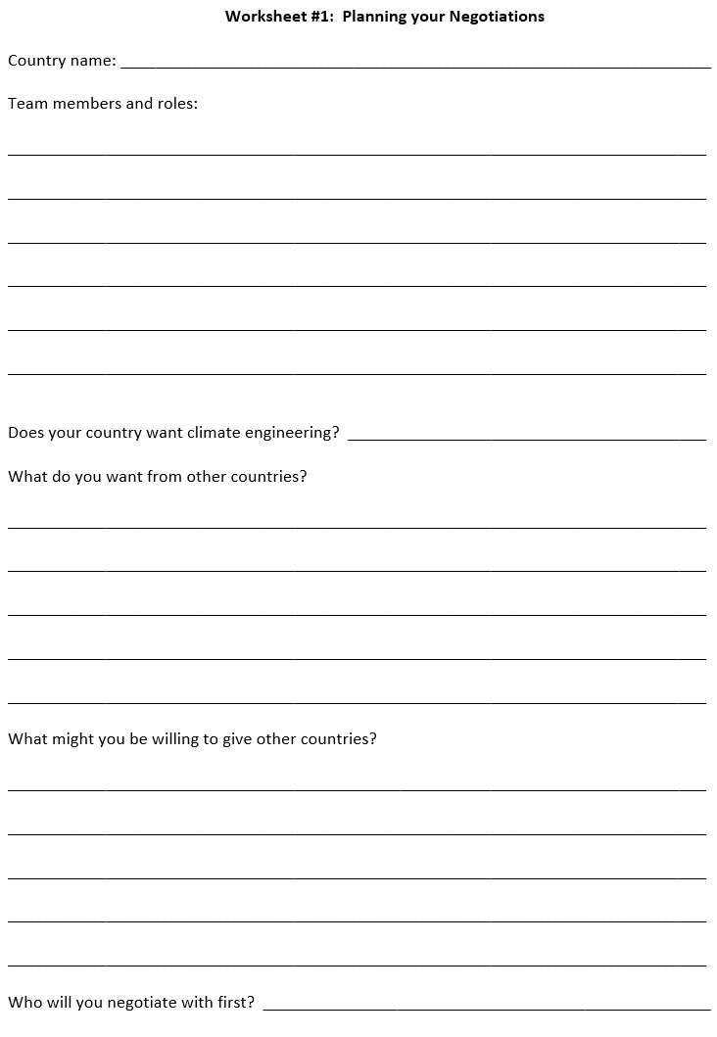
As your country prepares for negotiations, consider the following:
Interconnectedness of the biosphere
Teleconnections and coupling between the atmosphere, hydrosphere, and cryosphere
Global economy and trade
Climate engineering tradeoffs (what’s good for__; may not be good for __)
Desire to slow global warming is not universal amongst nations
Geoengineering should be regulated as a public good (transparent public oversight)
Those affected by the decision should have a say in the decision
Transparency and availability of geoengineering research plans and research results
Independent assessments of impacts (tricky because of transboundary effects and the definition of “independent”)
Establish governance structure before deployment

Slide 69
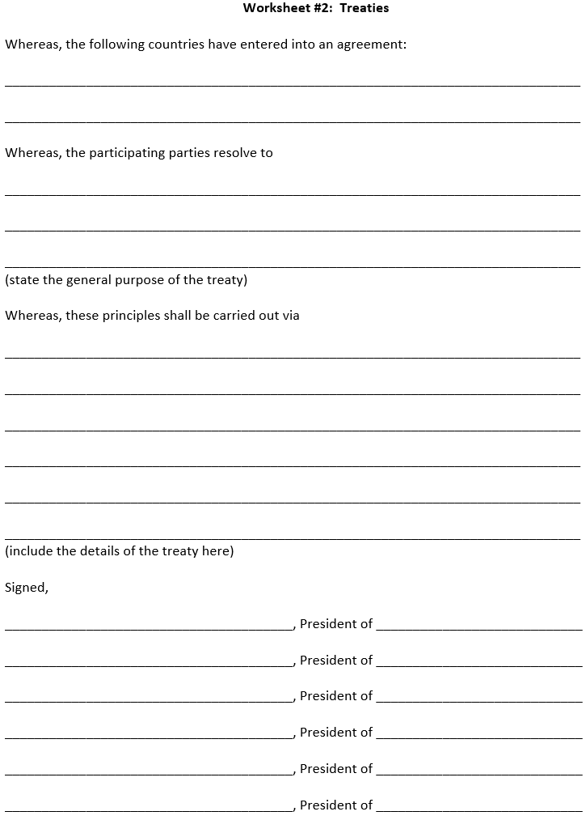
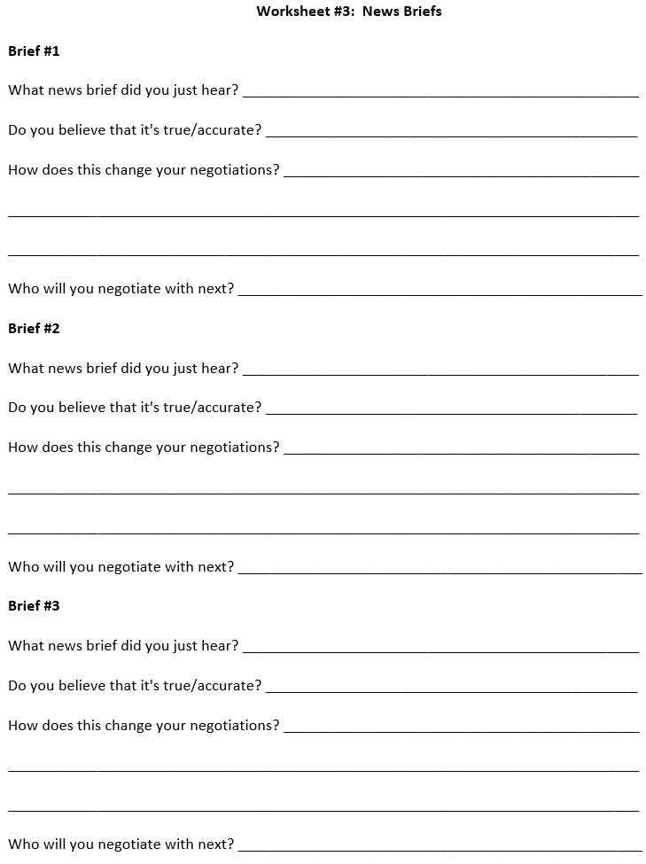
Other Documents to Guide the Activity:

Slide 70
Background Statement
The year is 2030. Climate change has been getting steadily worse, and nations around the world are feeling its effects. The Secretary General of the United Nations has called a summit to discuss whether the world should start a trial run of climate engineering. Representatives from six nations have traveled to the UN to begin negotiations. If they agree that deployment should start, it will begin in 2035, which is around the time global average temperature will be 1.5°C (nearly 3°F) warmer than in the preindustrial era.
6 nations with differing interests, wealth, agendas, and potential impacts from climate engineering

Slide 71
Breaking News!
Angosia’s capital city is hit by a hurricane that caused widespread power outages and water shortages. Scientists conclude that this would not have happened in the absence of climate change. The government of Angosia releases a statement declaring Florin partly responsible because of its long history of fossil fuel use.
The year is 2030. Climate change has been getting steadily worse, and nations around the world are feeling its effects. The Secretary General of the United Nations has called a summit to discuss whether the world should start a trial run of climate engineering. Representatives from six nations have traveled to the UN to begin negotiations. If they agree that deployment should start, it will begin in 2035, which is around the time global average temperature will be 1.5°C (nearly 3°F) warmer than in the preindustrial era.

Slide 72
Breaking News! (2)
Angosia’s capital city is hit by a hurricane that caused widespread power outages and water shortages. Scientists conclude that this would not have happened in the absence of climate change. The government of Angosia releases a statement declaring Florin partly responsible because of its long history of fossil fuel use.
A right-wing think tank from Guilder releases a statement that due to advancements in infrastructure from major manufacturers in Guilder, Tanoa can be kept inhabitable and thriving for at least another 50 years.
The year is 2030. Climate change has been getting steadily worse, and nations around the world are feeling its effects. The Secretary General of the United Nations has called a summit to discuss whether the world should start a trial run of climate engineering. Representatives from six nations have traveled to the UN to begin negotiations. If they agree that deployment should start, it will begin in 2035, which is around the time global average temperature will be 1.5°C (nearly 3°F) warmer than in the preindustrial era.

Slide 73
Breaking News! (3)
Angosia’s capital city is hit by a hurricane that caused widespread power outages and water shortages. Scientists conclude that this would not have happened in the absence of climate change. The government of Angosia releases a statement declaring Florin partly responsible because of its long history of fossil fuel use.
A right-wing think tank from Guilder releases a statement that due to advancements in infrastructure from major manufacturers in Guilder, Tanoa can be kept inhabitable and thriving for at least another 50 years.
Impatient with the slow pace of the negotiations, the Prime Minister of Durhan (who is not at the UN this week) announces that Molvania has been secretly helping them develop climate engineering technology. Durhan plans to deploy climate engineering in 2040, which he calls “A Durhanese Solution to a global problem”, with or without support from the UN.

Slide 74
Questions
Did you reach an overall decision?
How did your negotiations go? What happened?
Were there any common themes that came up?
How important were natural science and engineering in your discussions?
What did you learn?

Slide 75
Learning Outcomes
The science is important, but it's not the only thing
People really internalize the exercise because they take ownership
Encourages creativity (we do not provide every detail)

Slide 76
Agenda (3)
Project Website: https://go.iu.edu/4BPh
(listed at the top of the first page in your binders)
What Climate Engineering looks like (Lesson 1 activity)
Intro to Climate Engineering and Research + Q and A (video and discussion)
Morning Break
How Marine Cloud Brightening works (Lesson 2)
Development and Presentations of student designs (Lessons 3 & 5)
Lunch Break
Social, Ethical, Economic, Political dimensions of Climate Engineering (Lesson 4 Model UN)
Classroom Implementation Strategies

Slide 77
Classroom Implementation
When to implement and how much class time to schedule?
Adaptations for grade-level and subject area
Other strategies and practices?
What barriers remain regarding classroom implementation?
*Catherine and Kirstin

Slide 78
Questions/Comments/Thoughts/Ideas welcome!
Project Website: https://go.iu.edu/4BPh
(listed at the top of the first page in your binders)
Implementation barriers? How can we help?
Paul Goddard pgoddard@iu.edu
Ben Kravitz bkravitz@iu.edu
Adam Scribner jascrib@iu.edu

