Slide 1
Climate Engineering Teaching Module
Paul Goddard¹, Ben Kravitz¹, Adam Scribner², Kirstin Milks³, Catherine Peterson³
1. Department of Earth and Atmospheric Sciences 2. School of Education 3. Bloomington High School South
INDIANA UNIVERSITY

Slide 2
Agenda
Agenda
40 mins: Lesson 1 Climate Engineering Design
25 mins: What is & Why Teach Climate Engineering? + Q&A
5 mins: BREAK
30 mins: Lesson 2 MCB Experiment Demo & MCB Research
15 mins: Overview of Lessons 3-5
10 mins: Wrap-up + Q&A
Project Website: https://go.iu.edu/4BPh
(listed at the top of the first page in your binders)

Slide 3
Design a Technology to Slow Global Warming
Lesson 1 Objective

Slide 4
Climate engineering
Climate engineering is the deliberate modification of an environmental system that impacts Earth’s climate in order to reduce the negative impacts of global warming.
But…
What is global warming and climate change?
How do we know it is occurring?
What are these environmental systems you speak of?
You want me to fix global warming?!?!

Slide 5
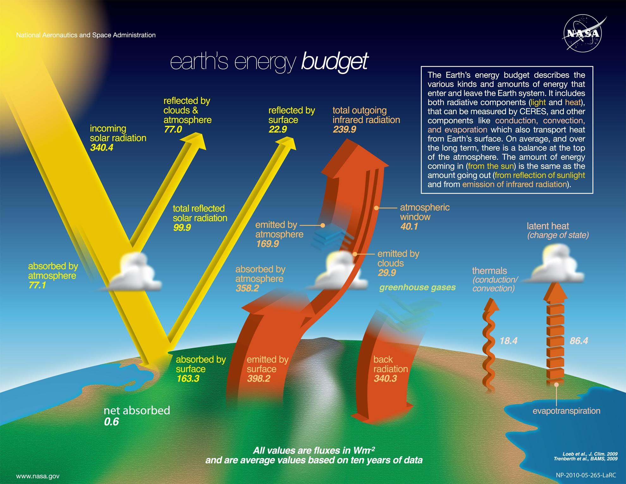
Global warming
Global Warming Simplified:
Energy going in is greater than the energy going out

Slide 6
Global warming 2
>
+
+
Global Warming Simplified:
Energy going in is greater than the energy going out

Slide 7
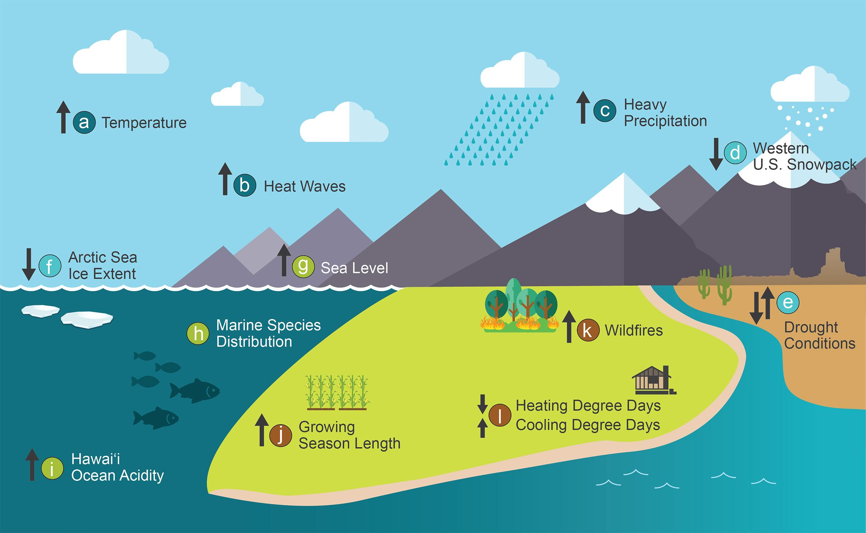
Climate change evidence
Evidence of Climate Change
4th National Climate Assessment
(5th NCA came out last year)

Slide 8
Global warming 3
>
+
+
Global Warming Simplified:
Energy going in is greater than the energy going out

Slide 9
Climate engineering (1)
Climate Engineering is about developing technologies to reverse this inequality
>
+
+

Slide 10
Climate engineering 2
Climate Engineering is about developing technologies to reverse this inequality
>
+
+
Think about how to increase the right side of the equation
Reflection of incoming sunlight
At the Surface?
In the Atmosphere?
In Space (and thus decrease the left side of the equation)?
Permit more infrared radiation (heat) to escape to space
How to open this “window”?

Slide 11
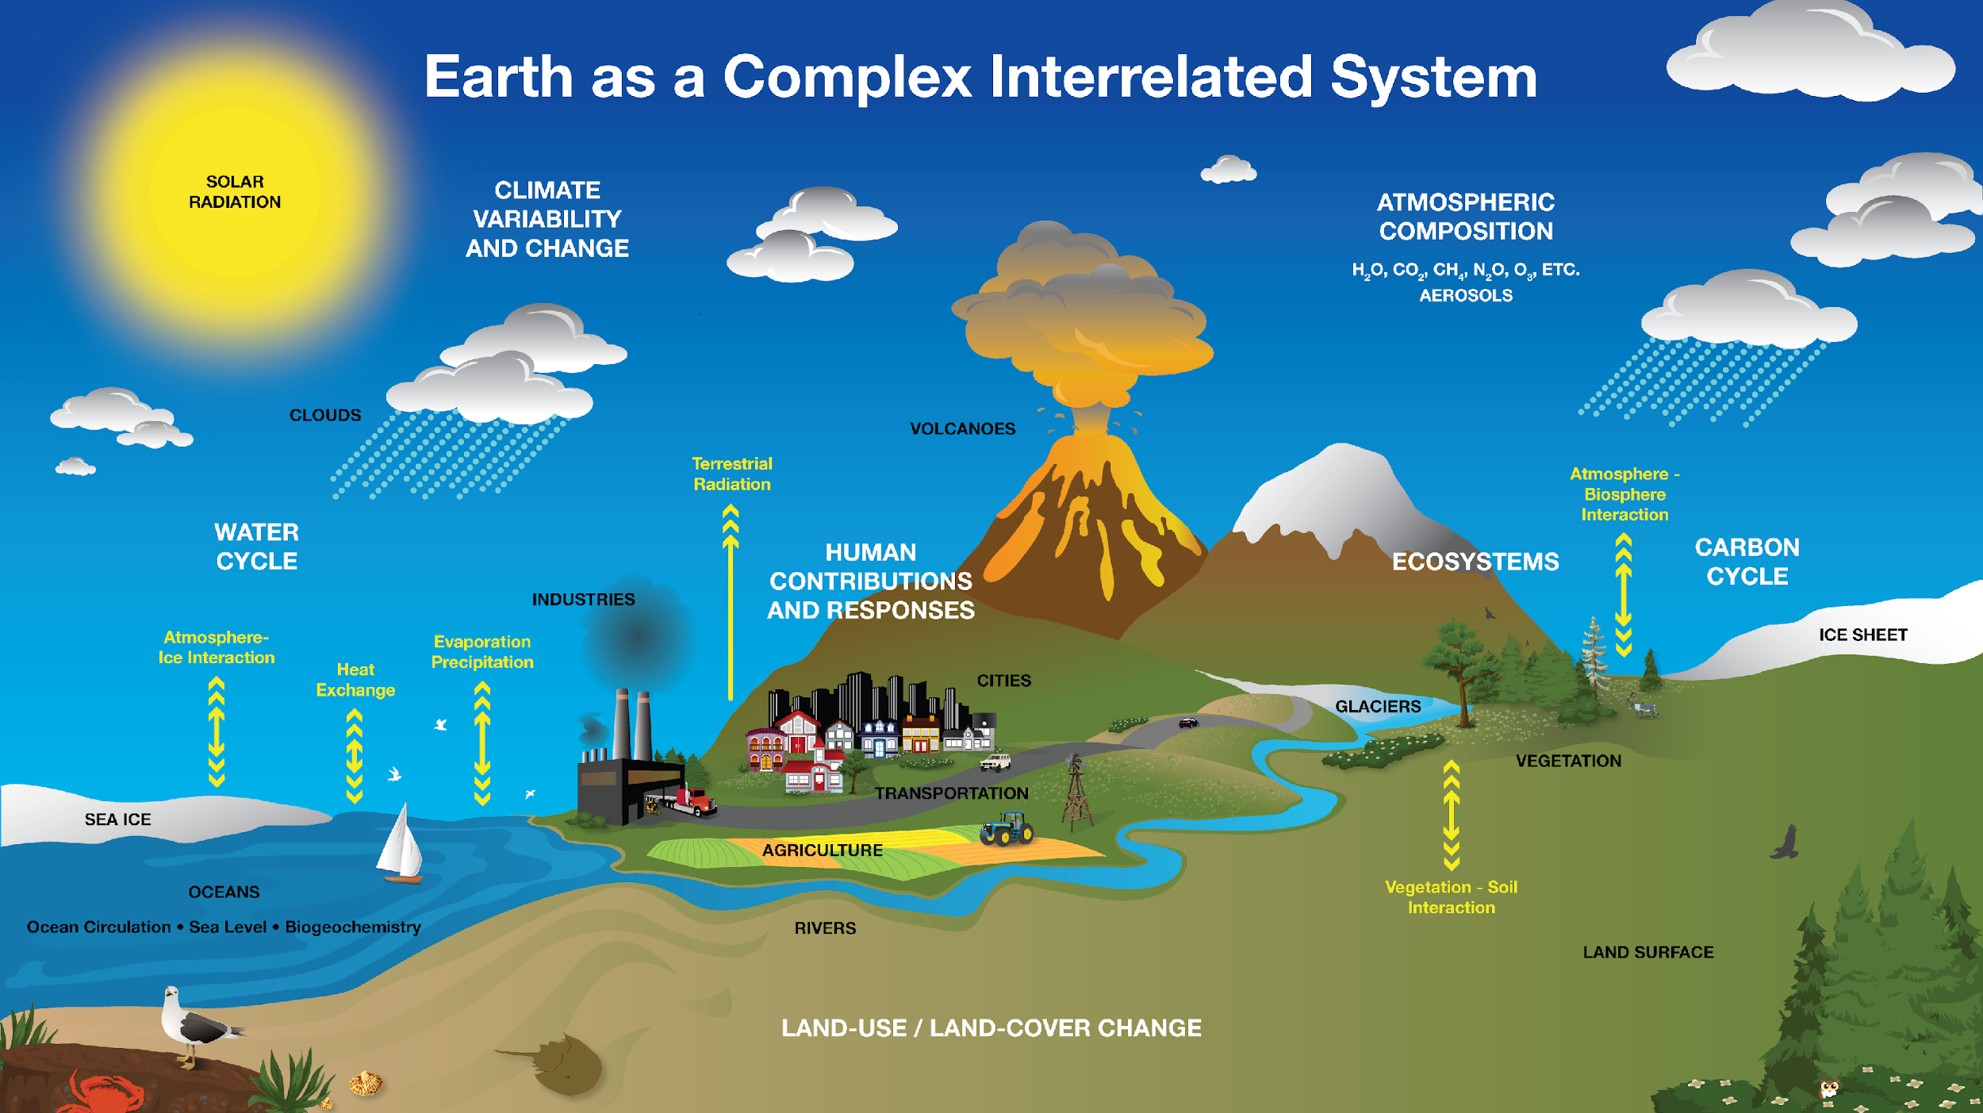
Climate engineering 3
Climate Engineering is about developing technologies to reverse this inequality by modifying a part of the climate system
NASA

Slide 12
Climate engineering 4
Can you think of ways to modify these systems to slow global warming? (increase the RHS or decrease LHS)
Incoming
solar radiation
>
Total reflected incoming radiation
+
Total outgoing infrared radiation
Write as many (wild!) ideas as possible in 3 minutes.
NASA

Slide 13
Climate engineering 5
Can you think of ways to modify these systems to slow global warming? (increase the RHS or decrease LHS)
Incoming
solar radiation
>
Total reflected incoming radiation
+
Total outgoing infrared radiation
Now, as a small group write (wild!) ideas for 3 minutes
NASA

Slide 14
Climate engineering 6
Incoming
solar radiation
>
Total reflected incoming radiation
+
Total outgoing infrared radiation
What ideas does AI have? - Ask ChatGPT:
“Create 10 wild ideas that fit the category of geoengineering to stop global warming”
Then ask ChatGPT: “But, more wild” to get some sensational ideas
NASA

Slide 15
Mind Map
Organize group and individual sticky notes on large sheet of paper or wall.
Category 1
Category 2
Design a Solution for Global Warming
Category 3
Category 4

Slide 16
Mind Map (2)
Organize group and individual sticky notes on large sheet of paper or wall.
Carbon Uptake
Emission Reduction
Example Categories
Design a Solution for Global Warming
Sunlight Reduction
Miscellaneous

Slide 17
Concept Sketching
CONCEPT 1
CONCEPT 2
CONCEPT 3
Notes:
Concept drawings or sketches are drawings, often freehand, that are used by designers such as architects, engineers and interior designers as a quick and simple way of exploring initial ideas for designs. Concept drawing - Designing Buildings

Slide 18
Concept Sketching (2)
Individually… Draw an upside-down “Y” on paper
Sketch 3 ideas in the 3 spaces on your paper using one colored pencil (10 min)

Slide 19
As a group… Pass your paper to the person to your right.
Sketch more design details on their paper using your colored pencil (2-3 min for each rotation).
Repeat until you have added to everyone else’s papers.
Concept Sketching (1)

Slide 20
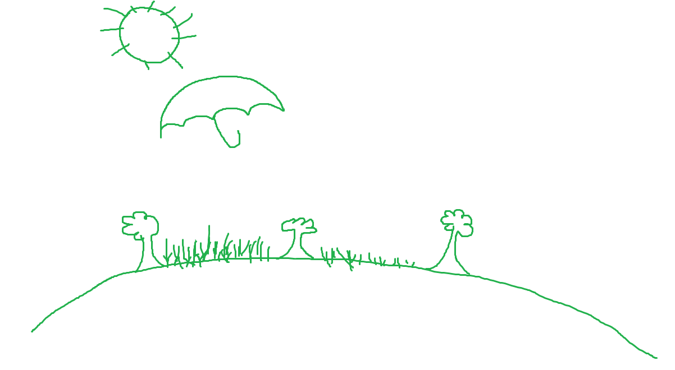
Concept Sketching - continued
Student 1

Slide 21
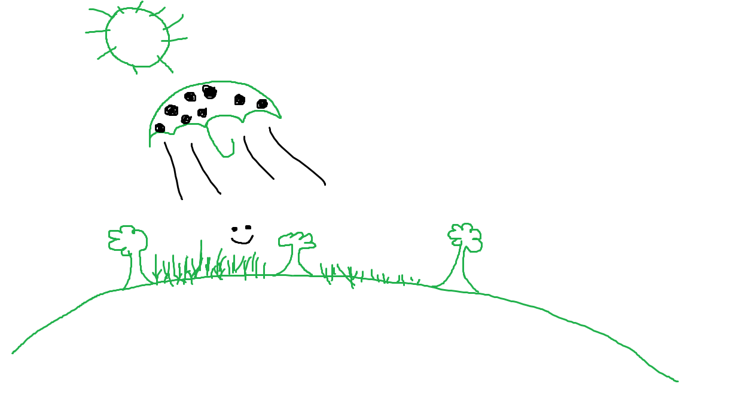
Concept Sketching (3)
Student 1
Student 2

Slide 22
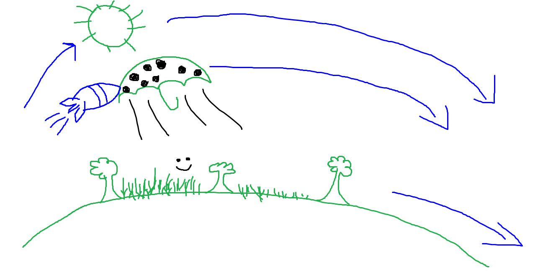
Concept Sketching (4)
Student 1
Student 2
Student 3

Slide 23
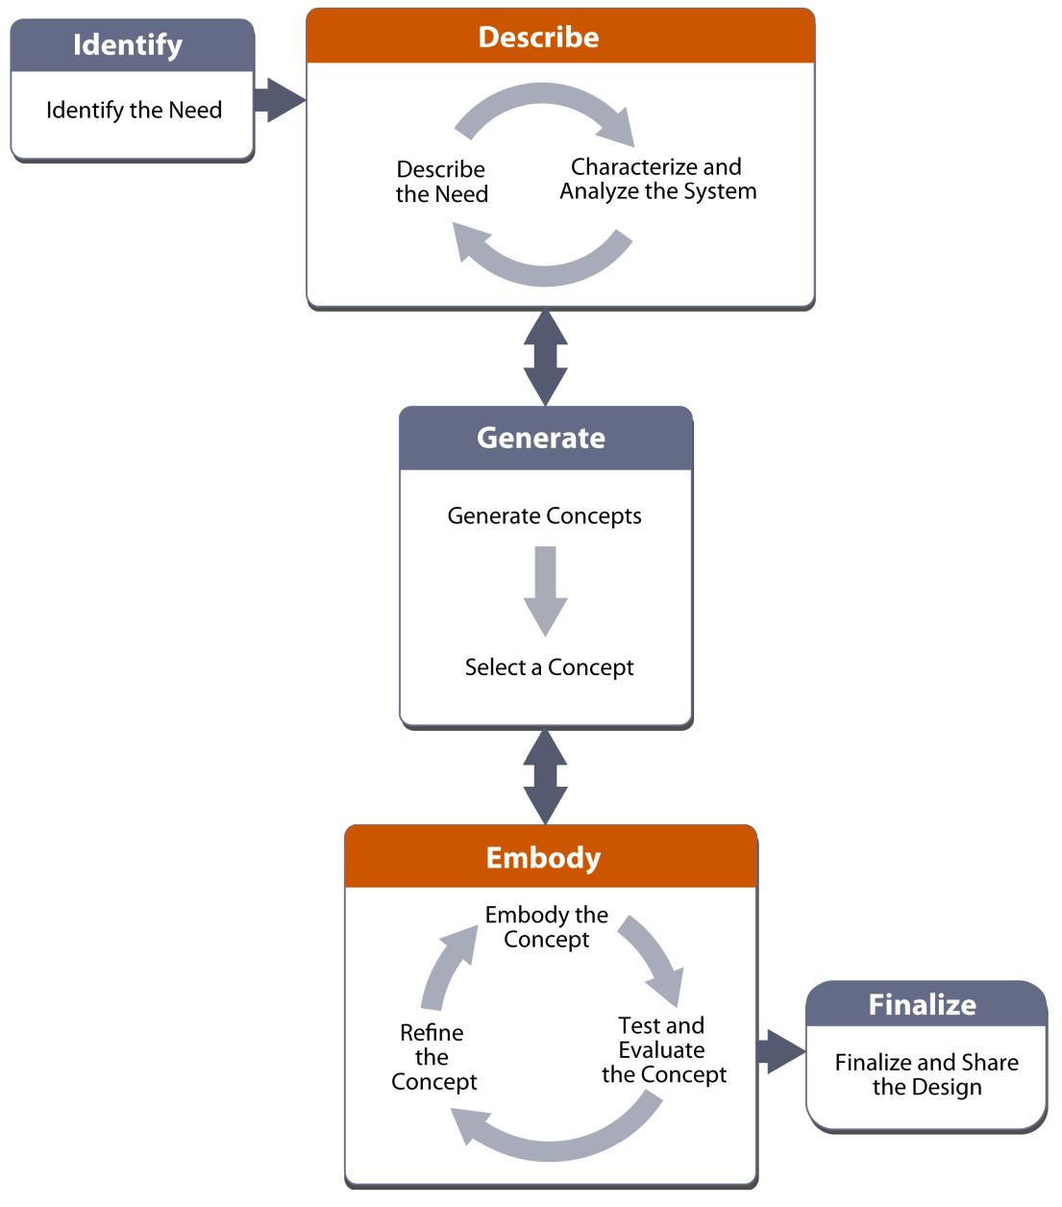
The Engineering Design Process Can Be Complex

Slide 24
The Engineering Design Process Can Be Complex (2)
Lesson 1: Concept Generation

Slide 25
The Engineering Design Process Can Be Complex (3)
Lesson 1: Concept Generation
Lessons 3 & 5: Select, Refine,
Finalize, and Share

Slide 26
This lesson introduced and developed ideas for engineering solutions to global warming and climate change while utilizing “Activity Before Content”
Summary

Slide 27
Why Teach Climate Engineering?
Introduction

Slide 28
Why Teach Engineering?
Introduction
Engineering provides a real-world context towards understanding science and its applications
Creative brainstorming (no wrong answers) leading to creative designs
Work with diverse teams
Next Generation Science Standards and Indiana State Education Standards

Slide 29
Why Teach Engineering? (1)
Introduction
Engineering provides a real-world context towards understanding science and its applications
Creative brainstorming (no wrong answers) leading to creative designs
Work with diverse teams
Next Generation Science Standards and Indiana State Education Standards

Slide 30
Why Teach Engineering? (2)
Introduction
Engineering provides a real-world context towards understanding science and its applications
Creative brainstorming (no wrong answers) leading to creative designs
Work with diverse teams
Next Generation Science Standards and Indiana State Education Standards
Now an Indiana Education Standard!

Slide 31
Why Teach Climate Science?
Introduction
“It’s real, it’s bad, it’s us, scientists agree, there’s hope” (Tony Leiserowitz)
Climate change is a “Wicked Problem” (Rittel and Webber, 1973)
Socio-political-economic complexity at all scales
High stakes
Conclusions aren’t true or false, but rather good or bad (subjectivity)
A collective effort is necessary no matter one’s career/life path

Slide 32
Introduction
What is Climate Engineering and what do we know about it?

Slide 33
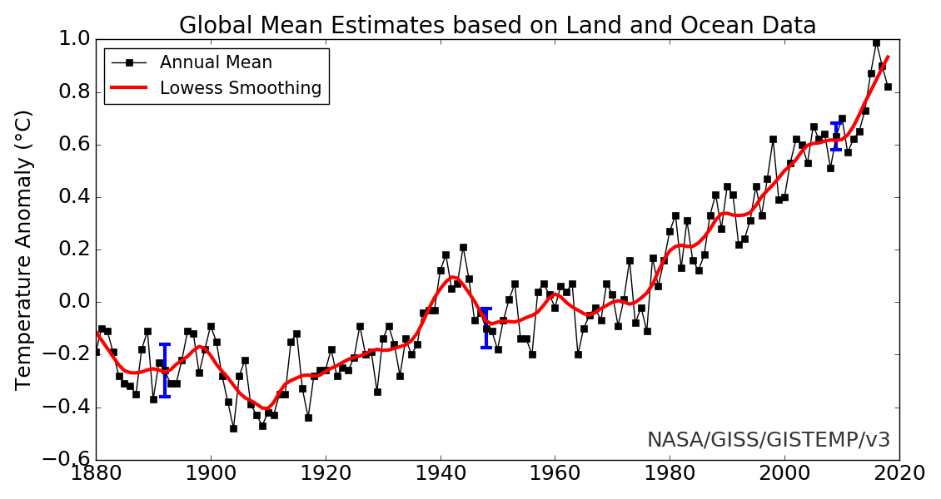
Land and ocean data
World War II (pollution)
Lots of large volcanic eruptions
Mt. Pinatubo
1991
Mt. Agung
1963

Slide 34
Land data
Stratosphere (15+ km up) – particles last a few years
Sulfate reflects sunlight
Troposphere (surface up to ~15 km) – particles last a few weeks
Aubry et al. (2021)

Slide 35
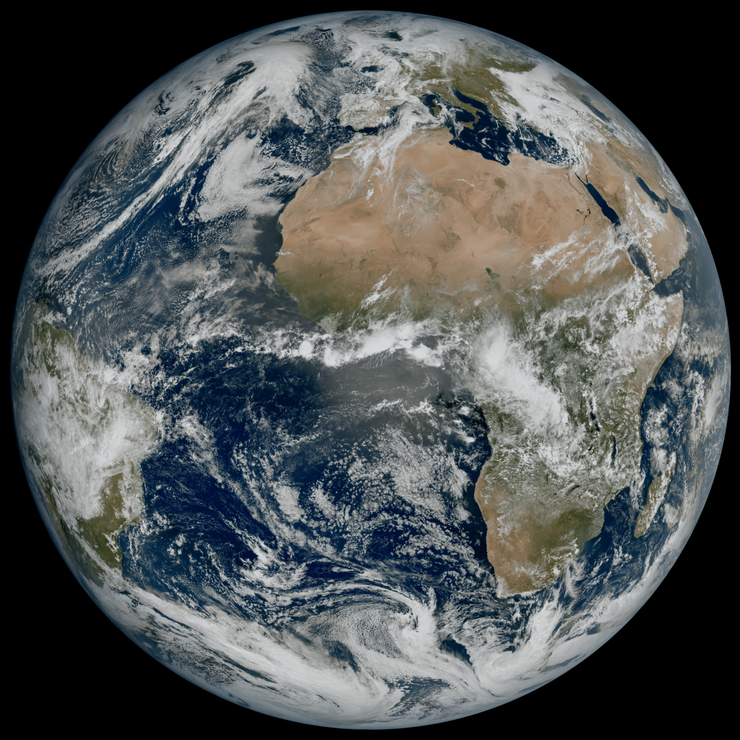
Earth reflection
Albedo: how reflective Earth is
Oceans: about 8%
Snow-covered ice: about 95%
Forests
Deserts
Clouds are bright and cover about 60% of Earth at any given time

Slide 36
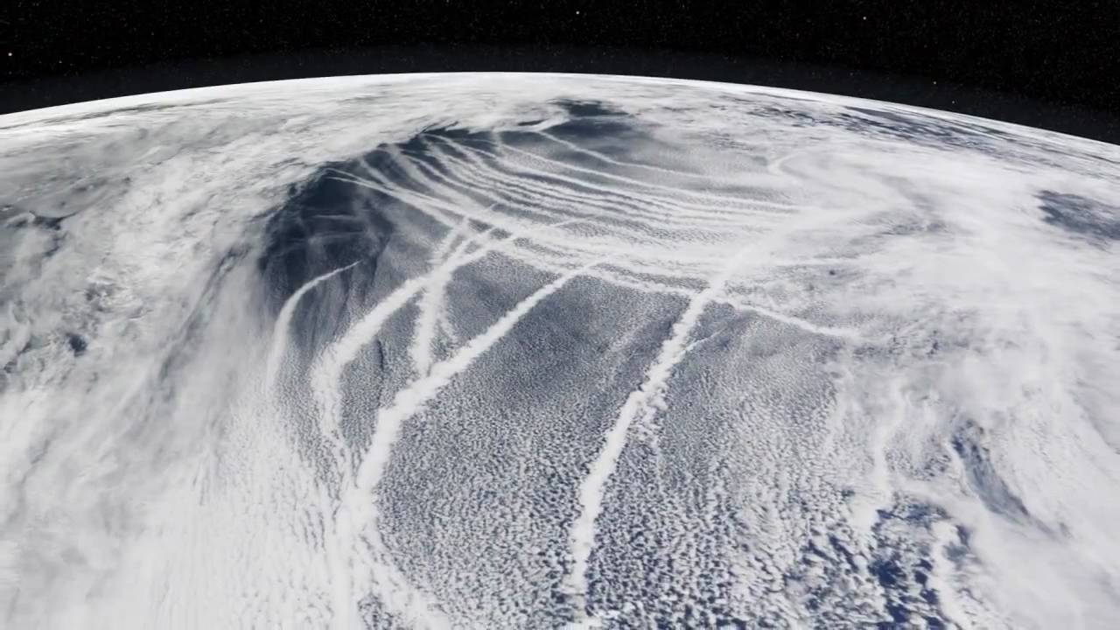
Earth reflection (2)
Ship tracks: when you add aerosols to clouds they can get brighter (under the right conditions)

Slide 37
Earth reflection (3)
Holuhraun (Iceland) put sulfur into the North Sea over a few months
The cloud droplets got smaller, which means they got brighter
Malavelle et al. (2017)

Slide 38
CLIMATE ENGINEERING PROPOSALS
CLIMATE ENGINEERING
CARBON DIOXIDE REMOVAL

Slide 39
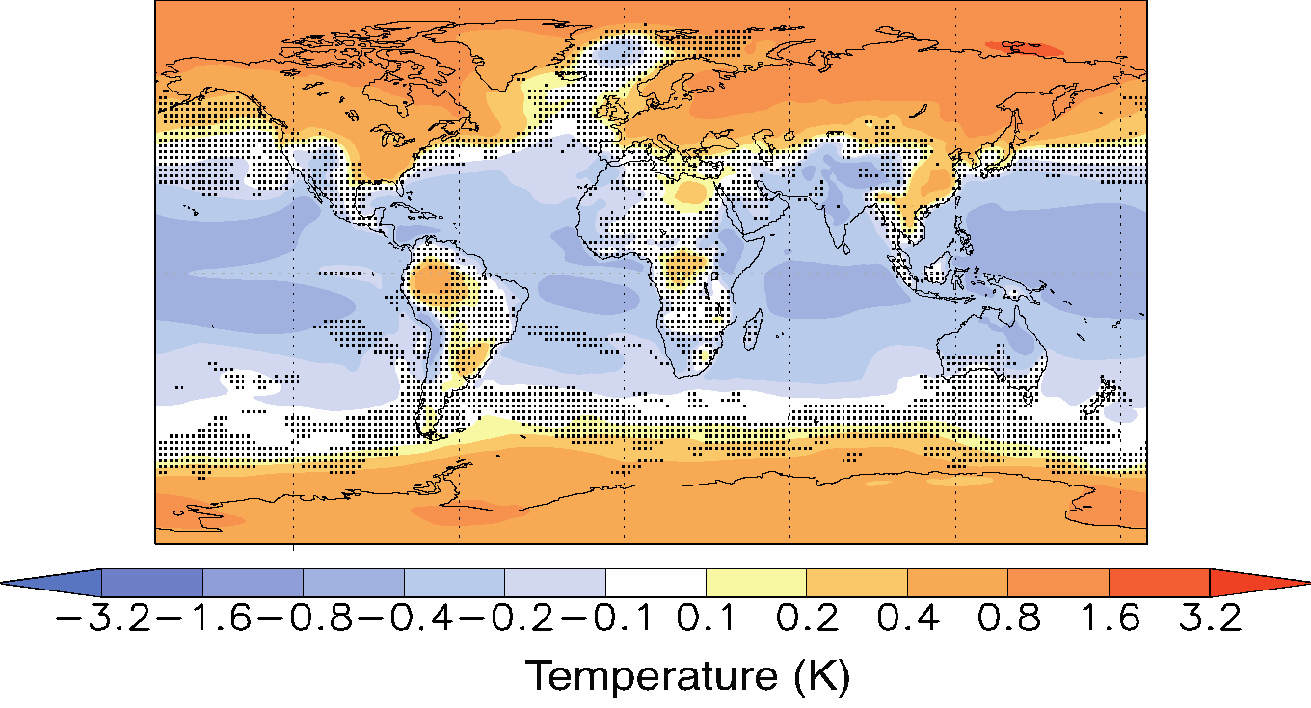
Models of climate engineering
What do the models say about global-scale climate engineering? (Space mirrors or stratospheric aerosol injection)
Temperature change (from a baseline)
If you increase CO₂ and turn down the sun
High CO₂
Climate engineering is imperfect: “overcooling” in the tropics and “undercooling” at the poles
It’s a lot better than a high carbon world
But…
Kravitz et al. (2013)

Slide 40
Figures on temperature
Precipitation goes down (but it would have gone up under global warming)
High CO₂ alone
High CO₂ plus climate engineering
Kravitz et al. (2013)

Slide 41
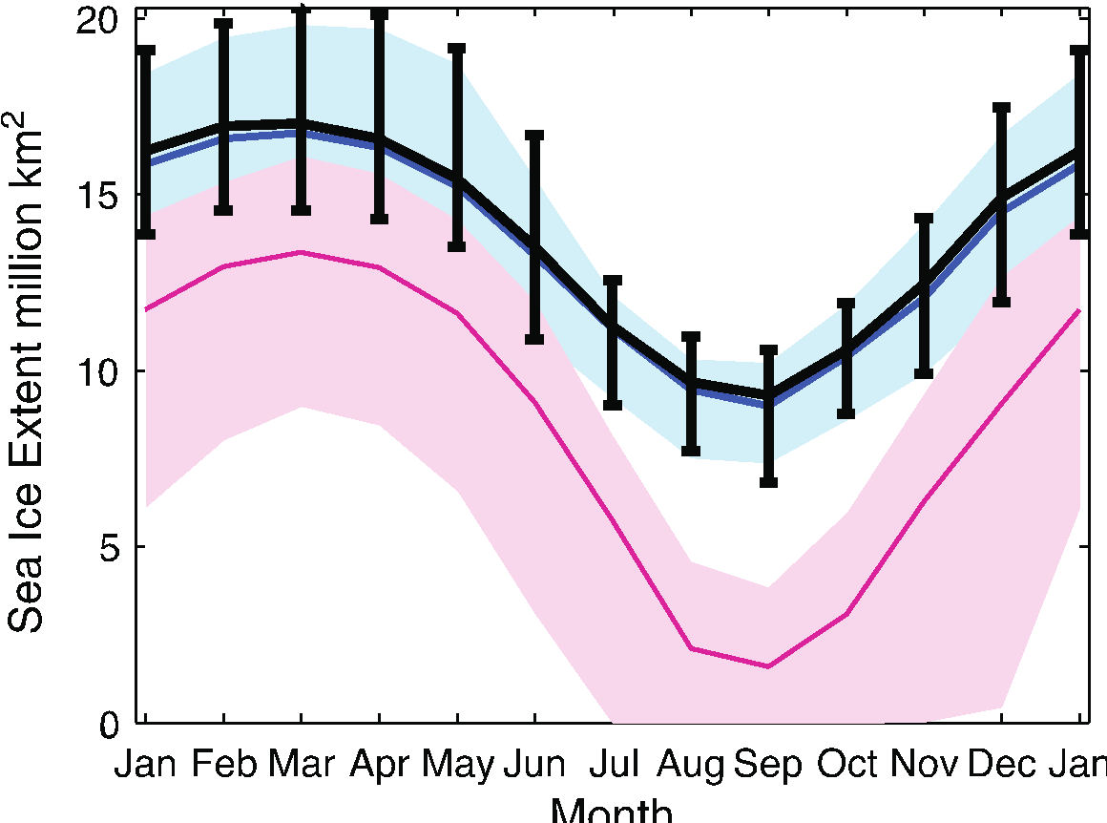
Figures on temperature (2)
Same story for…
Sea ice
Heat waves, floods, and droughts
Curry et al. (2014)
Moore et al. (2014)
Ocean heat transport
Bednarz et al. (2023)
Global climate engineering is not perfect, but it’s better (on average) than doing nothing

Slide 42
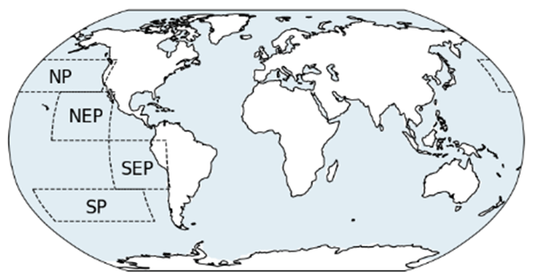
Marine Cloud Brightening (regional climate engineering)
Where there are usually ”brightenable” clouds
Northern hemisphere summer
Substantial global effect
=
very large regional effect
Northern hemisphere winter
Regional precipitation changes
Haywood et al. (2023)

Slide 43
MCB causes ”Super La Niña”?
Temperature
Precipitation
Strongest La Niñas
Marine cloud brightening
Haywood et al. (2023)

Slide 44
Fewer side effects if you choose different regions
Temperature
Precipitation
5% “most brightenable” regions
30% “least brightenable” regions
Chen et al. (2024)

Slide 45
Climate engineering can be designed
Latitude of stratospheric aerosol injection
Season of stratospheric aerosol injection

Slide 46
What if we wanted to save polar ice?
Goddard et al. (2023)
Arctic injection can efficiently restore sea ice
Antarctic ice is more complicated because ice loss is driven by large-scale winds and ocean currents
Lee et al. (2023)

Slide 47
What if we didn’t want SAI to “overcool” the tropics and “undercool” the poles?
SAI just at equator
SAI at multiple latitudes
Temperature
Precipitation

Slide 48
What if everyone wanted to paint their roofs white?
Effects tend to be local, which is good (no transboundary effects) and bad (amount of cooling is limited)

Slide 49
Some general things we know
Climate engineering is imperfect, but it’s a lot better for most* than climate change
To some degree, climate engineering can be designed to reduce side effects
But you can’t get rid of all side effects. There will be trade-offs.
Most of what we know about climate engineering is through models.
Things we haven’t talked about yet
What does ”better” mean? For whom?
Some other important risks
How do we get information that models can’t provide?

Slide 50
Climate engineering is better for most but not all
Geopolitical risks?
Moisture availability
Flooding events
Climate change effects are moderated/exacerbated
Irvine et al., 2019

Slide 51
What if we suddenly stop?
“Business-as-usual”
Sudden rebound after termination
Climate engineering
Figure courtesy S. Tilmes

Slide 52
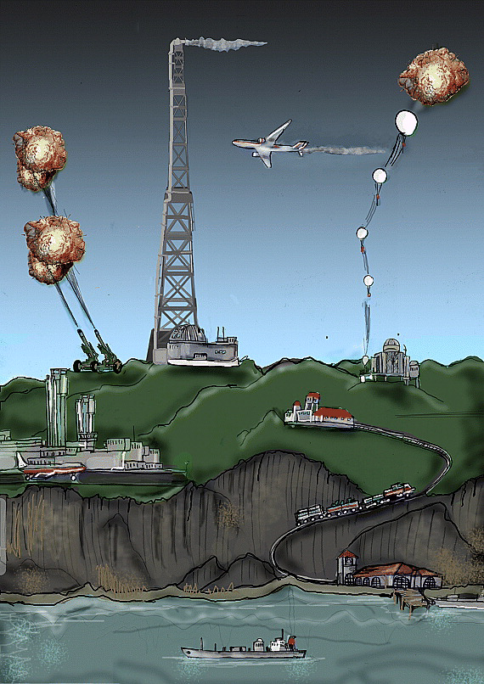
Current best estimates:
Cooling the planet by 1°C would cost about $10-100 billion per year

Slide 53
How should climate engineering be used?
We have to cut greenhouse gas emissions. That will keep climate change from getting worse but won’t make it better.
We can use Carbon Dioxide Removal to pull carbon out of the atmosphere. That will make climate change better. But it’s slow (hundreds of years).
Climate engineering?
In the meantime, maybe we would want to use a limited amount of climate engineering to buy time.
MacMartin and Kravitz (2019)
After Long and Shepherd (2014)

Slide 54
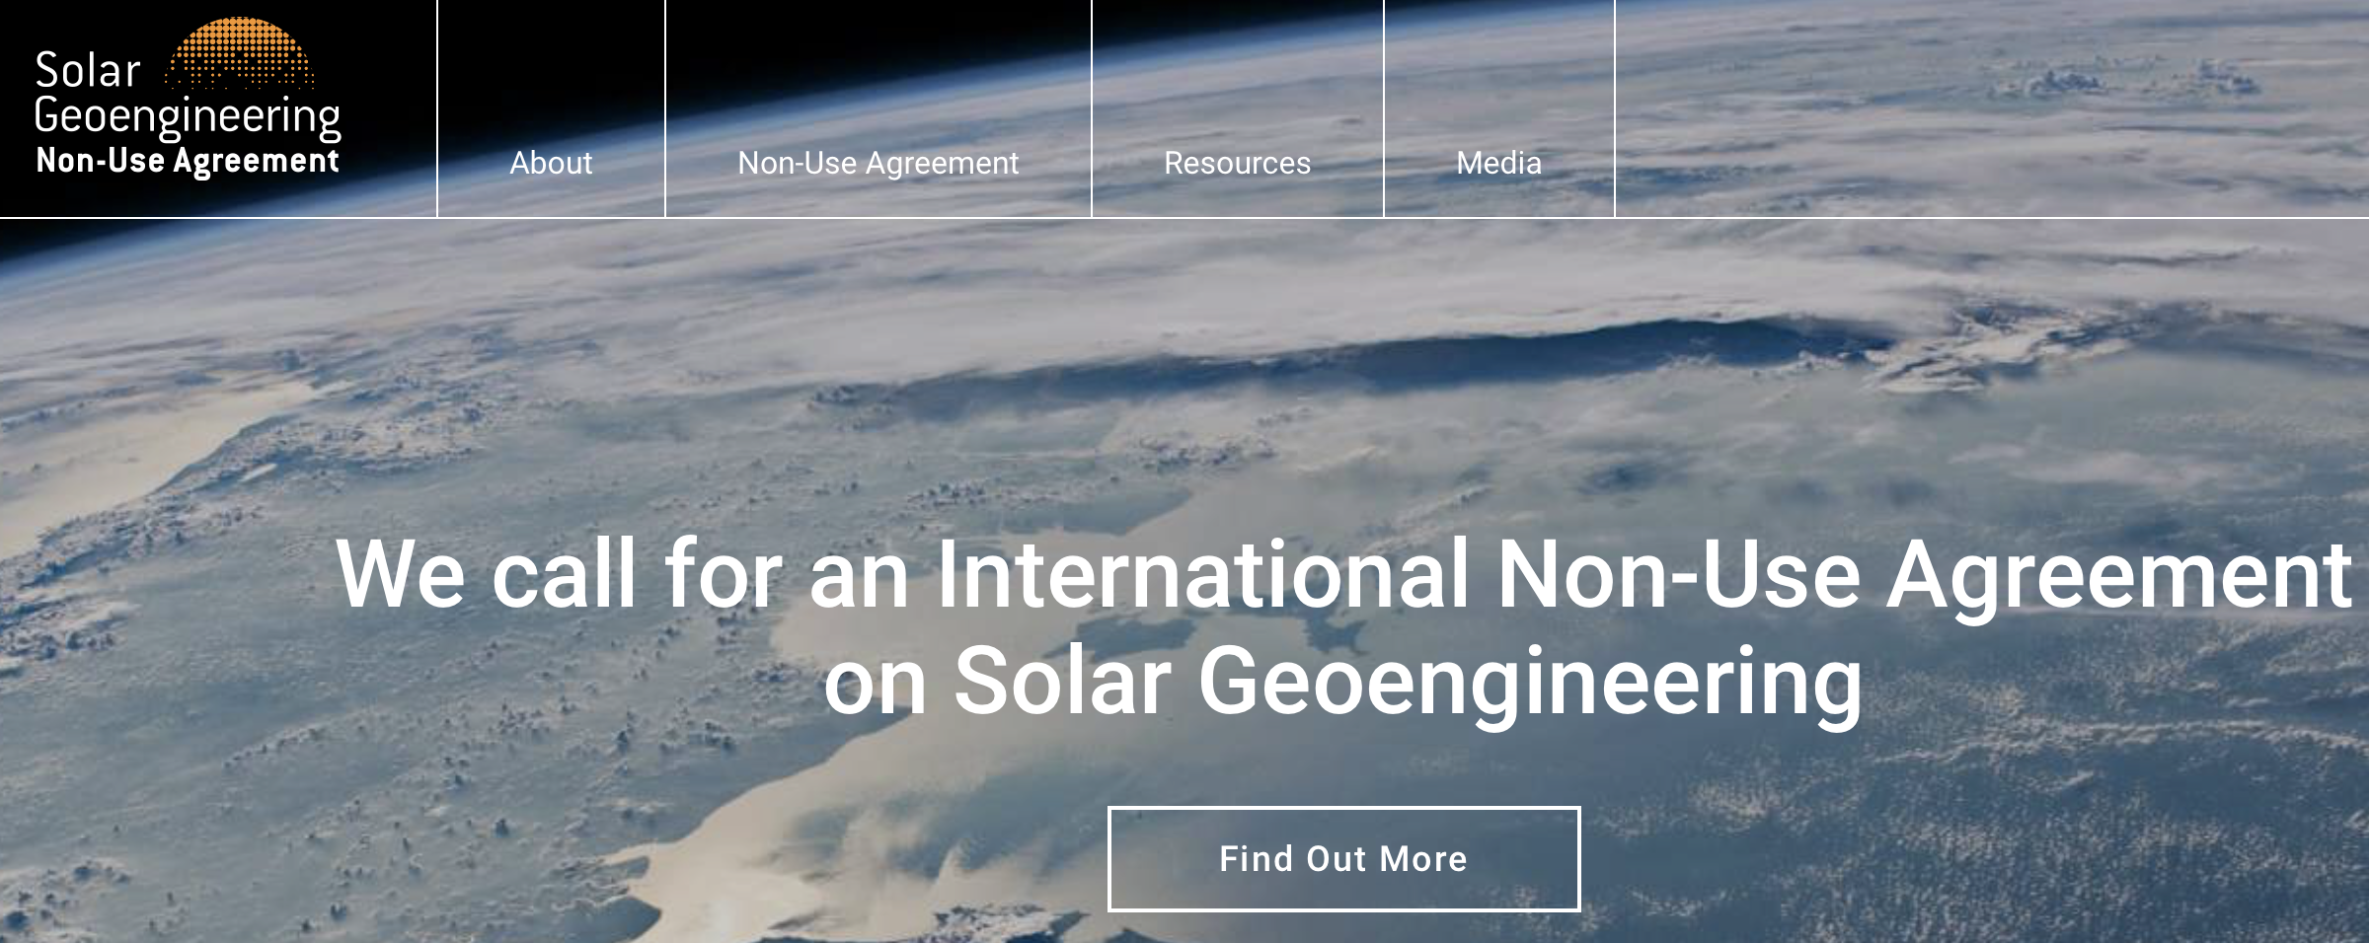
chemtrails

Slide 55
What can students and teachers do?
We don’t want to rely on something that won’t work
We don’t want to preemptively ban something that could save lives
Learn about this topic
Talk about it responsibly
Help make the truth rise above the noise

Slide 56
Things to keep in mind when teaching this
You can’t talk about climate engineering without talking about what it’s trying to solve: climate change.
Climate engineering could be an entry point to talking about climate change (see Lesson 1 – no content required).
Many of the “wild” ideas that people come up with are the same ideas the experts have been exploring.
You do not have to know everything, or even many things, to teach this topic. If you don’t know something, the experts probably don’t know either!
The physical science uncertainties are not the most important. The social implications of climate engineering are far more uncertain. You and your students know as much about these as anyone.

Slide 57
Agenda (1)
Agenda
40 mins: Lesson 1 Geoengineering Design
25 mins: What is & Why Teach Geoengineering? + Q&A
5 mins: BREAK
30 mins: Lesson 2 MCB Experiment Demo
& MCB Research
15 mins: Overview of Lessons 3-5
10 mins: Wrap-up + Q&A
Project Website: https://go.iu.edu/4BPh
(listed at the top of the first page in your binders)

Slide 58
Experiment with a Proposed Climate Engineering Technology (Marine Cloud Brightening)
Lesson 2 Objective

Slide 59
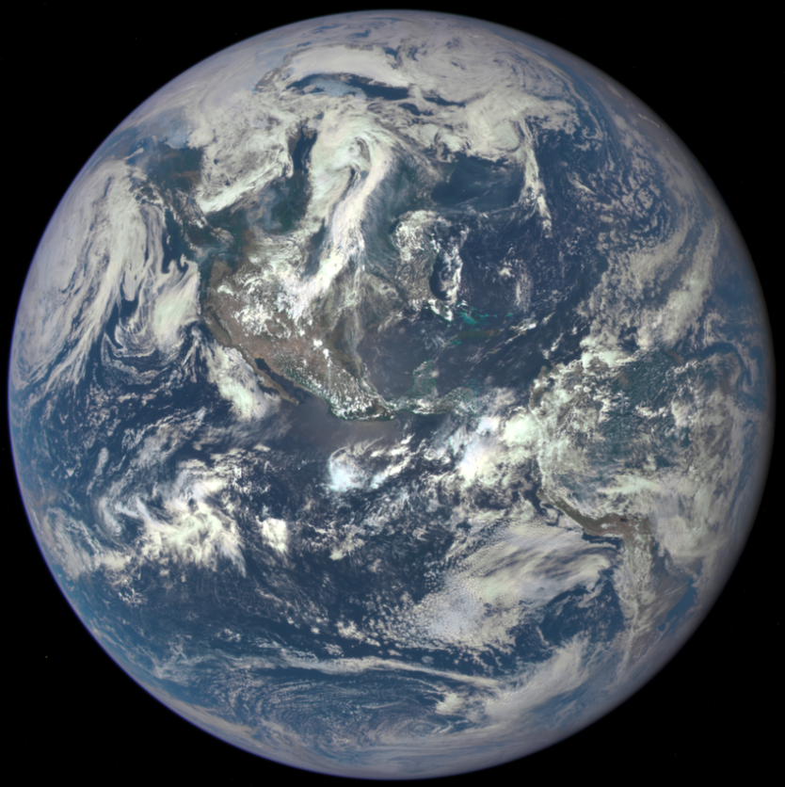
Albedo of Common Earth Surfaces
Image Credit: NASA

Slide 60
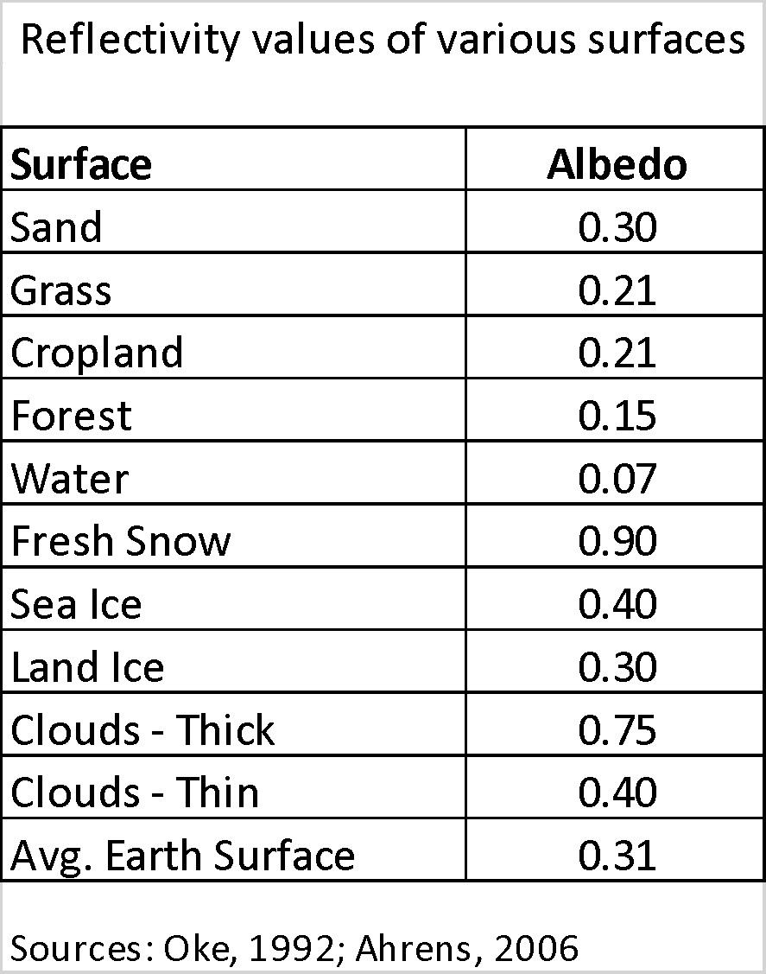
Albedo of Common Earth Surfaces (2)
Image Credit: NASA

Slide 61
Research Question:
Can we engineer brighter clouds?
Image Credit: NASA

Slide 62
Experimental Design & Methods How would you design an experiment to brighten clouds?

Slide 63
Question 1: Components of a Cloud
Vapor
Clouds are made from water vapor condensing on very small aerosol particles, called cloud condensing nuclei, or CCN.
Definition: An aerosol is simply a very small particle suspended in air

Slide 64
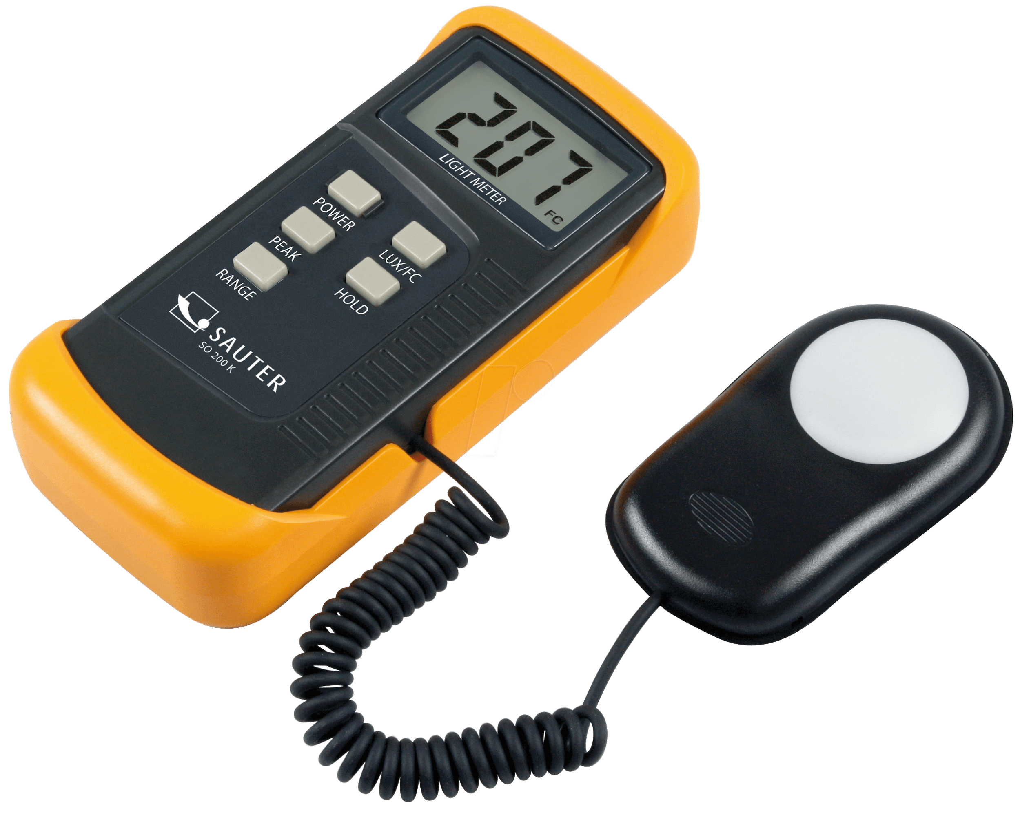
Experimental Design to Answer the Research Question:
Create a Cloud-in-a-Bottle and Vary the Cloud Components
Record the reflectance (brightness) of a cloud using a lux meter.

Slide 65
videos
https://drive.google.com/file/d/13gS2LMqGwDXbPaPAF9BQuCbdf51GzzHY/view?usp=sharing
https://drive.google.com/file/d/1sMgcZq1RiaCJkklNZEHtrNE0zPUUXXY3/view?usp=sharing
https://drive.google.com/file/d/18LpOGMESVKUkdocbuplMplV9J3-bphT7/view?usp=sharing
Experiment Video – Materials and Set-Up
Experiment Video – Low-aerosol trials
Experiment Video – High-aerosol trials
Also see Lesson Plan for scaffolding tips and teaching strategies!

Slide 66
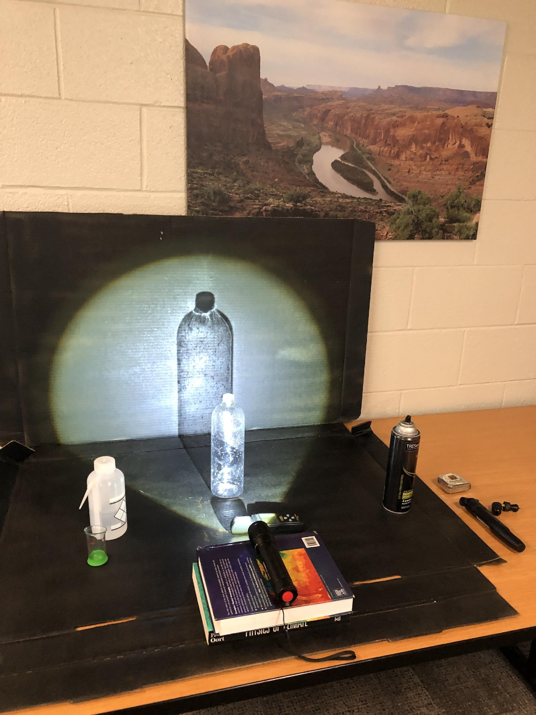
Experimental Design & Methods
Notes:
Gear-up: teachers can facilitate a discussion of about a experiment design here. What are the variables and constant? Which variable are we testing?

Slide 67
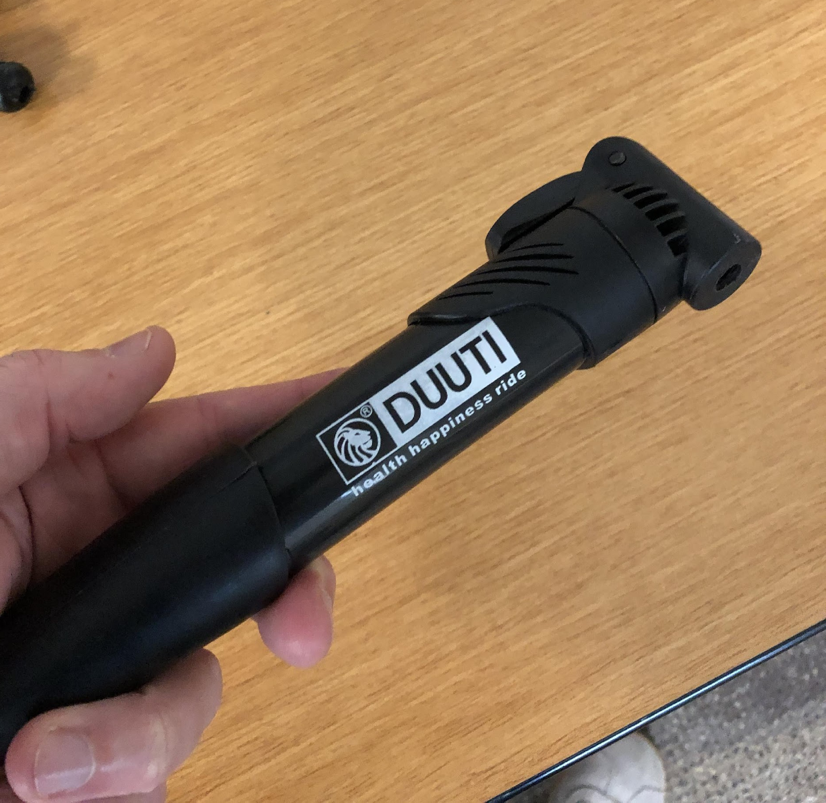
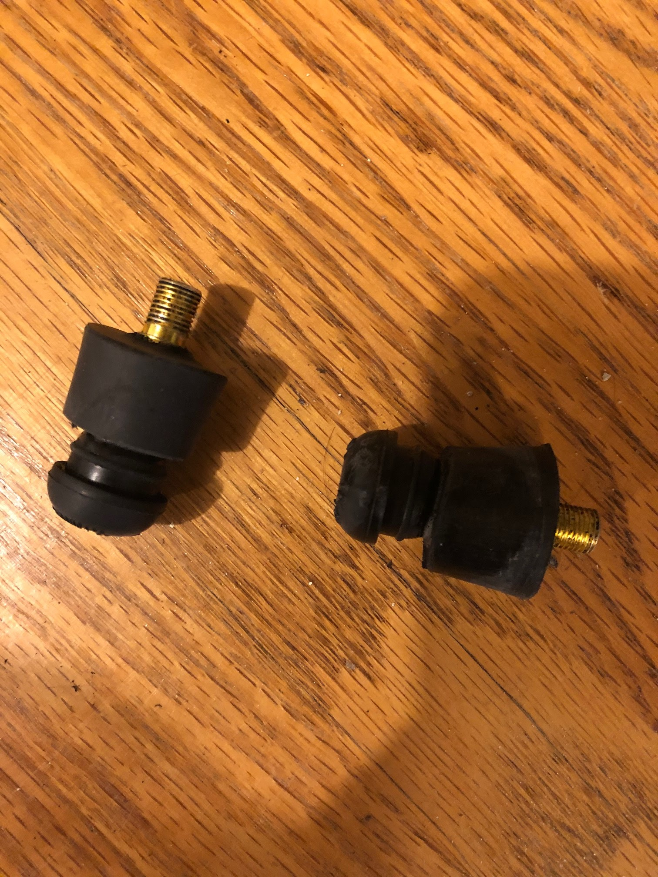
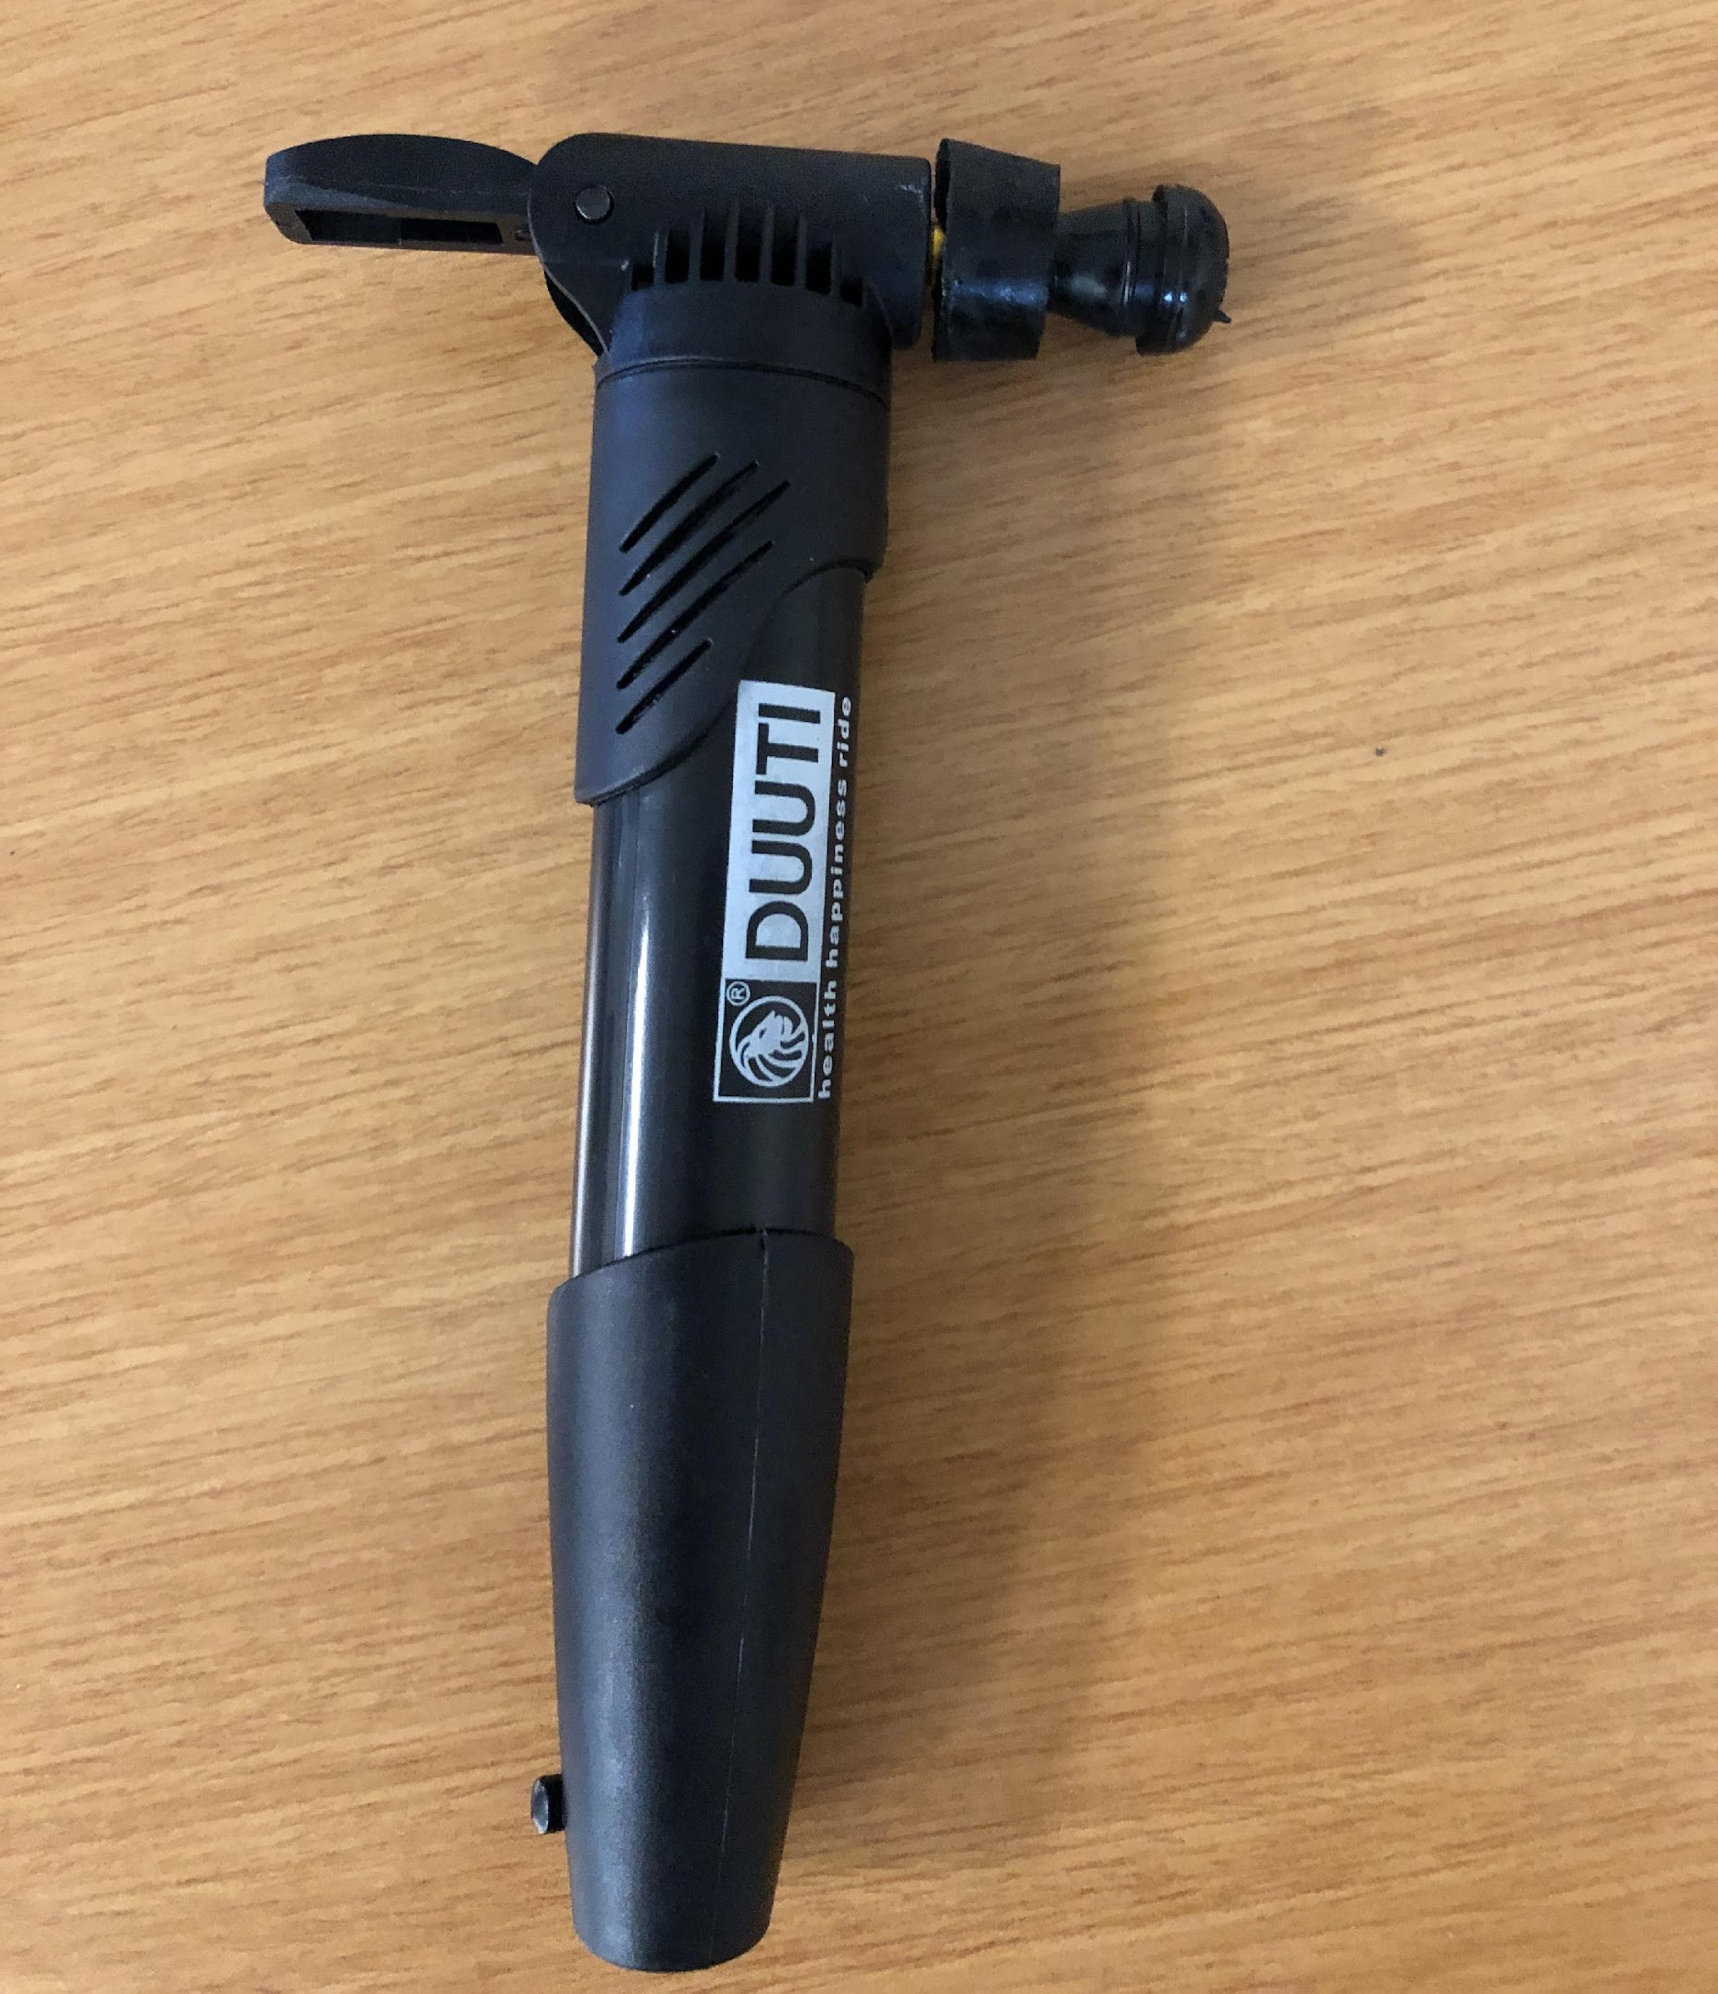
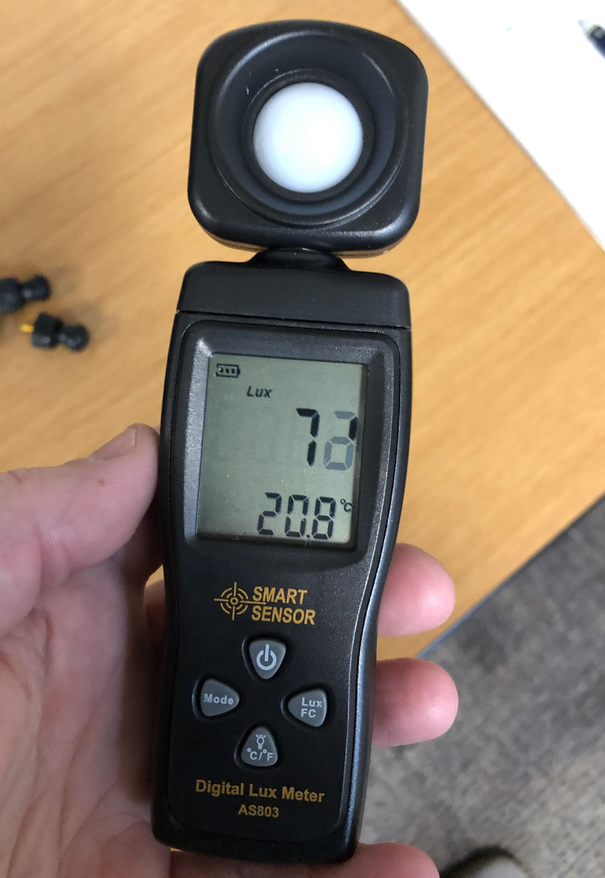
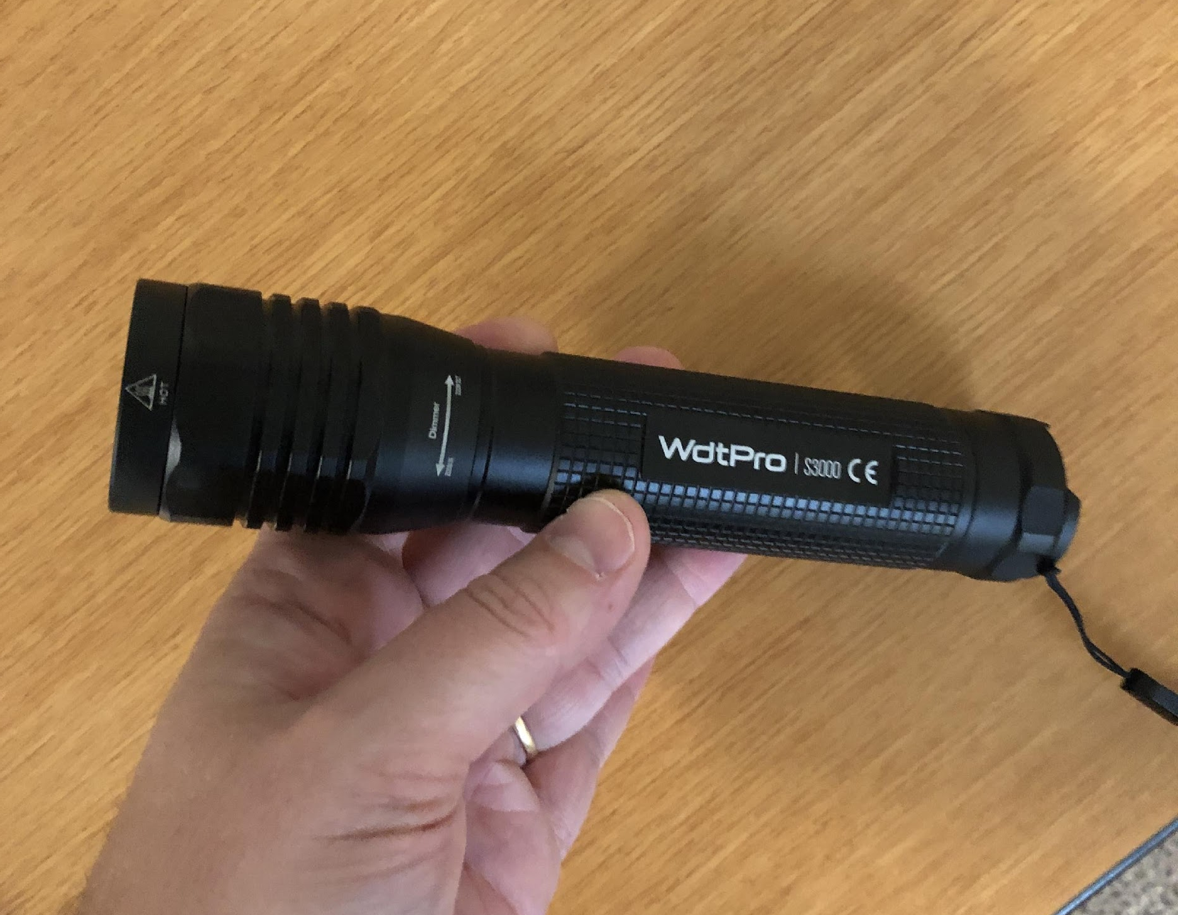
Materials and tools
Aerosol hairspray
Water & measurable units
Hand air pump
Picture of plug in the bottle
Clear 1-liter plastic bottles
Rubber stopper & valve plug
Light source
Picture of hand air pump with valve plug attached
Lux meter

Slide 68
Materials and tools (2)
Aerosol hairspray
Water & measurable units
Hand air pump
Picture of plug in the bottle
Clear 1-liter plastic bottles
Rubber stopper & valve plug
Light source
Picture of hand air pump with valve plug attached
Lux meter

Slide 69
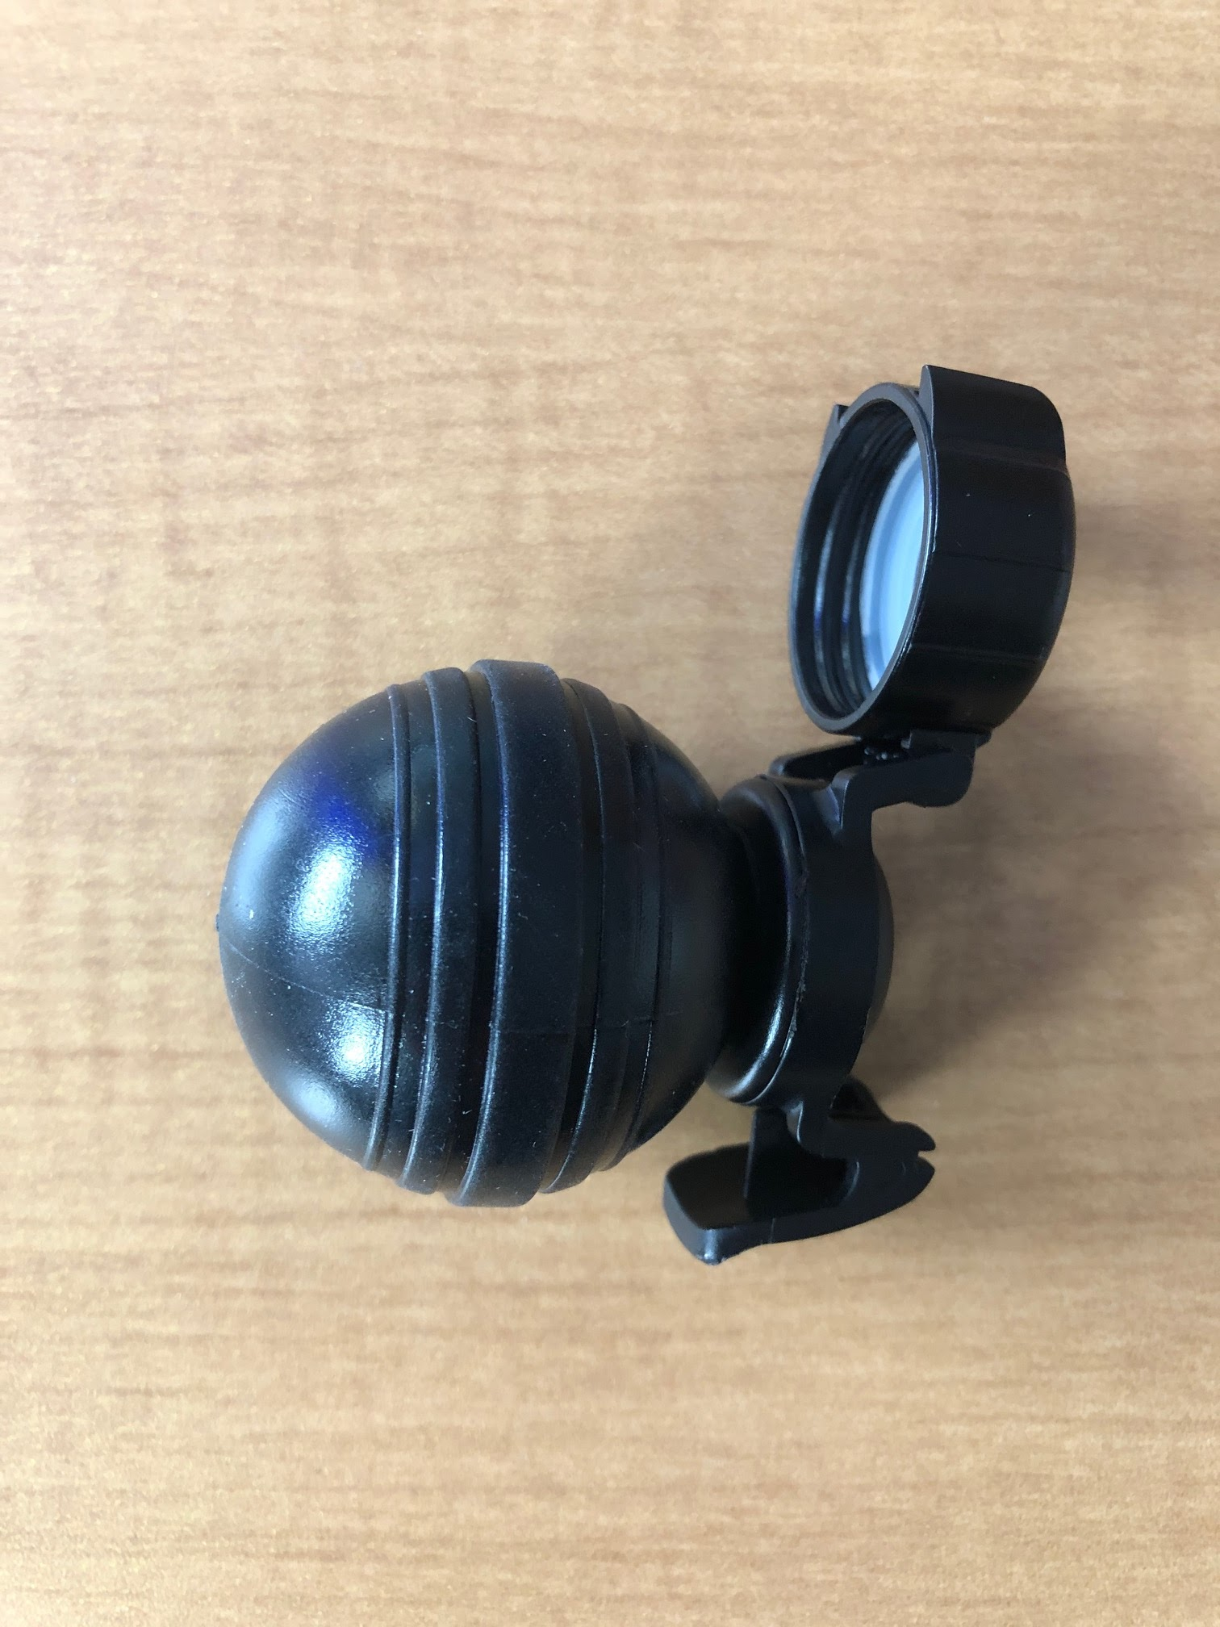
Materials and tools (3)
OR:
“Fizz Keeper”
Picture of fizz keeper on the bottle

Slide 70
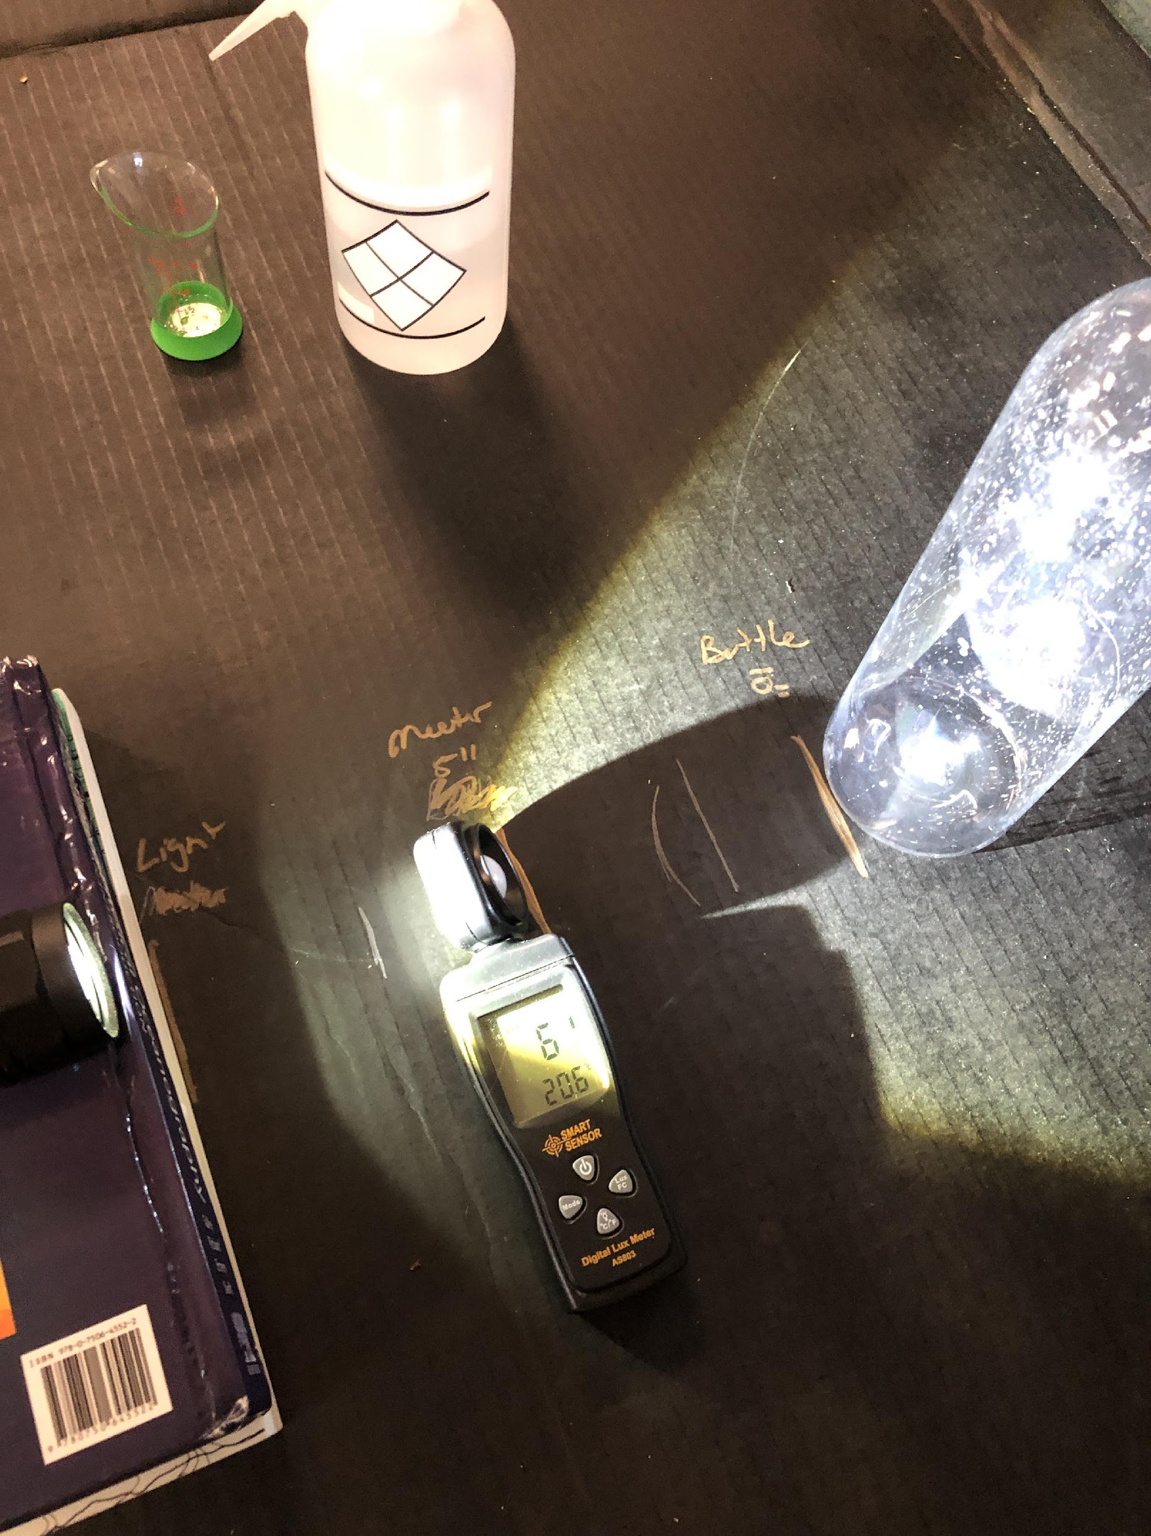
Setting up apparatus
15 by 15 by 15 set up
Set the flashlight 15 cm above surface
Set the lux meter 15 cm in front of light source, point sensor at the middle of the bottle
Set the plastic bottle 15 cm in front of the lux meter

Slide 71
Experiment One: Low-Aerosol Environment
Add 20 ml water to the bottle. Swish around to cover inner surface.
Spray 3 times with the aerosol hairspray into the bottle (Wear a mask).
Quickly cap with the rubber stopper and valve plug.
Use the air pump 15x (CAUTION – Do not over pressurize). OR: Use the “Fizz Keeper” and squeeze air into the bottle until you can not add any more air.
Immediately pull out the stopper or open the “Fizz Keeper” (make sure bottle remains 15 cm from lux meter).
And ….

Slide 72
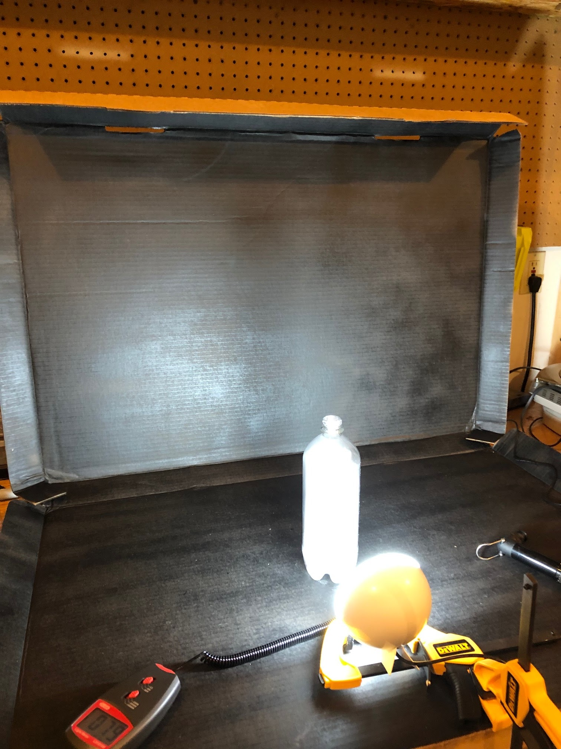
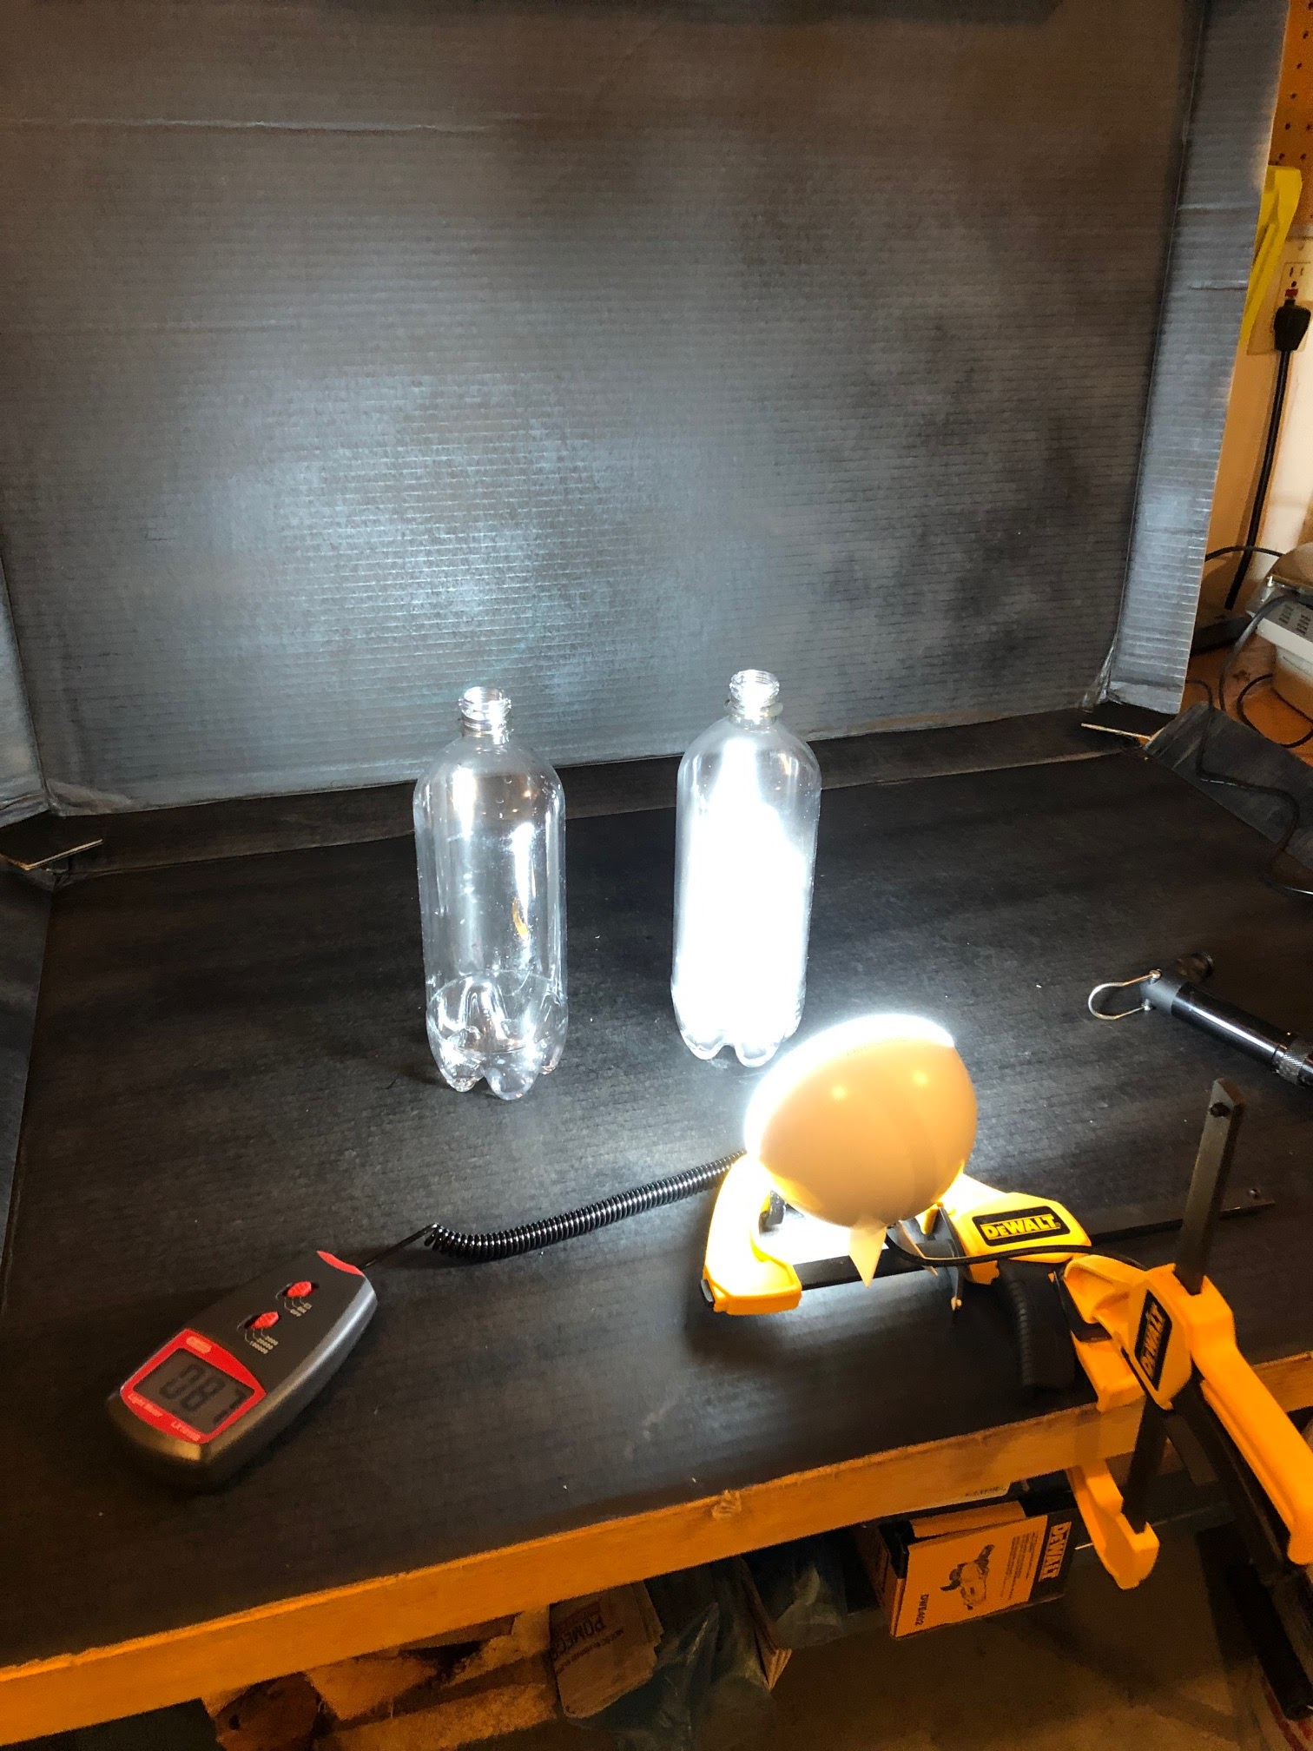
Experiment One: Low-Aerosol Environment (2)
… Clouds!
Capture the lux meter reading ASAP and record the value.
Wait until the cloud fully dissipates (1-2 minutes), record the lux meter reading
Repeat Experiment One for at least 4 trials (up to 10).

Slide 73
Record Data
Following the same procedure, run at least 4 trials for Experiment Two in which 10 sprays of hairspray are used.
Record the lux meter reading for each trial on the worksheet
Experiment One: Low-Aerosol Environment 3 Sprays of Hairspray
 | Lux Meter Reading (lx)
Trial # | Bottle w/ Cloud | Bottle w/o Cloud | Difference
1
2
3
4
5
6
7
8
9
10
Experiment Two: High-Aerosol Environment 10 Sprays of Hairspray
 | Lux Meter Reading (lx)
Trial # | Bottle w/ Cloud | Bottle w/o Cloud | Difference
1
2
3
4
5
6
7
8
9
10

Slide 74
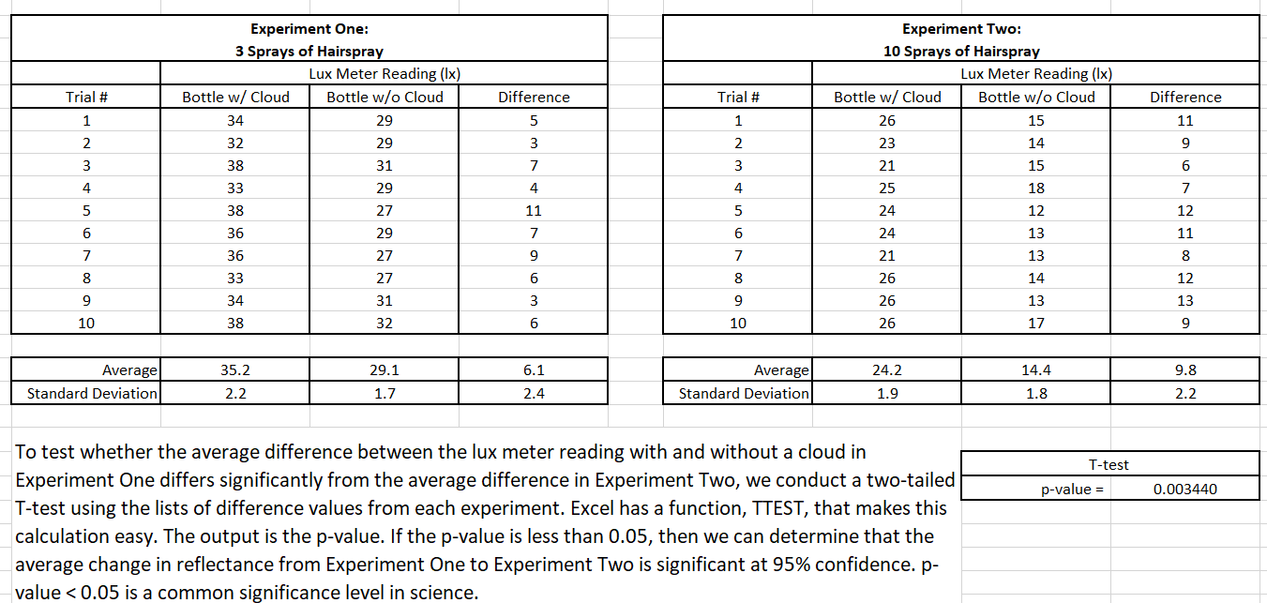
data

Slide 75
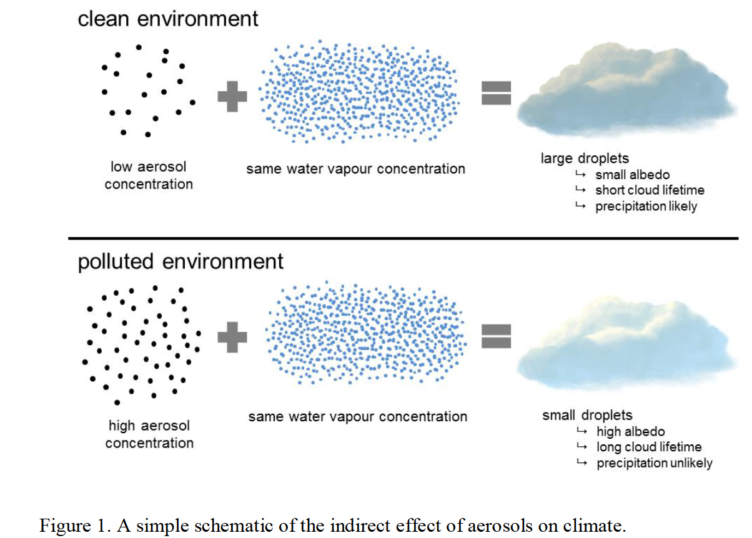
Review
The greater the number of cloud condensing nuclei (sea salt aerosols) the higher the cloud albedo, and thus greater reflectively of the cloud.
https://helda.helsinki.fi/bitstream/handle/10138/154682/lifecycl.pdf?sequence=1&isAllowed=y

Slide 76
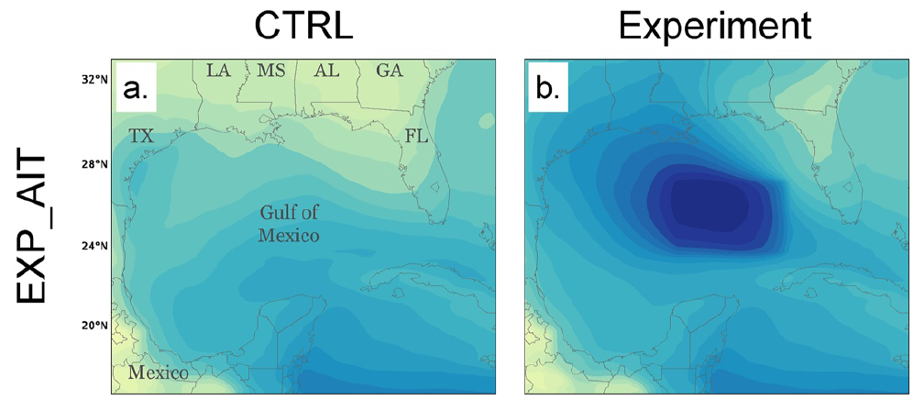
Sea Salt Aerosol Concentration
Goddard et al., 2022

Slide 77
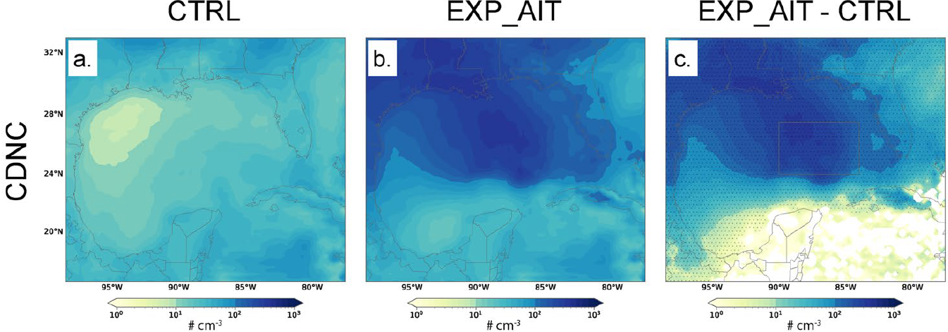
Cloud Droplet Number Concentration

Slide 78
Cloud Albedo

Slide 79
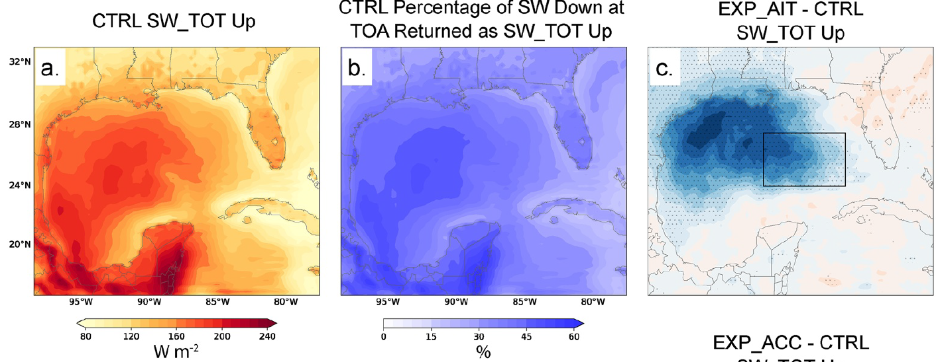
TOA Shortwave Radiative Response

Slide 80
Image about warming

Slide 81
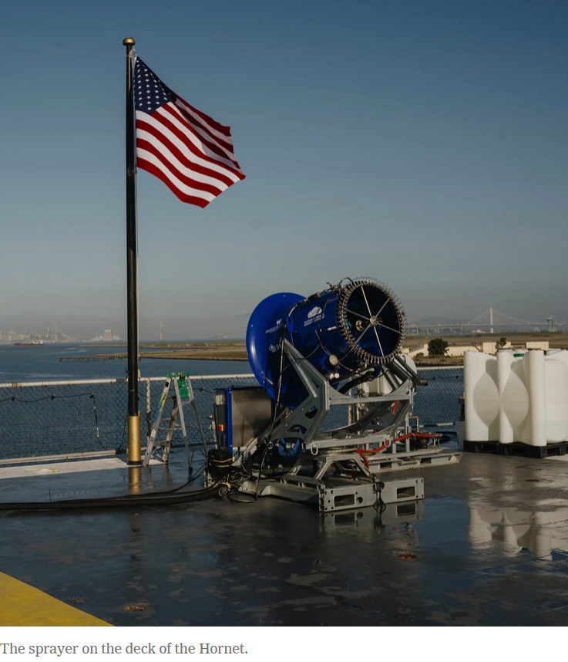
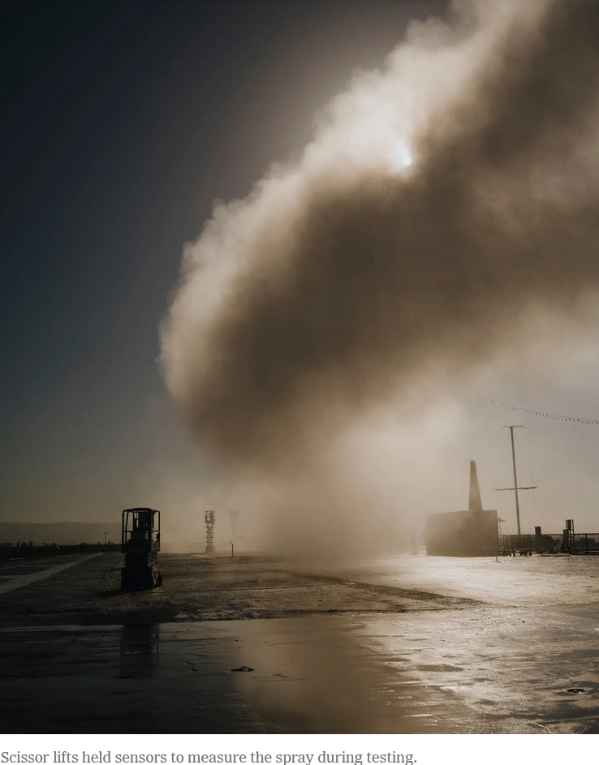
Images about warming

Slide 82
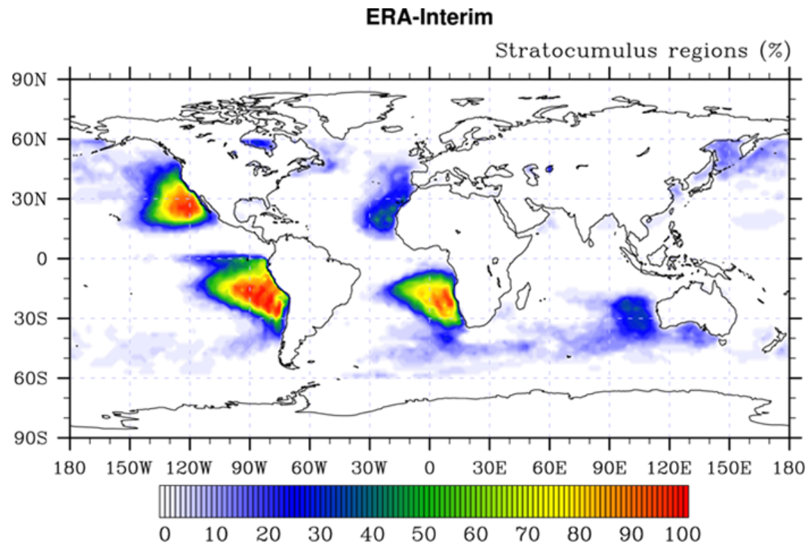
Stratocumulus regions
Neubauer et al., 2014

Slide 83
TRADEOFFS???
Neubauer et al., 2014

Slide 84
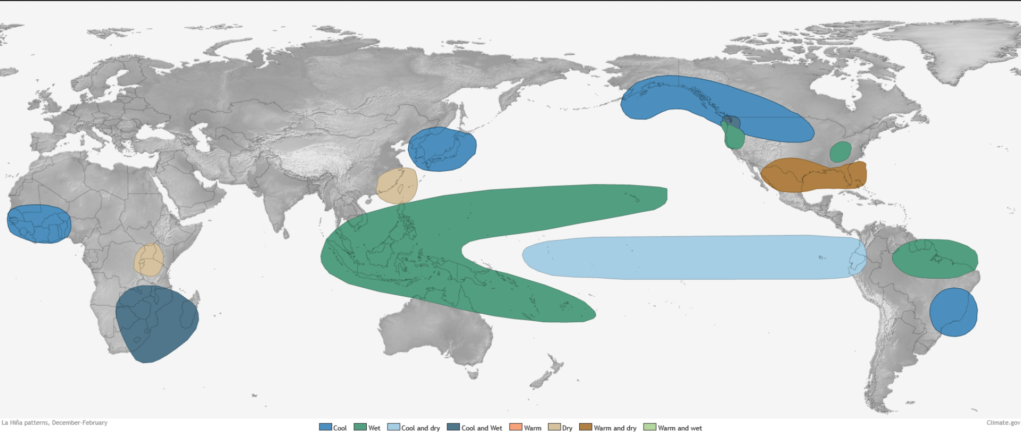
DJF La Niña Patterns

Slide 85
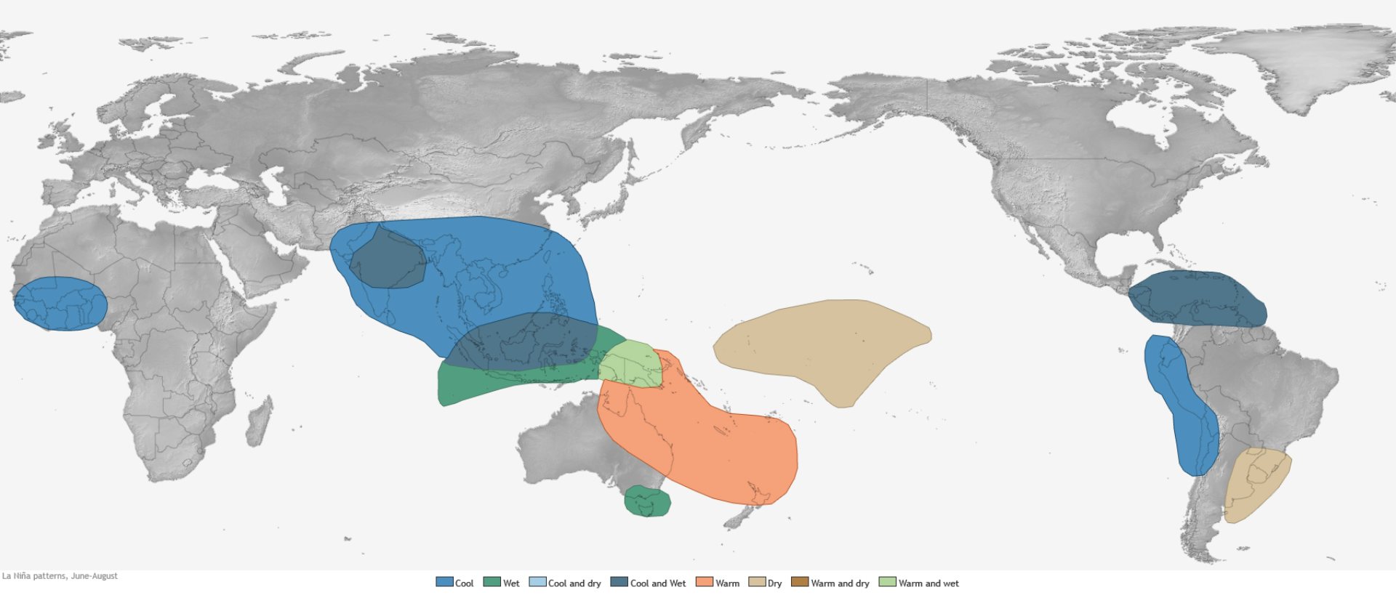
JJA La Niña Patterns

Slide 86
Stratocumulus regions (2)
Neubauer et al., 2014

Slide 87
Lesson 1: Collaborative Geoengineering Design Activity Lesson 2: Experiment with a Geoengineering Technology (MCB) Lesson 3: Develop a Blueprint of your Design Lesson 4: Model U.N. Lesson 5: Capstone Presentation to Scientists and Stakeholders
Climate Engineering Teaching Module

Slide 88
Lesson 3: Developing a Blueprint

Slide 89
Use the Decision Matrix to help decide which design to further develop. Can you combine features from multiple designs to better meet the criteria? Provide feedback to group members.
Criteria to Consider when Selecting and Revising your Designs | Score 1-5
How well does your design slow global warming and/or climate change? (1 - not well, 5 - very well)
Does your technology modify or work with an environmental system? (1 - does not, 5 - perfect match)
What is the cost of your technology (consider materials, resources, and upkeep)? (1 - high cost, 5 - low cost)
Does your design scale well (can you test your technology on a small-scale, then expand to large-scale deployment)? (1 - not well, 5 - very well)
Rate the amount of unintended negative consequences of deploying your technology? (1 - many, 5 - few)
Is your design unique? (1 – other students have similar designs, 5 – it’s one-of-a-kind!)
Total (max 30 points)

Slide 90
Create an Engineering Blueprint
The UH-72 performs logistics and support missions within the US for homeland security, disaster response missions, and medical evacuations.
Twin Engines
Main Rotor
Checklist
Title
A descriptive subtitle
Drawings from at least
two perspectives
Label & a Table of features
Label & a Table of the size
Meets all criteria
11’4’’
36’1’’
Cockpit
42’9’’
Tail Rotor
Landing Skids
https://www.bluemoonpatentprints.com

Slide 91
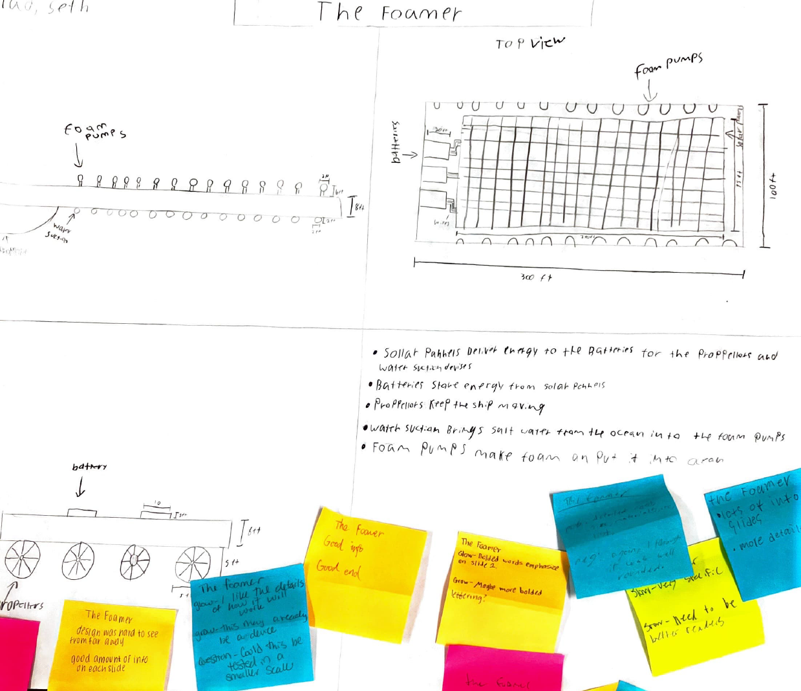
Final Product
Examples from Bloomington South Earth Science Students:

Slide 92
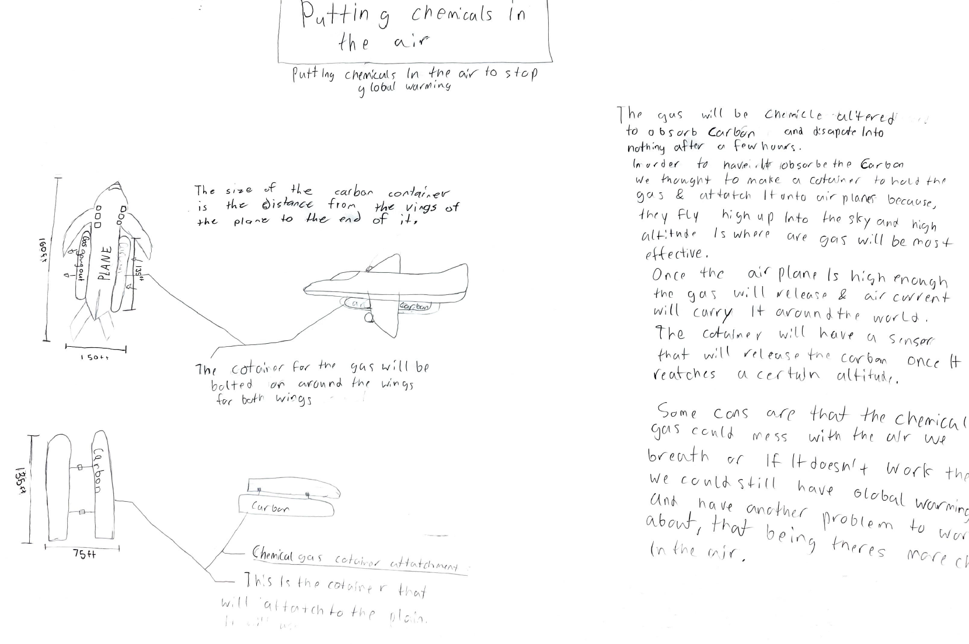
Final Product (2)
Examples from Bloomington South Earth Science Students:

Slide 93
Lesson 4: Model UN

Slide 94
Background Statement
The year is 2030. Climate change has been getting steadily worse, and nations around the world are feeling its effects. The Secretary General of the United Nations has called a summit to discuss whether the world should start a trial run of climate engineering. Representatives from six nations have traveled to the UN to begin negotiations. If they agree that deployment should start, it will begin in 2035, which is around the time global average temperature will be 1.5°C (nearly 3°F) warmer than in the preindustrial era.

Slide 95
Background Statement (2)
The year is 2030. Climate change has been getting steadily worse, and nations around the world are feeling its effects. The Secretary General of the United Nations has called a summit to discuss whether the world should start a trial run of climate engineering. Representatives from six nations have traveled to the UN to begin negotiations. If they agree that deployment should start, it will begin in 2035, which is around the time global average temperature will be 1.5°C (nearly 3°F) warmer than in the preindustrial era.
6 nations with differing interests, wealth, agendas, and potential impacts from climate engineering
3 unexpected events occur during the meeting

Slide 96
Disruptive statements
Angosia’s capital city is hit by a hurricane that caused widespread power outages and water shortages. Scientists conclude that this would not have happened in the absence of climate change. The government of Angosia releases a statement declaring Florin partly responsible because of its long history of fossil fuel use.
A right-wing think tank from Guilder releases a statement that due to advancements in infrastructure from major manufacturers in Guilder, Tanoa can be kept inhabitable and thriving for at least another 50 years.
Impatient with the slow pace of the negotiations, the Prime Minister of Durhan (who is not at the UN this week) announces that Molvania has been secretly helping them develop climate engineering technology. Durhan plans to deploy climate engineering in 2040, which he calls “A Durhanese Solution to a global problem”, with or without support from the UN.

Slide 97
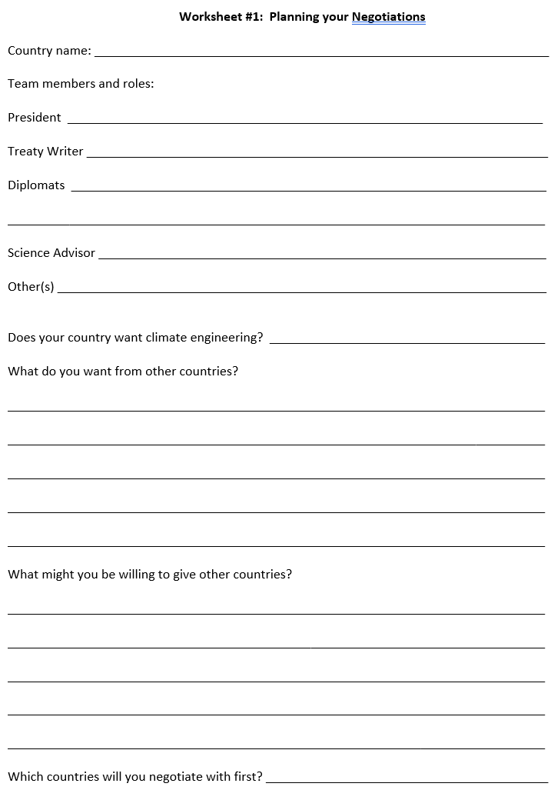
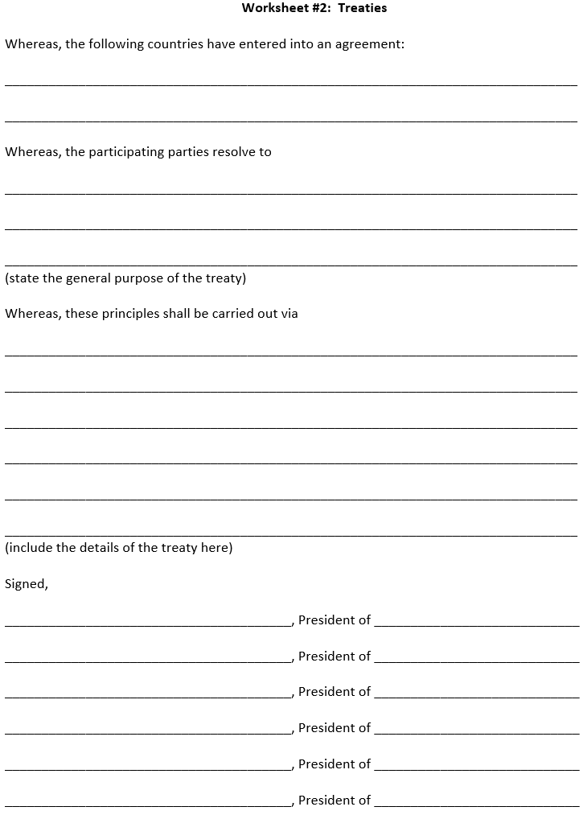
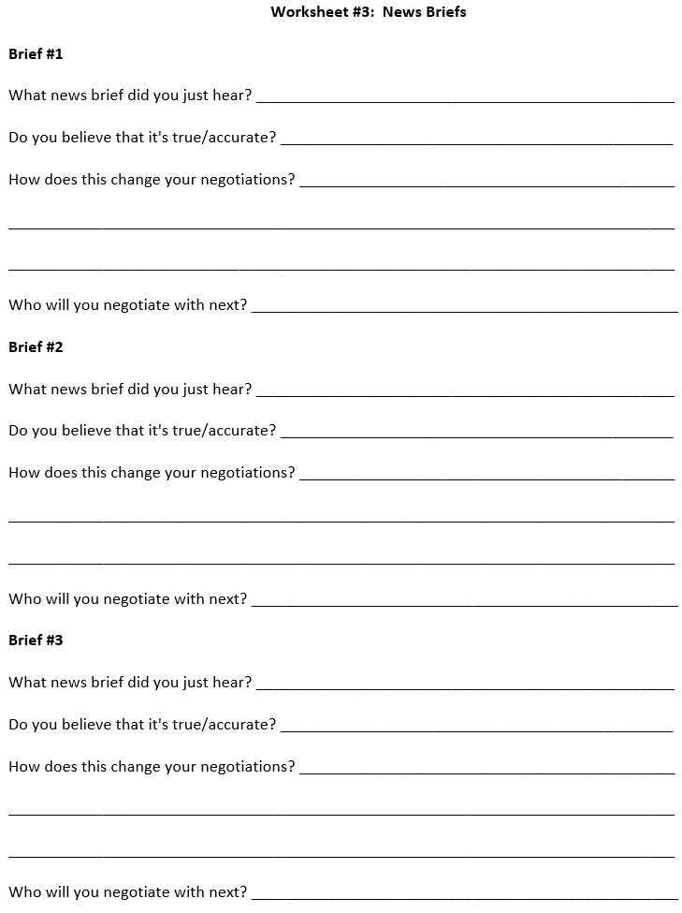
Supporting Documents

Slide 98
Outcomes
The science is important, but it's not the only thing
People really internalize the exercise because they take ownership
Encourages creativity (we do not provide every detail)

Slide 99
Lesson 5: Capstone Presentation

Slide 100
Purpose
Students will present their climate engineering design to an audience consisting of climate scientists, engineers, stakeholders, and/or policymakers.
Engineers and scientists give presentations of their work to a wide variety of audiences.
This task challenges the students to take their work outside of the classroom, to communicate their designs to a new audience, and to gather feedback from new sources.

Slide 101
Presentation Template
Each group selects one technology to present.
Student 1: Presents the blueprint, features, size, materials and costs
Student 2: Describes how the technology will function to slow global warming and/or climate change
Student 3: Limitations of the design? Regional or Global solution to warming and climate change? Long- or short-term solution?
Student 4: Who benefits? What are the unintended consequences and risks?
Student 5: How should this technology be deployed? By whom? When? Who pays?

Slide 102
Students will learn:
Physical science is just one aspect of climate change
Climate engineering could help slow global warming
Variety of knowledge and skills are needed (climate science and engineering are important, but not exclusive)

Slide 103
Lesson 1: Collaborative Design Activity Lesson 2: Experiment with a Geoengineering Technology Lesson 3: Develop a Blueprint of your Design Lesson 4: Model U.N. Lesson 5: Capstone Presentation to Stakeholders
Climate Engineering Teaching Module
Join us for a workshop in the Fall (date TBD, usually October)!
All Materials are included (lesson plans, worksheets, PPT presentations, experiment materials, teacher resources)
Need to borrow materials? Email pgoddard@iu.edu

Slide 104
Questions/Comments/Thoughts/Ideas welcome!
Implementation barriers? How can we help?
Paul Goddard pgoddard@iu.edu
Ben Kravitz bkravitz@iu.edu
Adam Scribner

