Slide 1
Climate Engineering Teaching Module Lesson 3 – Climate Engineering Design
Ben Kravitz¹, Paul Goddard¹, and Adam Scribner² 1.Department of Earth and Atmospheric Sciences 2. The School of Education
INDIANA UNIVERSITY

Slide 2
Select and Revise your Climate Engineering Technology
Objective

Slide 3
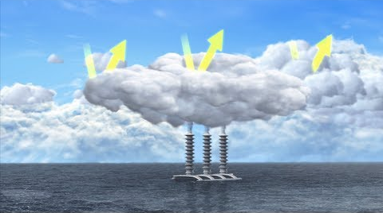
Climate Engineering:
Marine Cloud Brightening
Review
https://www.youtube.com/watch?v=cgJyw2cTrW4

Slide 4
Features
Review
Climate Engineering:
Marine Cloud Brightening
Utilizes environmental systems (clouds and seawater)
Works to reduce global warming by brightening clouds in order to reflect incoming solar radiation
A relatively inexpensive technology that can be scaled from local- to global-scale
https://www.youtube.com/watch?v=cgJyw2cTrW4

Slide 5
Review
Limitations:
Cost
Preferred ocean environment (low clouds, low background aerosols, far from land)
Will greatly benefit from global cooperation and support
Does not address increasing atmospheric greenhouse gases nor ocean acidification
Risks:
Regional to global changes in precipitation amounts and patterns
Regional changes to atmospheric and oceanic chemistry
Impacts on biology and ecosystems
Potential for rapid change if abruptly terminated

Slide 6
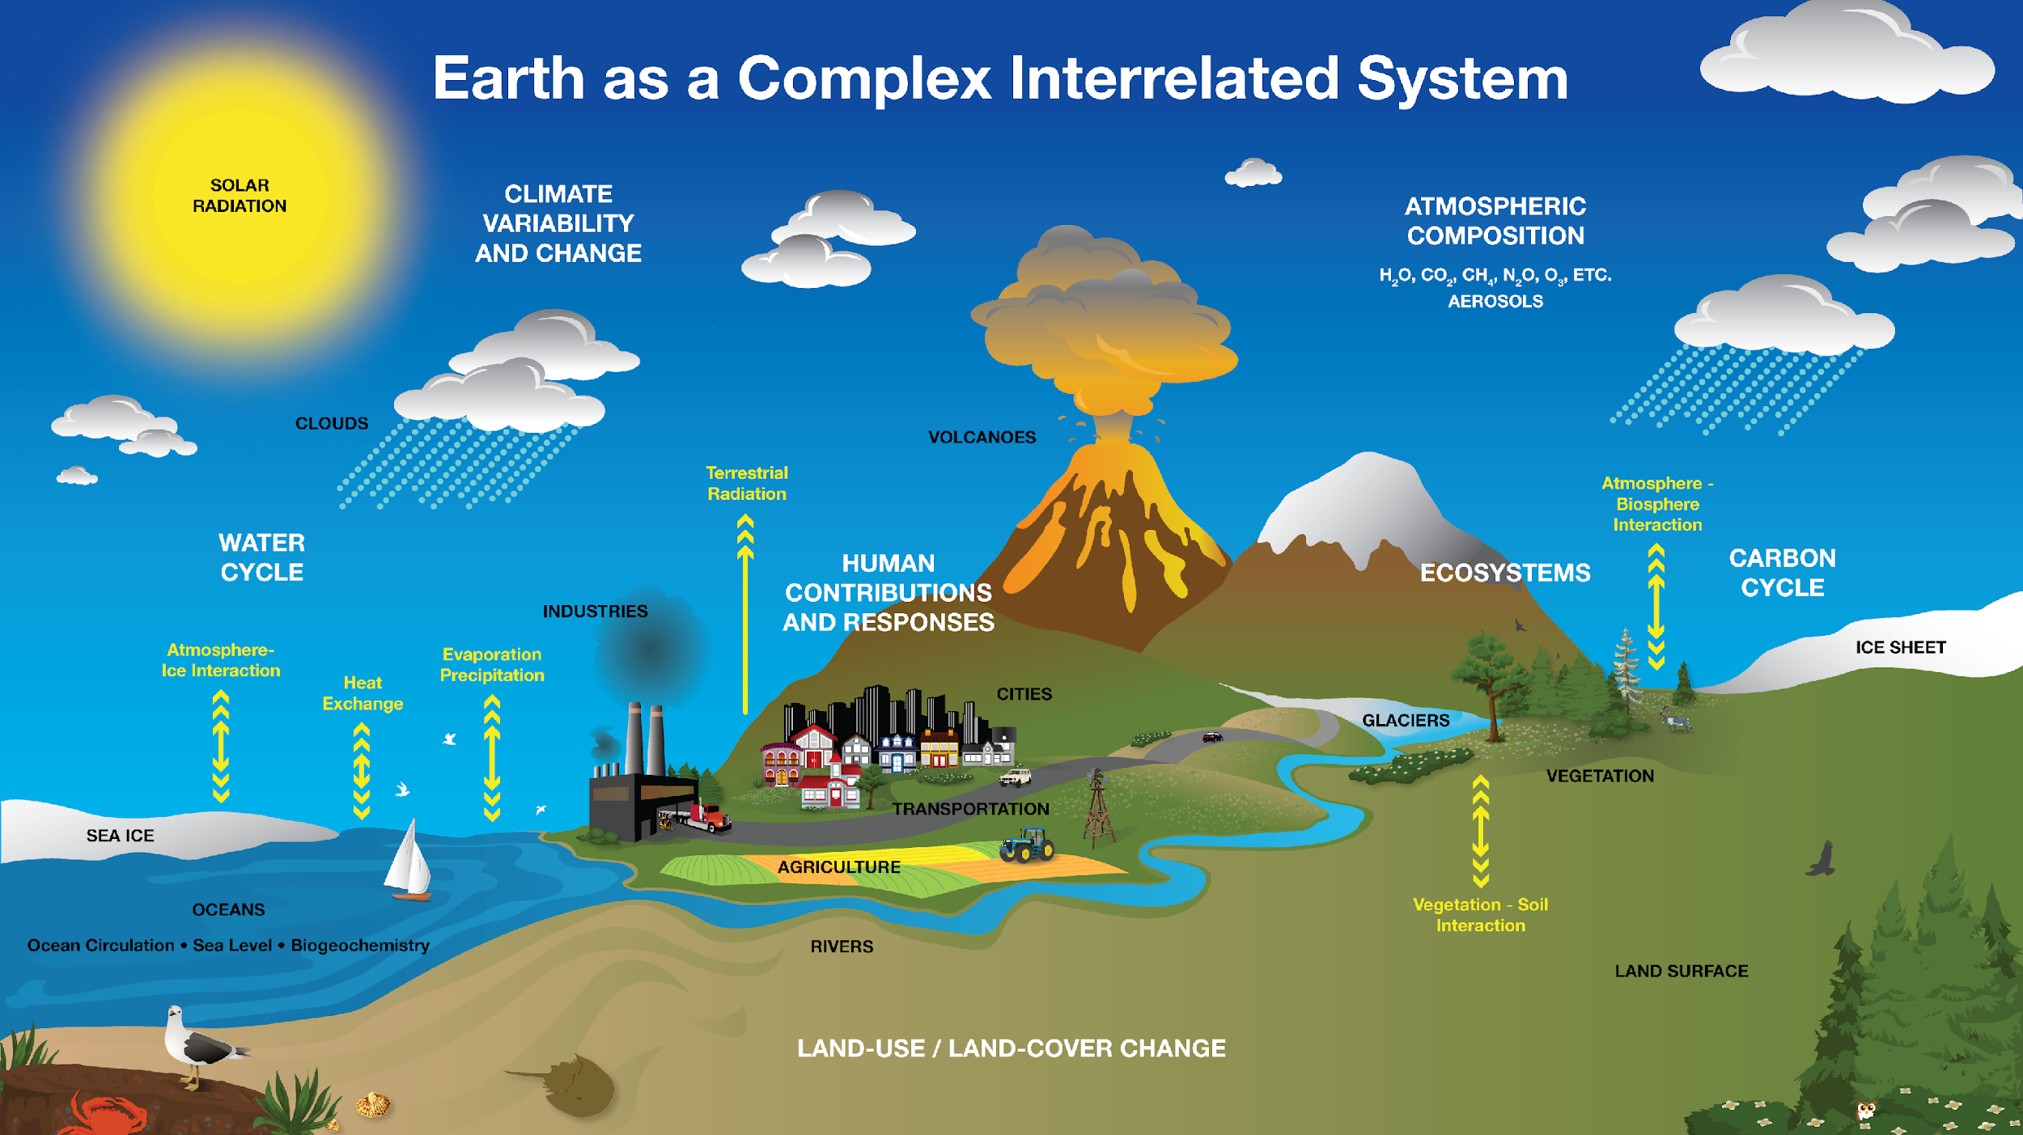
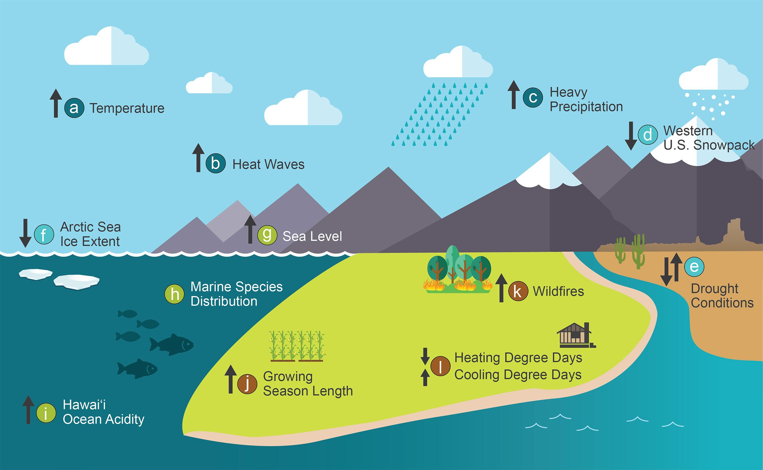
Revisit your three climate engineering designs.
NASA
How well do your designs modify environmental systems in order to slow global warming and/or climate change?
NCA4

Slide 7
Use the Decision Matrix to help decide which of your designs to further develop. Can you combine features from multiple designs to better meet the criteria? Provide feedback to your group members.
Criteria to Consider when Selecting and Revising your Designs | Score 1-5
How well does your design slow global warming and/or climate change? (1 - not well, 5 - very well)
Does your technology modify or work with an environmental system? (1 - does not, 5 - perfect match)
What is the cost of your technology (consider materials, resources, and upkeep)? (1 - high cost, 5 - low cost)
Does your design scale well (can you test your technology on a small-scale, then expand to large-scale deployment)? (1 - not well, 5 - very well)
Rate the amount of unintended negative consequences of deploying your technology? (1 - many, 5 - few)
Is your design unique? (1 – other students have similar designs, 5 – it’s one-of-a-kind!)
Total (max 30 points)

Slide 8
Create an Engineering Blueprint
Objective

Slide 9
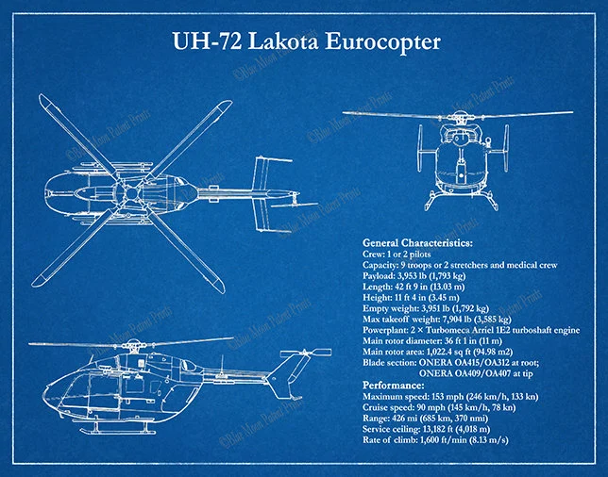
Final Product
The UH-72 performs logistics and support missions within the US for homeland security, disaster response missions, and medical evacuations.
Create an Engineering Blueprint
Twin Engines
Main Rotor
11’4’’
36’1’’
Cockpit
42’9’’
Tail Rotor
Landing Skids
https://www.bluemoonpatentprints.com

Slide 10
Final Product (cont)
The UH-72 performs logistics and support missions within the US for homeland security, disaster response missions, and medical evacuations.
Create an Engineering Blueprint
Twin Engines
Main Rotor
Checklist
Title
A descriptive subtitle
Drawings from at least
two perspectives
Label & a Table of features
Label & a Table of the size
Meets all criteria
11’4’’
36’1’’
Cockpit
42’9’’
Tail Rotor
Landing Skids
https://www.bluemoonpatentprints.com

Slide 11
This lesson develops the students’ engineering blueprints to meet specific criteria and considerations. In the next lesson we will conduct a Model U.N. to debate the deployment of Climate Engineering
Prepare for Lesson 4

Slide 12
Questions/Comments/Thoughts/Ideas welcome!
Ben Kravitz bkravitz@iu.edu
Paul Goddard pgoddard@iu.edu
Adam Scribner

