Slide 1
Climate Engineering Teaching Module Lesson 2 – Cloud in a Bottle Experiment
Ben Kravitz¹, Paul Goddard¹, and Adam Scribner² 1. Department of Earth and Atmospheric Sciences 2. The School of Education
INDIANA UNIVERSITY

Slide 2
Question 1: What are the main components of a cloud?
Pre-Experiment

Slide 3
Clouds are made from water vapor condensing on very small aerosol particles, called cloud condensing nuclei, or CCN.
Definition: An aerosol is simply a very small particle suspended in air
Question 1: Components of a Cloud
Vapor

Slide 4
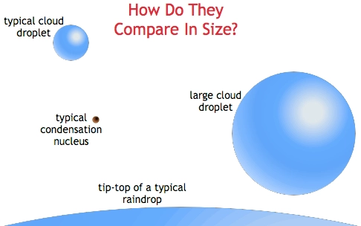
Question 1: Components of a cloud
Clouds are made from water vapor condensing on very small aerosol particles, called cloud condensing nuclei, or CCN.
Definition: An aerosol is simply a very small particle suspended in air
https://blogs.agu.org/wildwildscience/files/2014/04/droplets1.jpg

Slide 5
Question 2: What is albedo?
Pre-Experiment
Scientists defined the term albedo to quantify the percentage of incoming sunlight that is reflected by an object. For example, viewed from space the Earth has an albedo of about 0.30, meaning that 30% of incoming sunlight is reflected back to space. Given this information, what do you think is the albedo of a forest, of the ocean, of a desert, of snow, of a cloud?

Slide 6
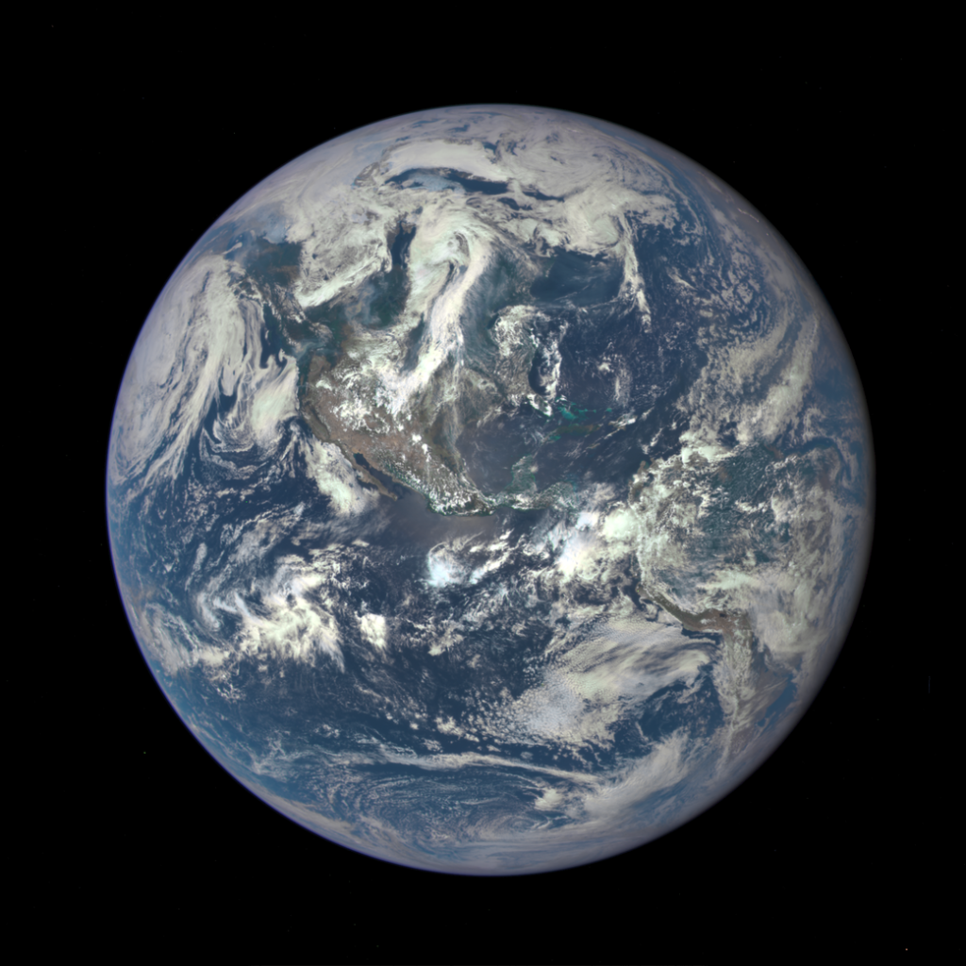
Question 2: Albedo of Common Earth Surfaces
Image Credit: NASA

Slide 7
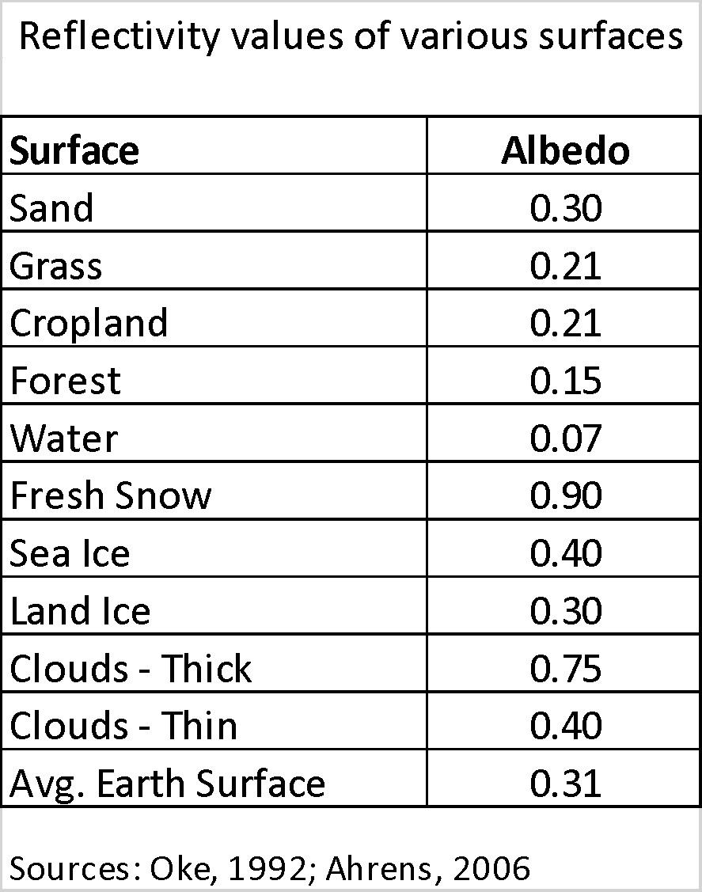
Question 2: Albedo of Common Earth Surfaces (continued)
Image Credit: NASA

Slide 8
Research Question:
Can we engineer brighter clouds?
Image Credit: NASA

Slide 9
Research Question:
Can we engineer brighter clouds?
Answer Question 3 in Worksheet
Image Credit: NASA

Slide 10
Experimental Design & Methods

Slide 11
Experimental Design & Methods How would you design an experiment to brighten clouds?

Slide 12
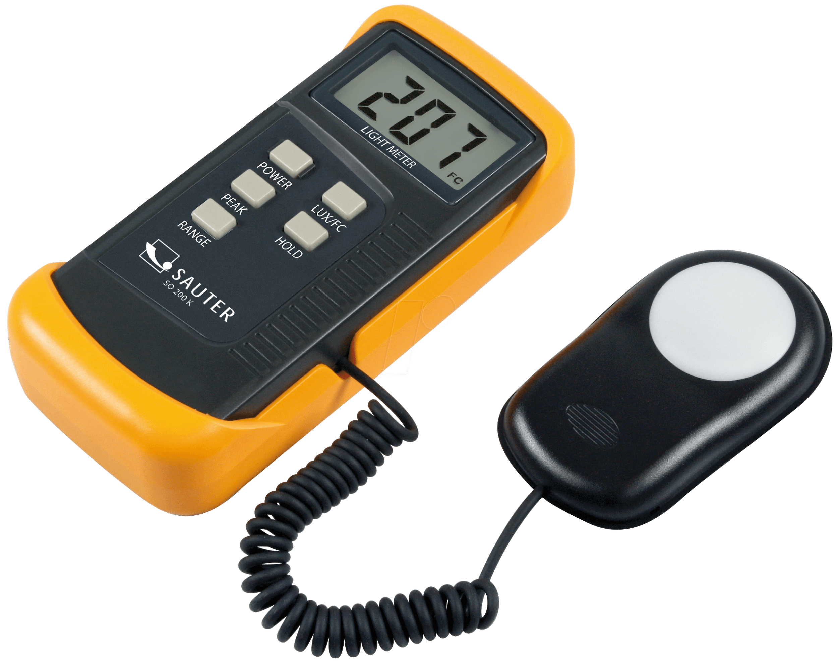
Experimental Design to Answer the Research Question:
Create a Cloud-in-a-Bottle and Vary the Cloud Components
Record the reflectance (brightness) of a cloud using a lux meter.

Slide 13
Experiment Videos
Experiment Video – Materials and Set-Up
https://drive.google.com/file/d/13gS2LMqGwDXbPaPAF9BQuCbdf51GzzHY/view?usp=sharing
https://drive.google.com/file/d/1sMgcZq1RiaCJkklNZEHtrNE0zPUUXXY3/view?usp=sharing
Experiment Video – Low-aerosol trials
Experiment Video – High-aerosol trials
https://drive.google.com/file/d/18LpOGMESVKUkdocbuplMplV9J3-bphT7/view?usp=sharing

Slide 14
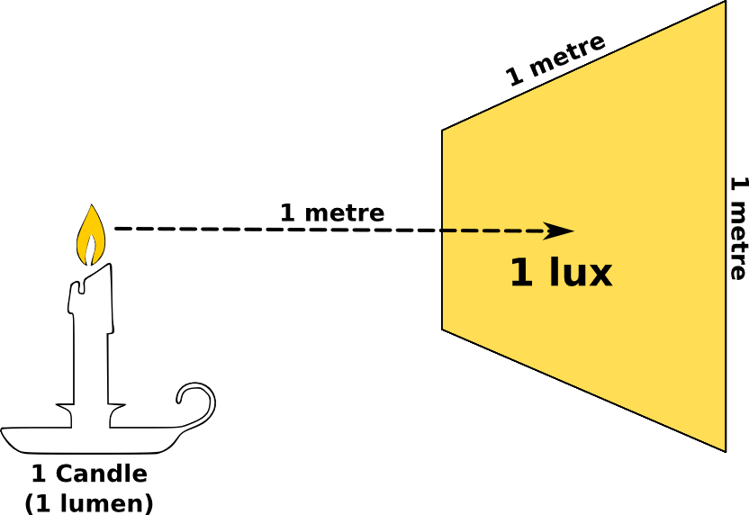
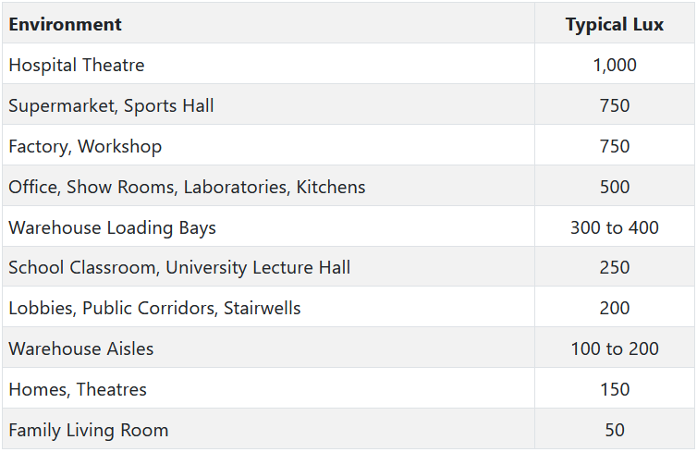
What is a lux?
A measurement of 1 lux is equal to the illumination of a one-meter square surface that is one meter away from a single candle.
https://greenbusinesslight.com/resources/lighting-lux-lumens-watts/

Slide 15
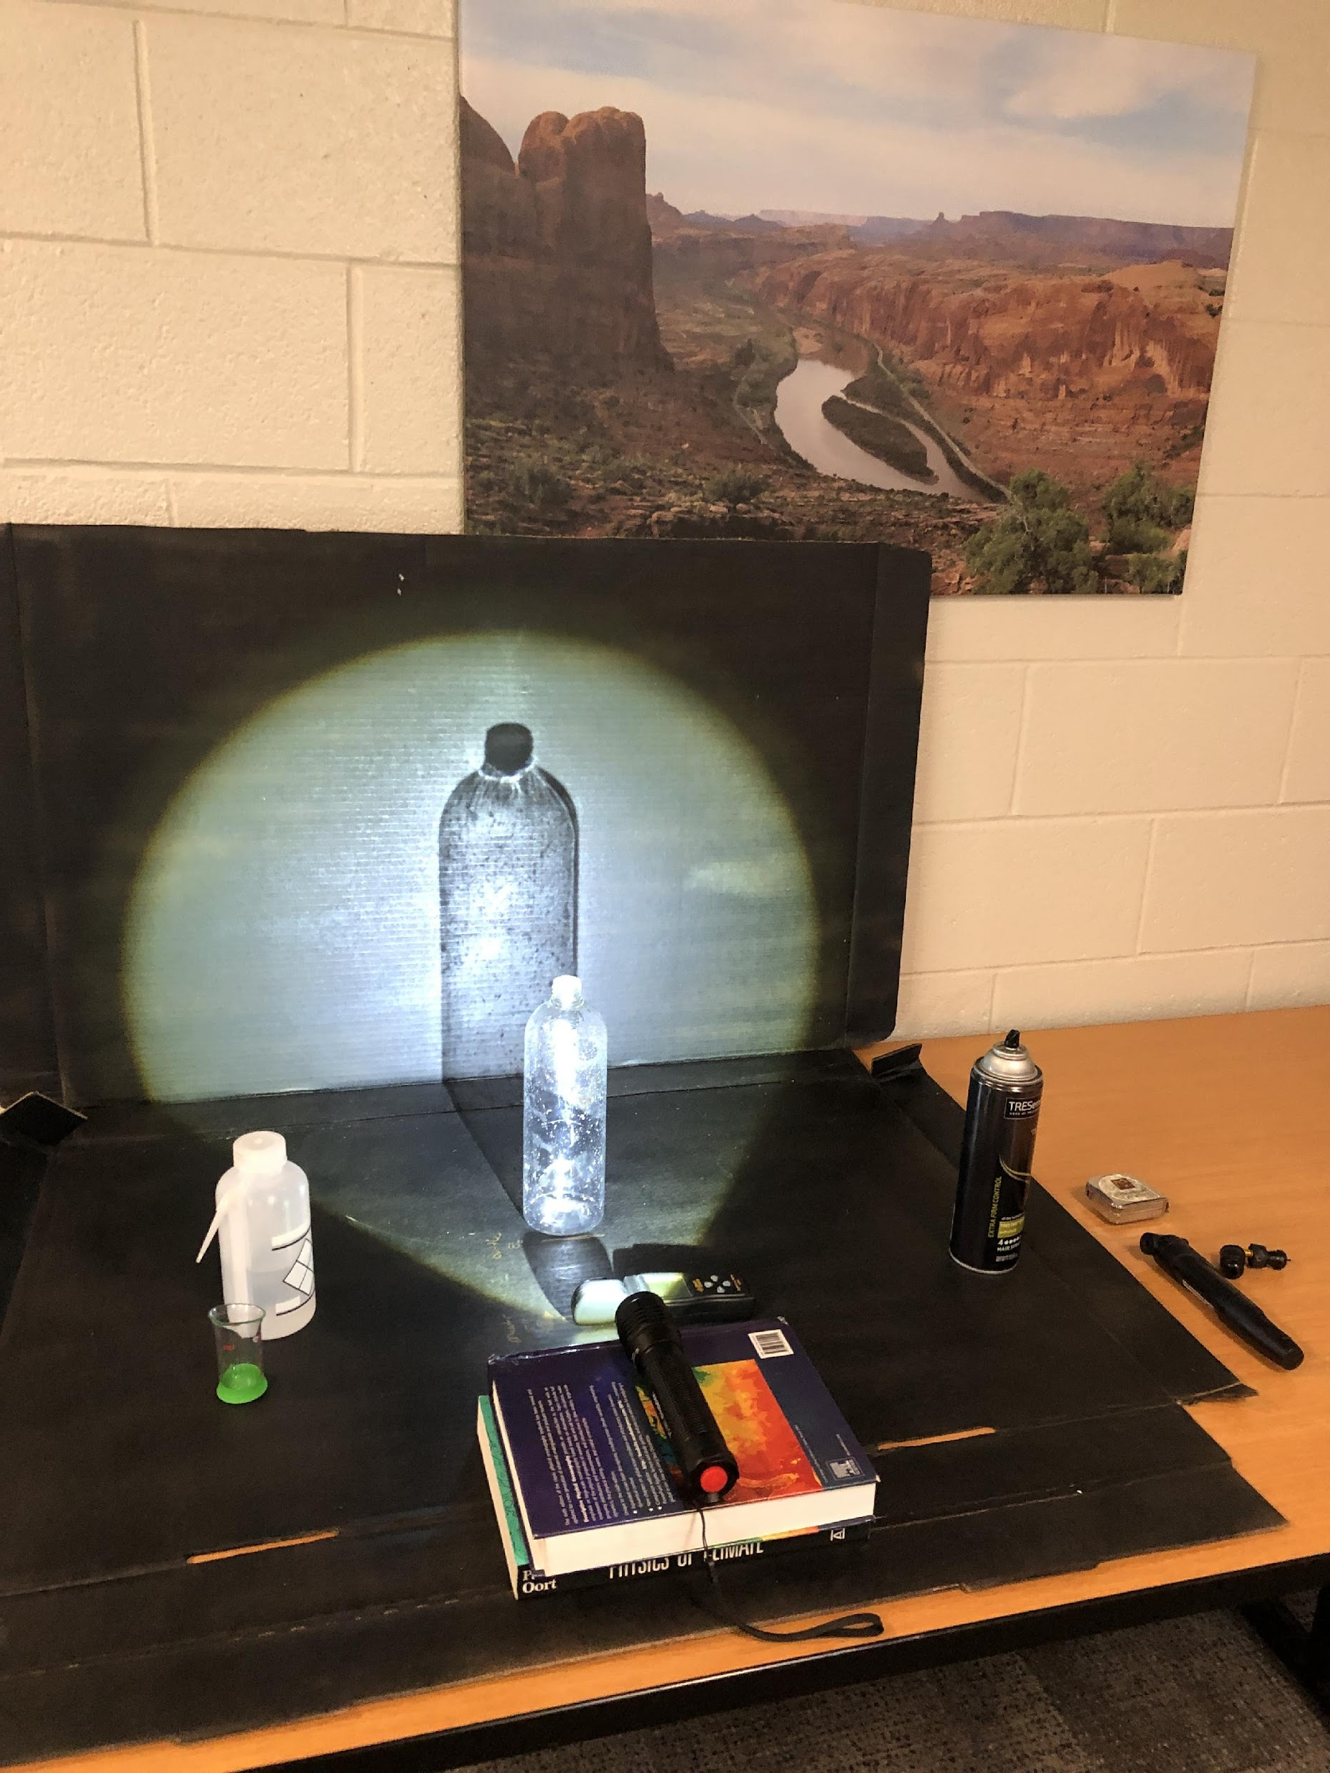
Design & Methods
In this experiment, we explore how/whether different amount of aerosol affect the brightness of the cloud.
In this experiment,
Independent variable is____
Dependent variables is_____
The constants are________
Notes:
Gear-up: teachers can facilitate a discussion of about a experiment design here. What are the variables and constant? Which variable are we testing?

Slide 16
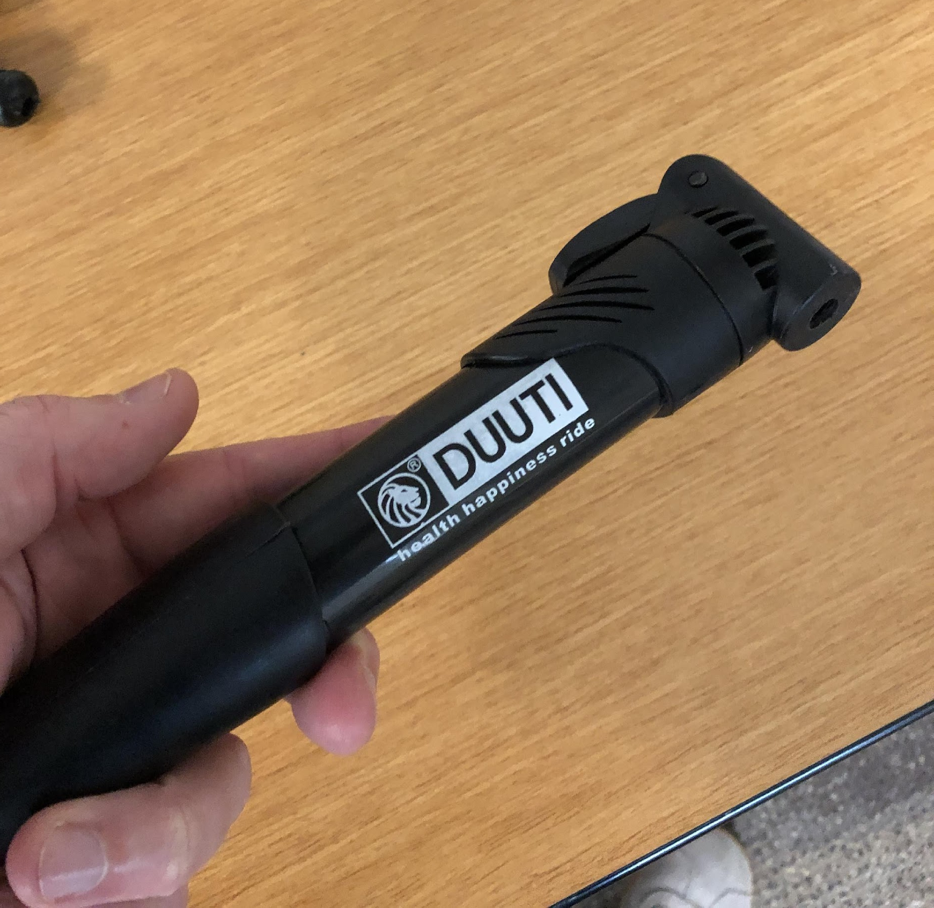
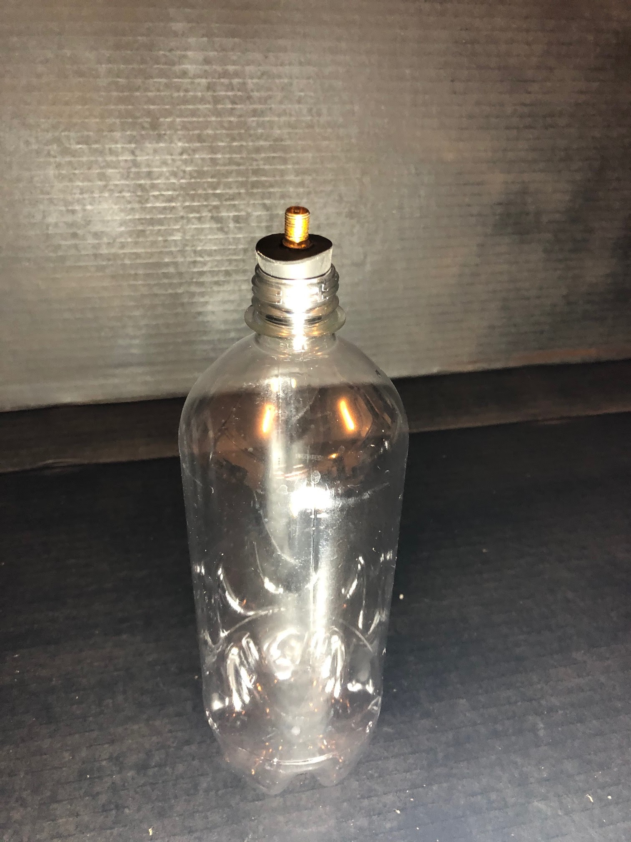
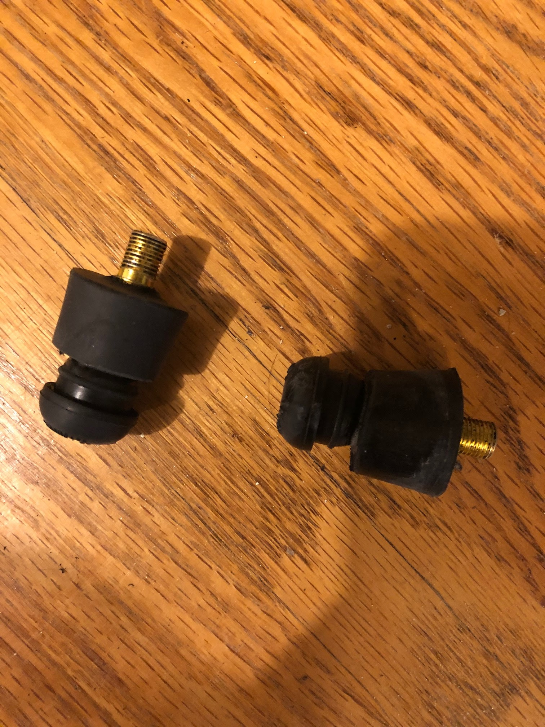
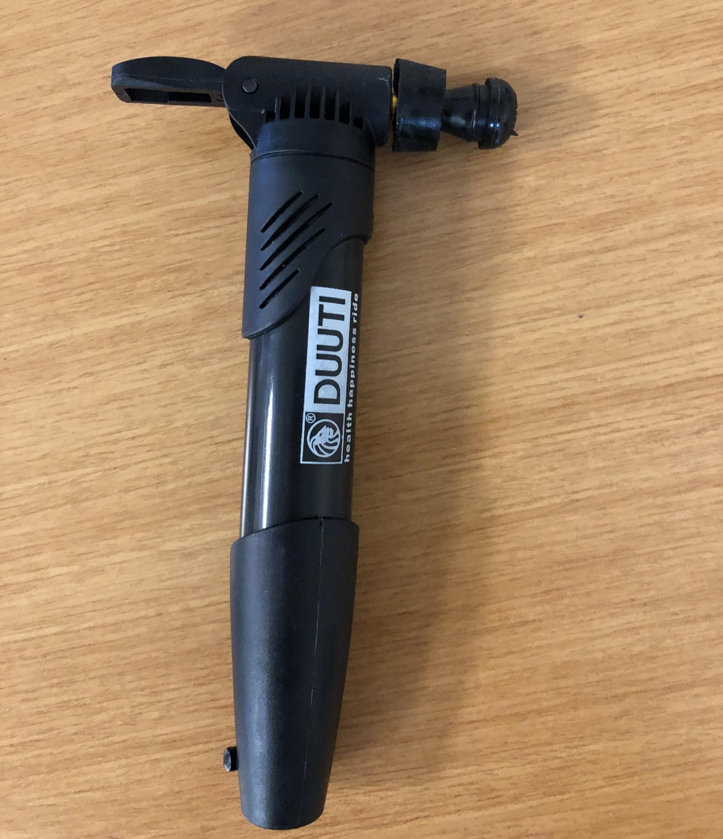
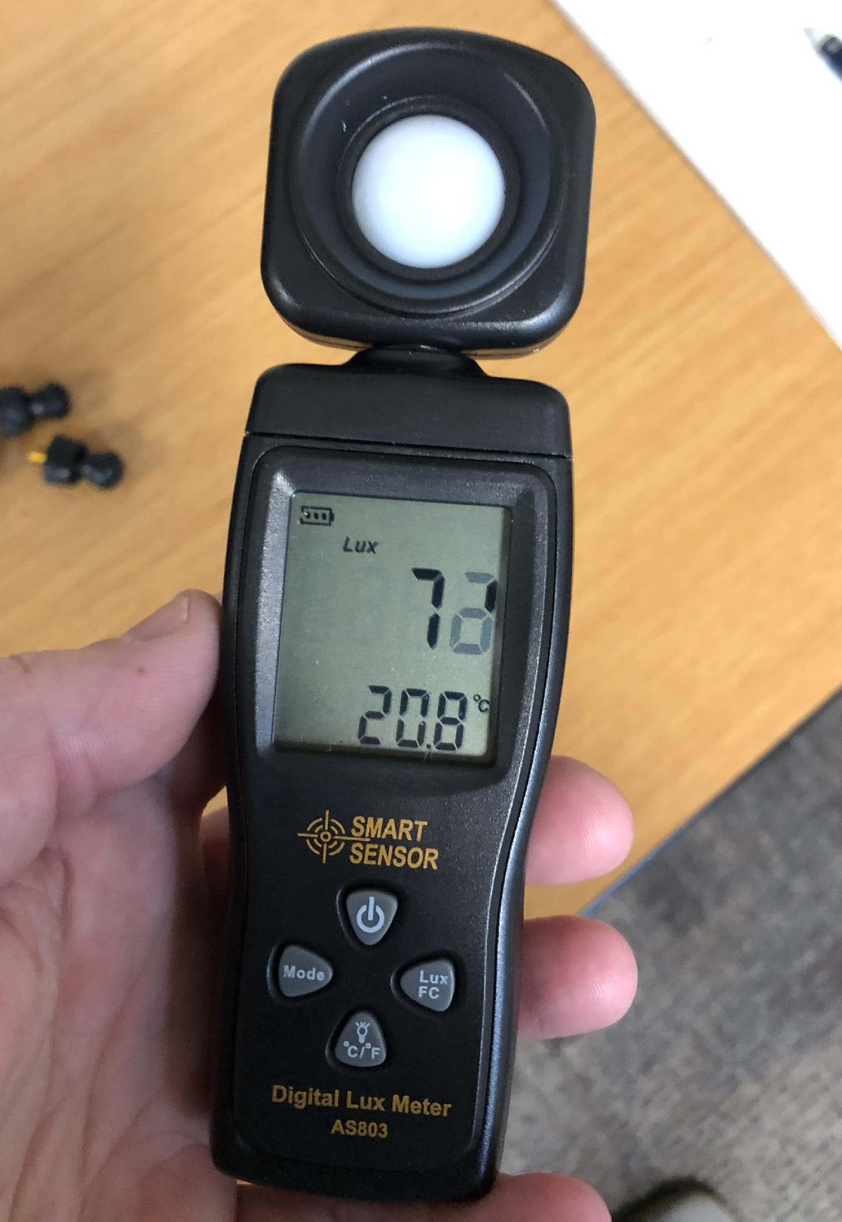
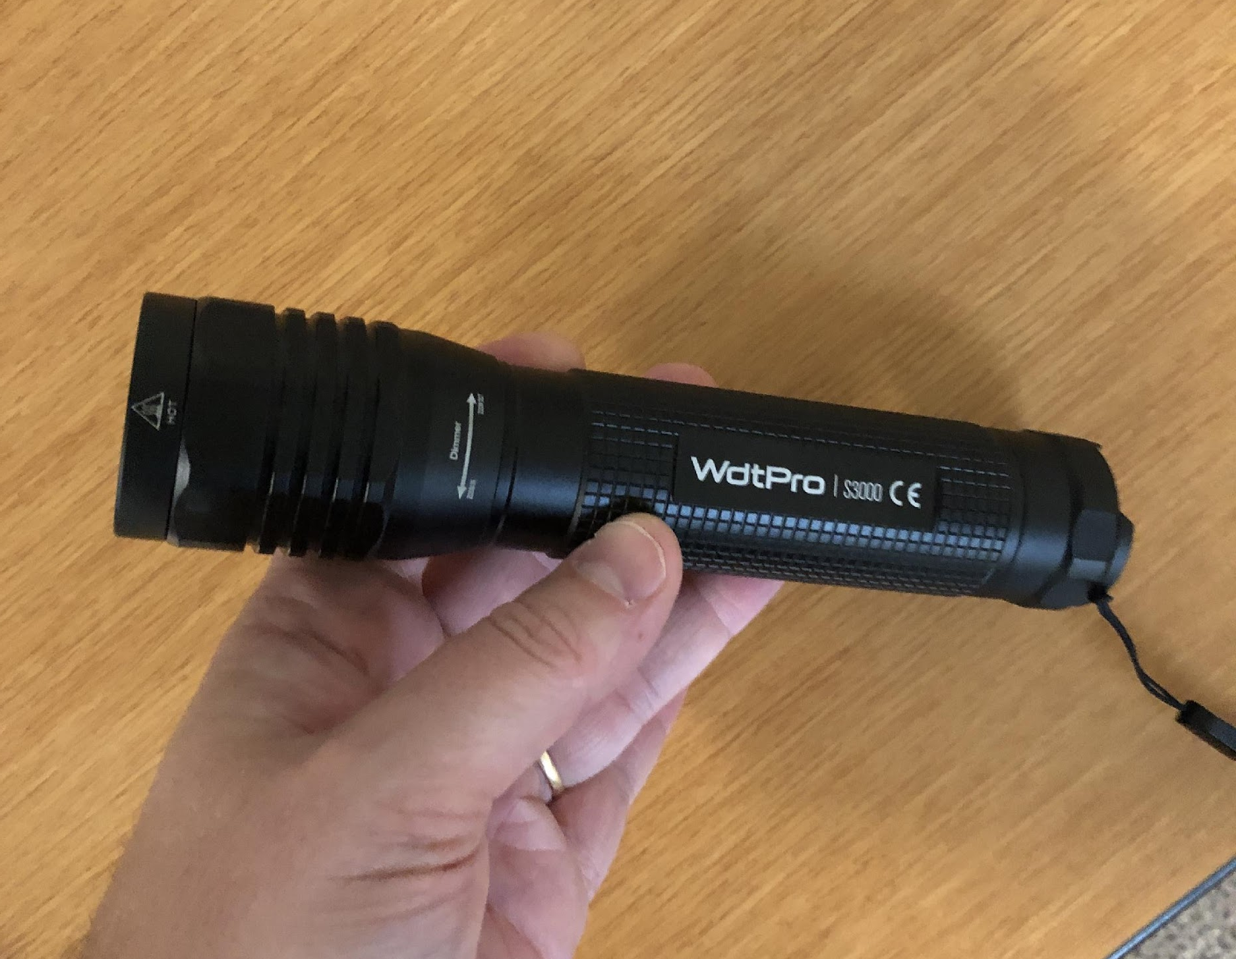
Materials and tools
Aerosol hairspray
Water & measurable units
Hand air pump
Picture of plug in the bottle
Clear 1-liter plastic bottles
Rubber stopper & valve plug
Light source
Picture of hand air pump with valve plug attached
Lux meter

Slide 17
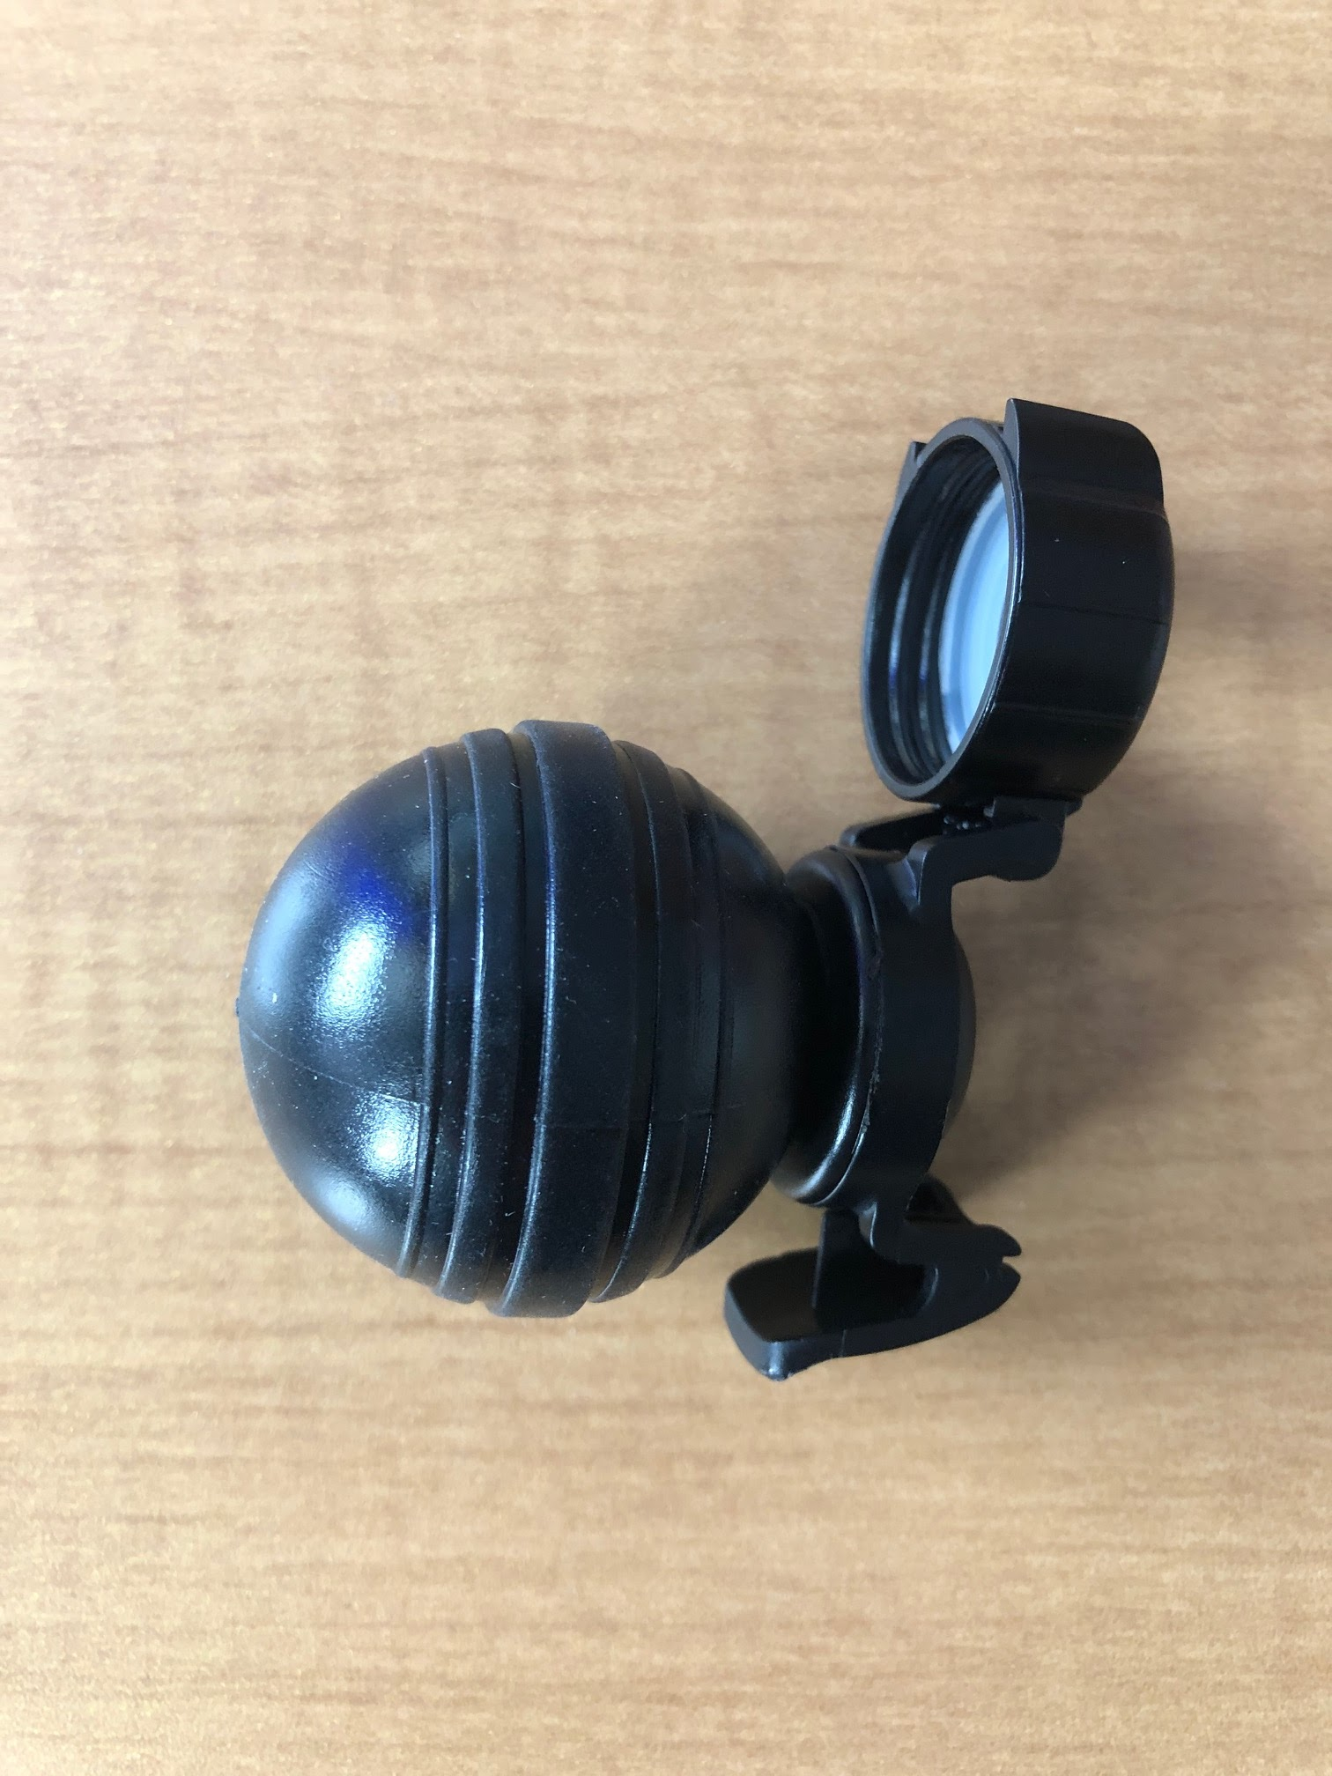
Materials and tools (continued)
OR:
“Fizz Keeper”
Picture of fizz keeper on the bottle

Slide 18
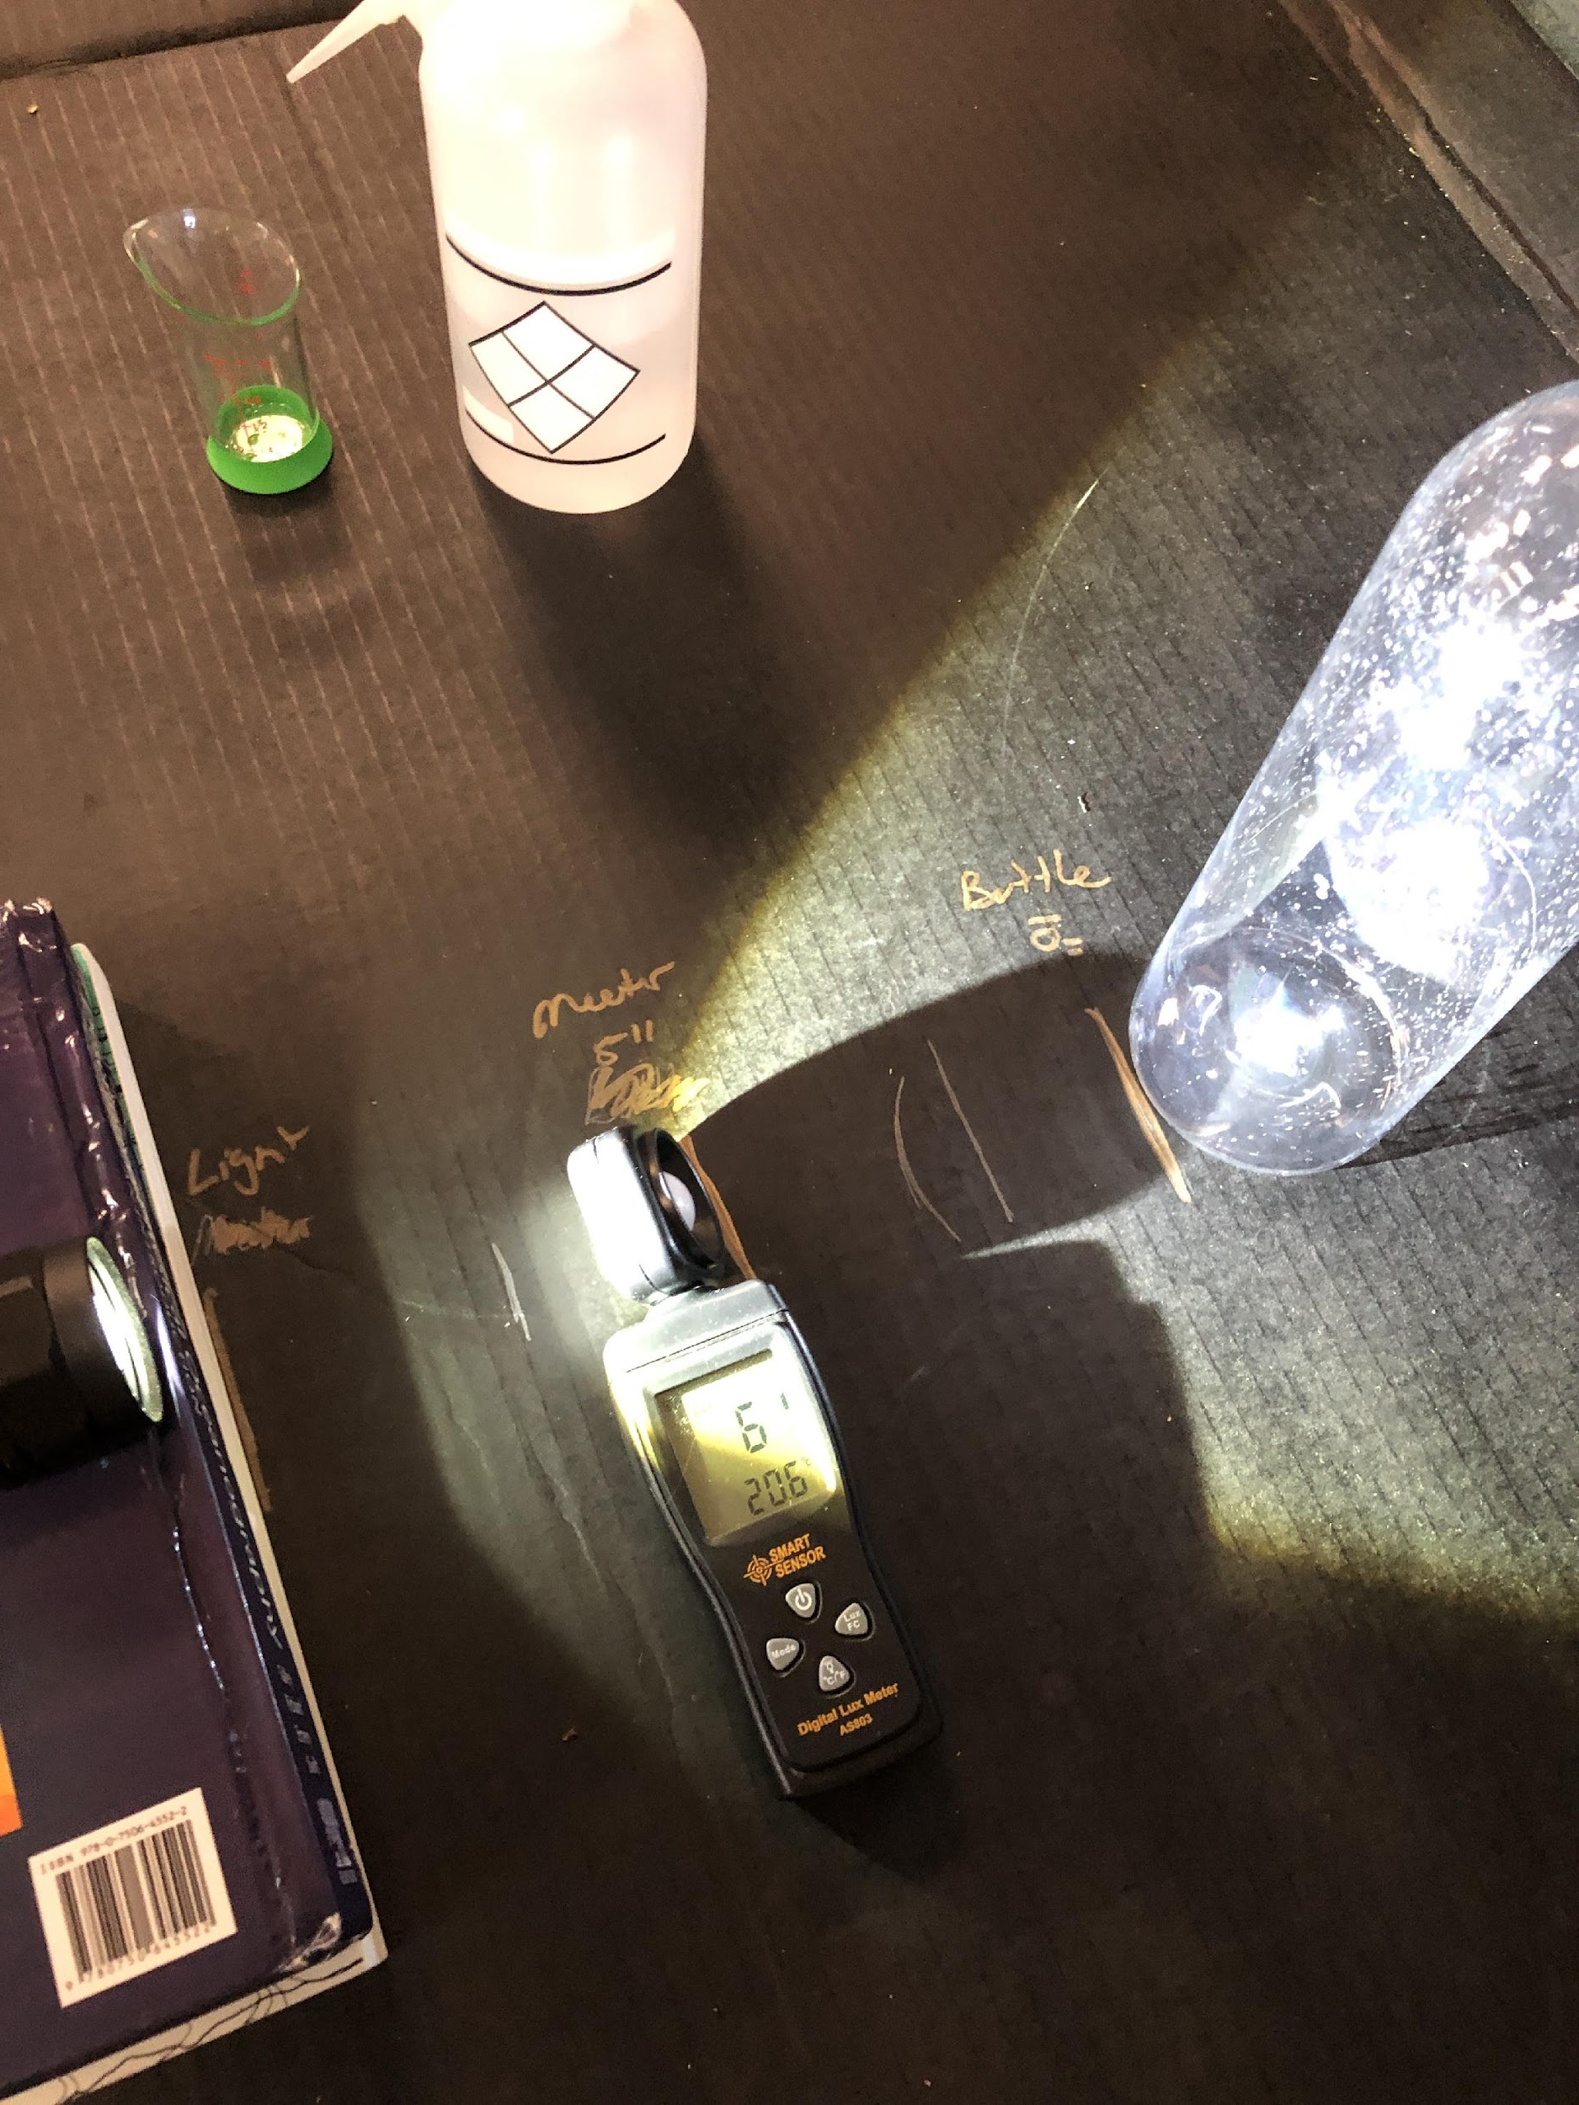
Setting up apparatus
15 by 15 by 15 set up
Set the flashlight 15 cm above surface
Set the lux meter 15 cm in front of light source, point sensor at the middle of the bottle
Set the plastic bottle 15 cm in front of the lux meter

Slide 19
Experiment One: Low-Aerosol Environment
Add 20 ml water to the bottle. Swish around to cover inner surface.
Spray 3 times with the aerosol hairspray into the bottle (Wear a mask).
Quickly cap with the rubber stopper and valve plug.
Use the air pump 15x (CAUTION – Do not over pressurize). OR: Use the “Fizz Keeper” and squeeze air into the bottle until you can not add any more air.
Immediately pull out the stopper (make sure bottle remains 15 cm from lux meter).
And ….

Slide 20
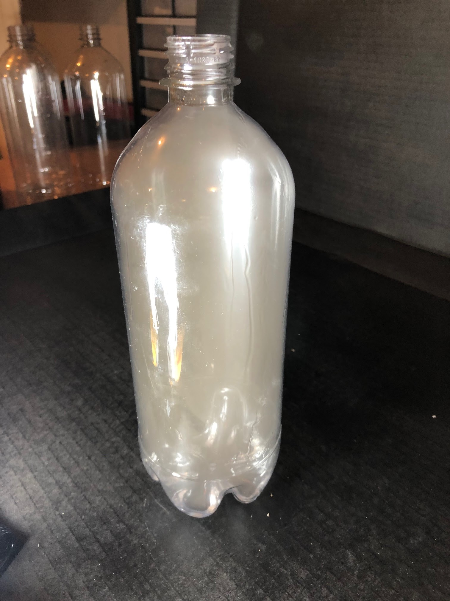
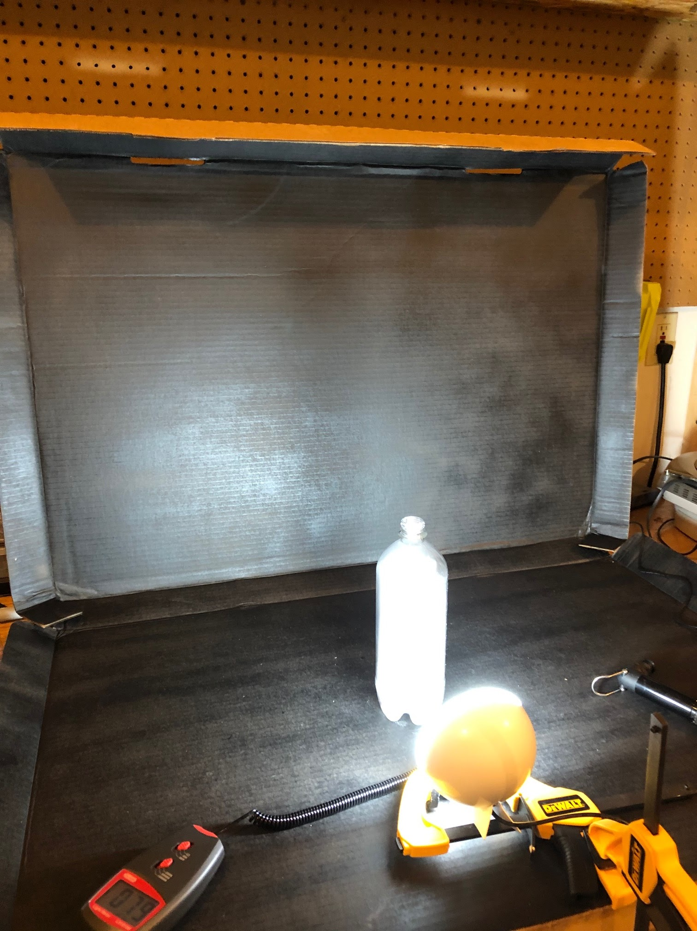
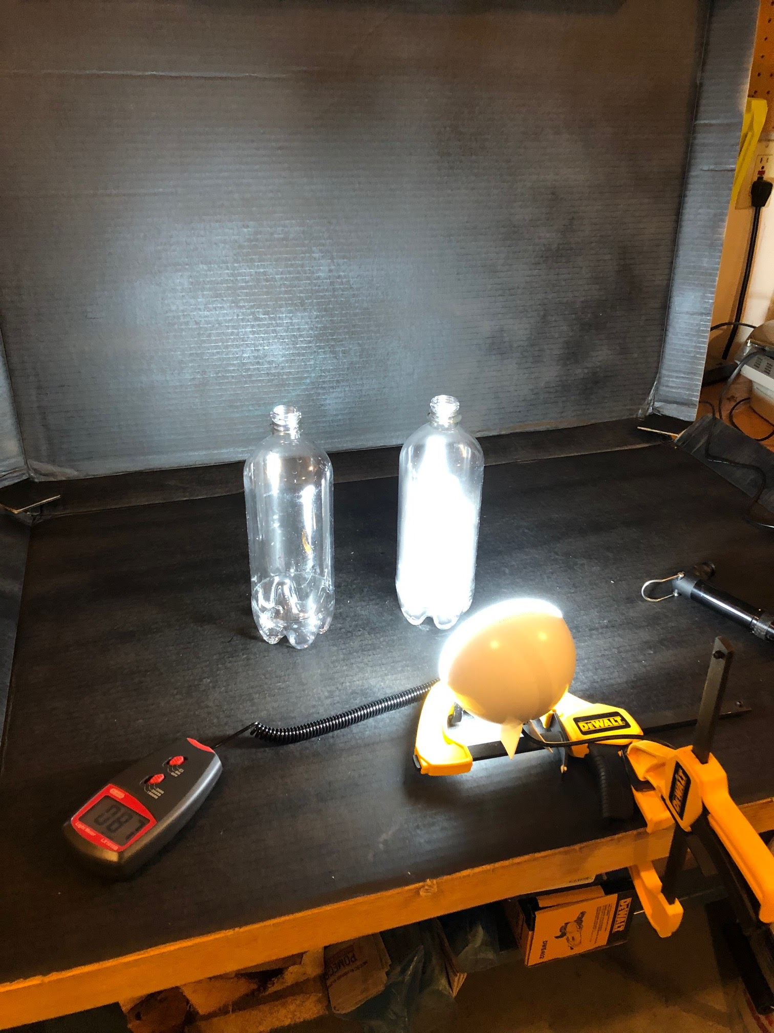
Experiment One: Low-Aerosol Environment (continued)
… Clouds!
Capture the lux meter reading ASAP and record the value.
Wait until the cloud fully dissipates (1-2 minutes), record the lux meter reading
Repeat Experiment One for at least 4 trials (up to 10).

Slide 21
Record Data
Following the same procedure, run at least 4 trials for Experiment Two in which 10 sprays of hairspray are used.
Record the lux meter reading for each trial on the worksheet
Experiment One: Low-Aerosol Environment 3 Sprays of Hairspray
 | Lux Meter Reading (lx)
Trial # | Bottle w/ Cloud | Bottle w/o Cloud | Difference
1
2
3
4
5
6
7
8
9
10
Experiment Two: High-Aerosol Environment 10 Sprays of Hairspray
 | Lux Meter Reading (lx)
Trial # | Bottle w/ Cloud | Bottle w/o Cloud | Difference
1
2
3
4
5
6
7
8
9
10

Slide 22
Answer Questions 4-9
Post-Experiment

Slide 23
Review Question 7
Explain why more aerosol particles (10 sprays vs. 3 sprays of hairspray) created a cloud that reflects more light?

Slide 24
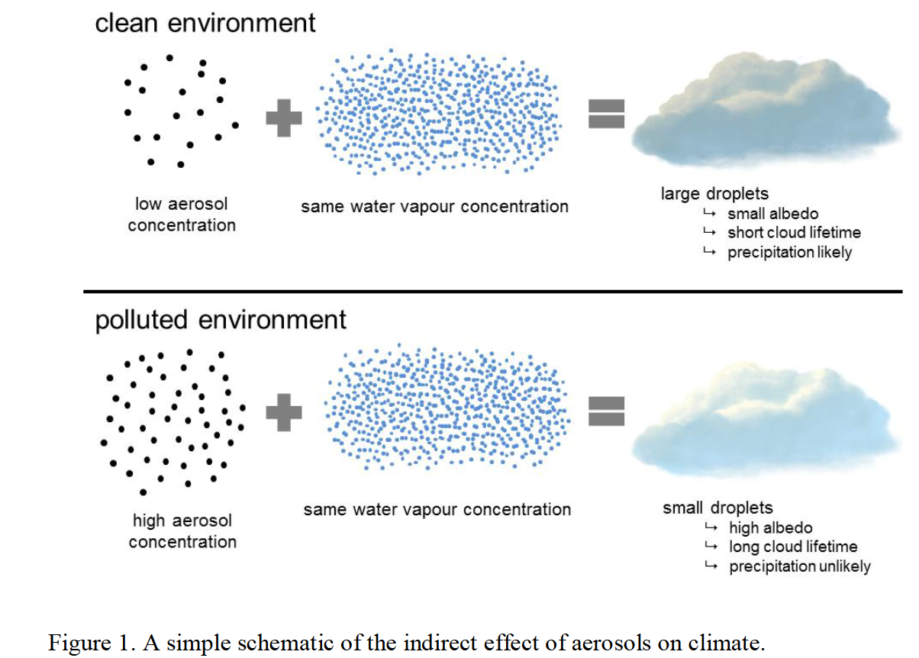
Review Question 7 - answer
The greater the number of cloud condensing nuclei (sea salt aerosols) the higher the cloud albedo, and thus greater reflectively of the cloud.
https://helda.helsinki.fi/bitstream/handle/10138/154682/lifecycl.pdf?sequence=1&isAllowed=y

Slide 25
Review Question 8
How could we implement this climate engineering technology to brighten clouds on a larger scale, in the real world?

Slide 26
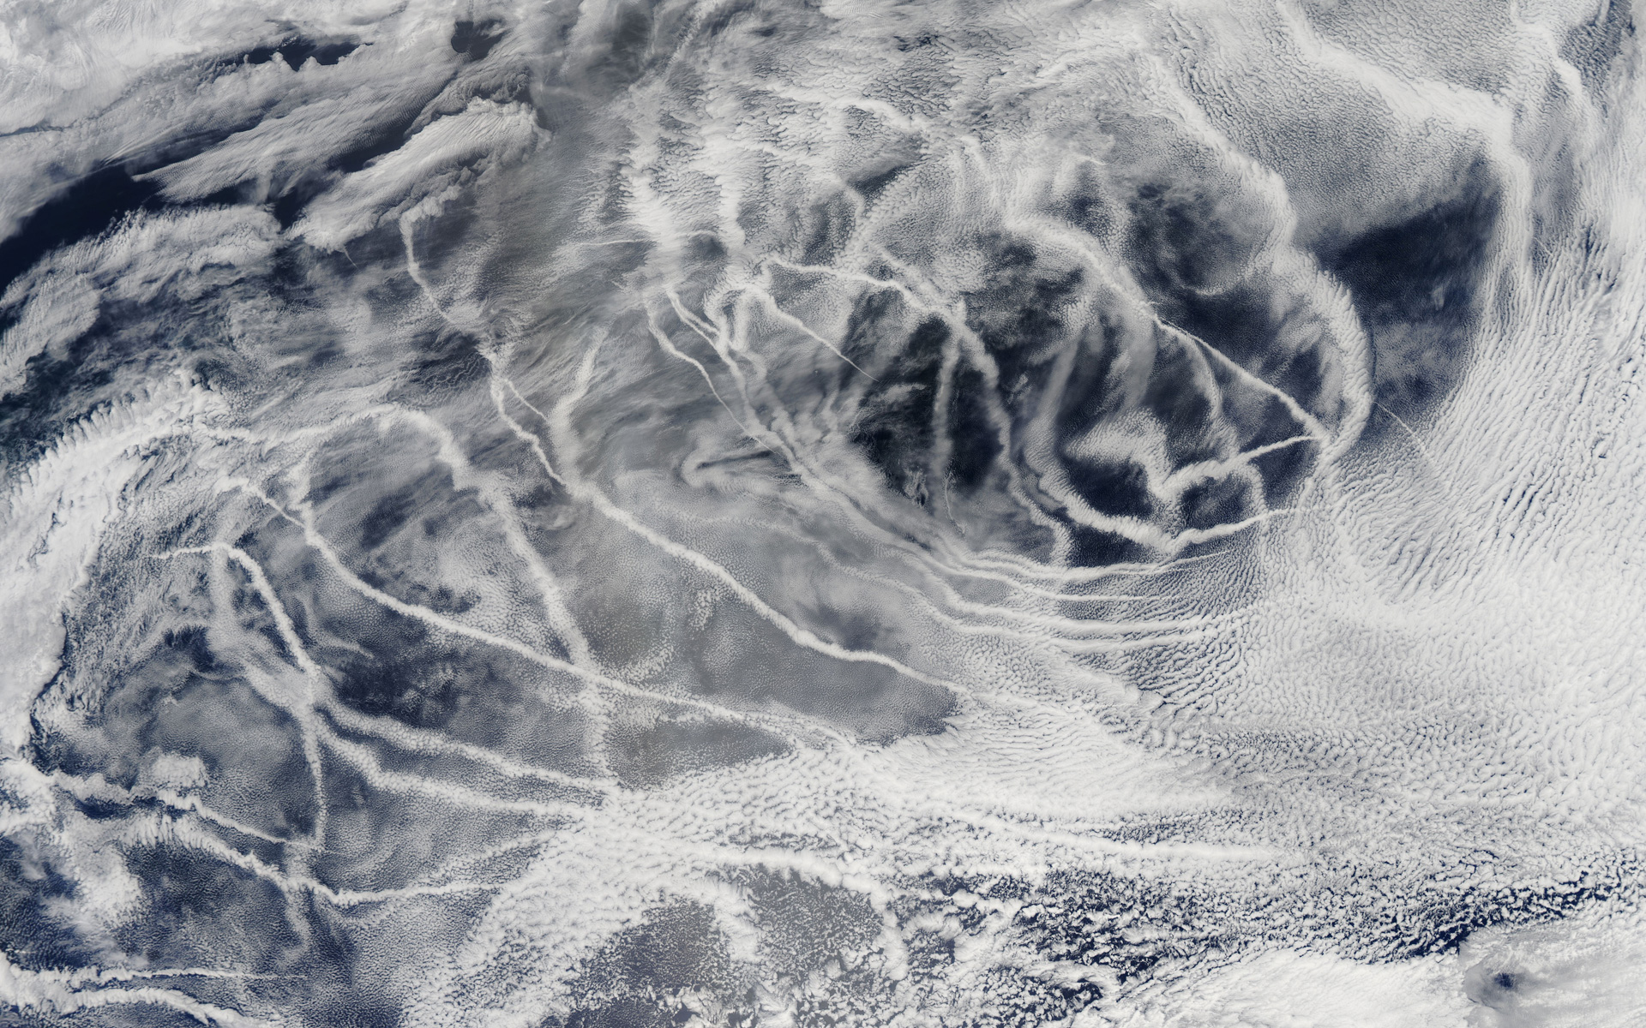
Review Question 8 – part 2
We have evidence that introducing aerosols into a marine environment will create and brighten clouds. Here is a picture of ‘ship tracks' above the northern Pacific Ocean. These patterns are produced when fine particles from ship exhaust float into a moist layer of atmosphere. The particles seed new clouds or attract water from existing cloud particles.
Image taken by the Moderate Resolution Imaging Spectroradiometer (MODIS) onboard NASA’s Aqua satellite on July 3, 2010.

Slide 27
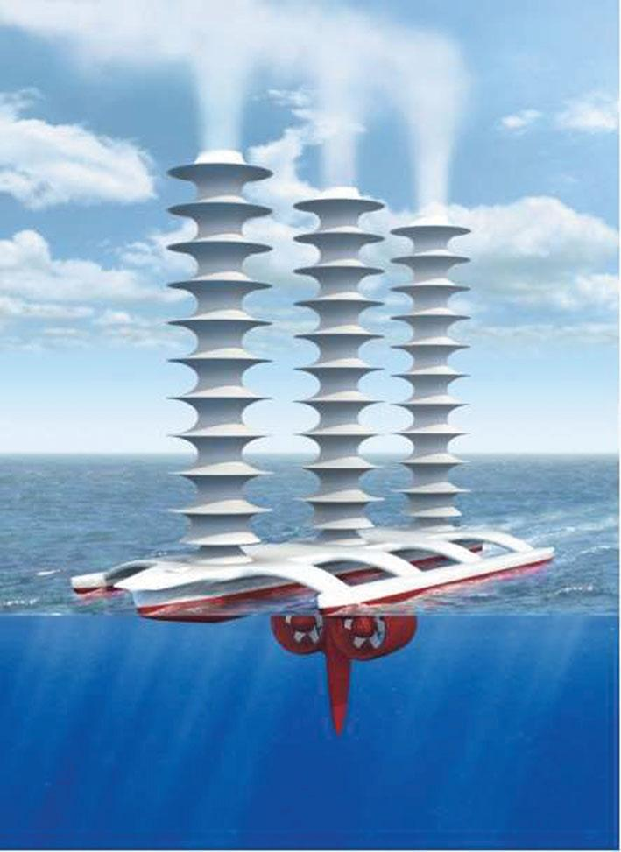
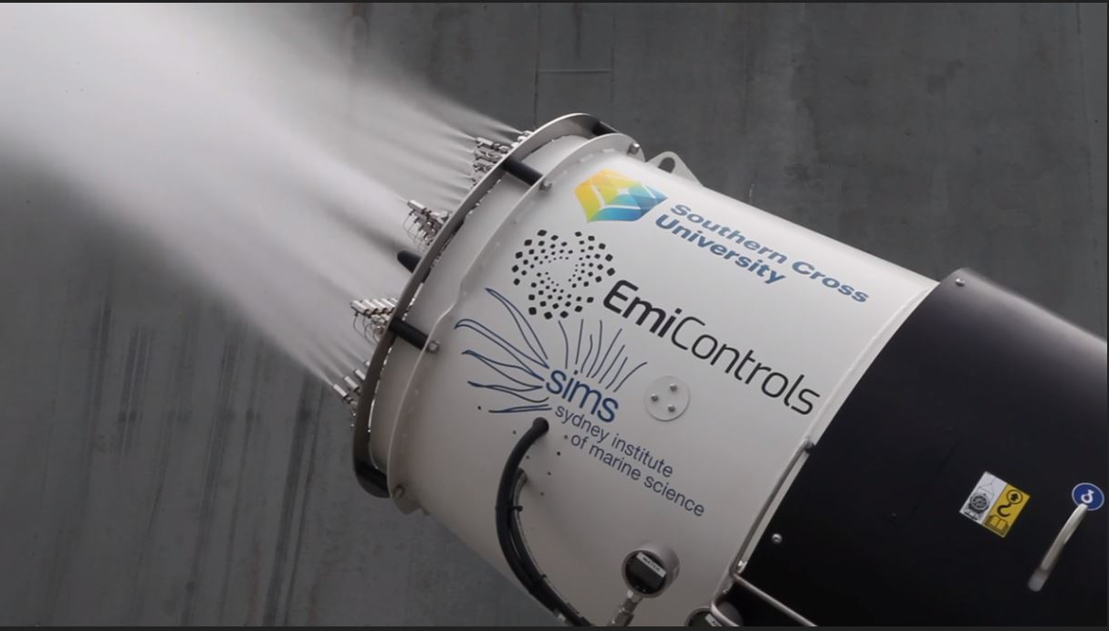
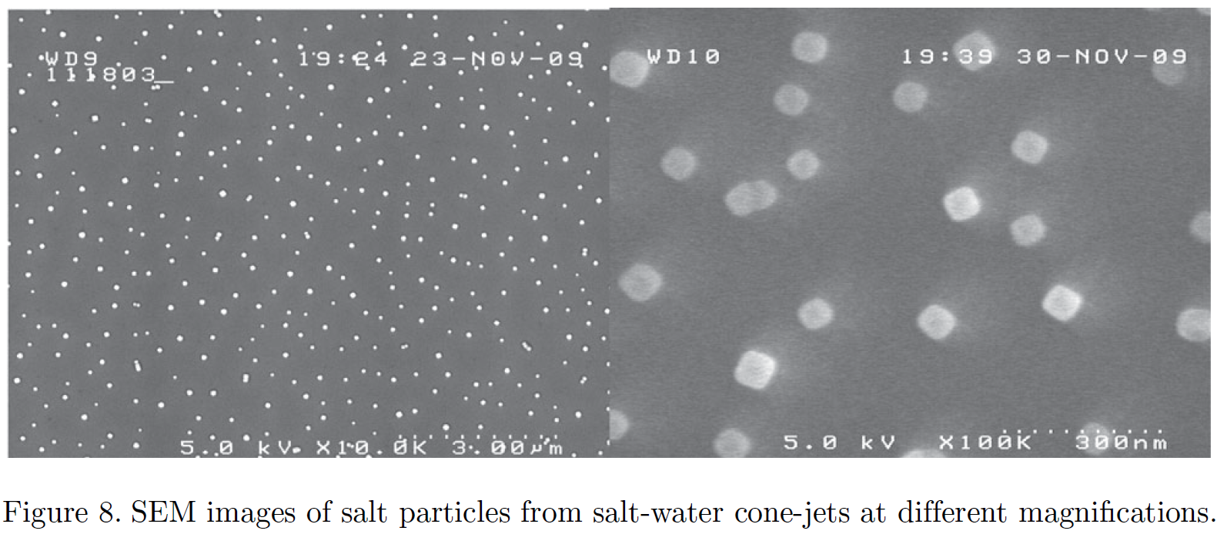
Review Question 8 – part 3
By using seawater sprayers on ships or autonomous marine vehicles, we can inject tiny sea salt particles into the lower atmosphere. These sea salt particles increase the cloud condensing nuclei. (Unlike ship exhaust, the sea salt particles are not accompanied by GHGs)
Image Credits: Daniel Harrison & Alejandro Tagliafico / SIMS and Southern Cross University. John MacNeill. Latham et al., 2012.

Slide 28
Review Question 8 – part 4
The greater the number of cloud condensing nuclei (sea salt aerosols) the higher the cloud albedo, and thus greater reflectively of the cloud.
https://helda.helsinki.fi/bitstream/handle/10138/154682/lifecycl.pdf?sequence=1&isAllowed=y

Slide 29
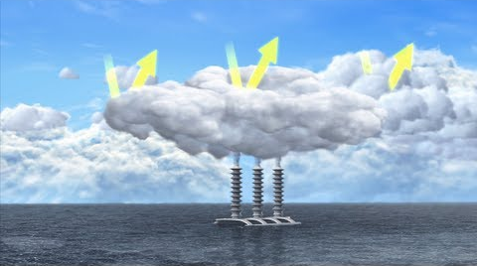
Review Question 8 – part 5
This climate engineering technology, known as Marine Cloud Brightening, is currently being researched by scientists and engineers using laboratories and computer models to assess the benefits and risks.
https://www.youtube.com/watch?v=cgJyw2cTrW4

Slide 30
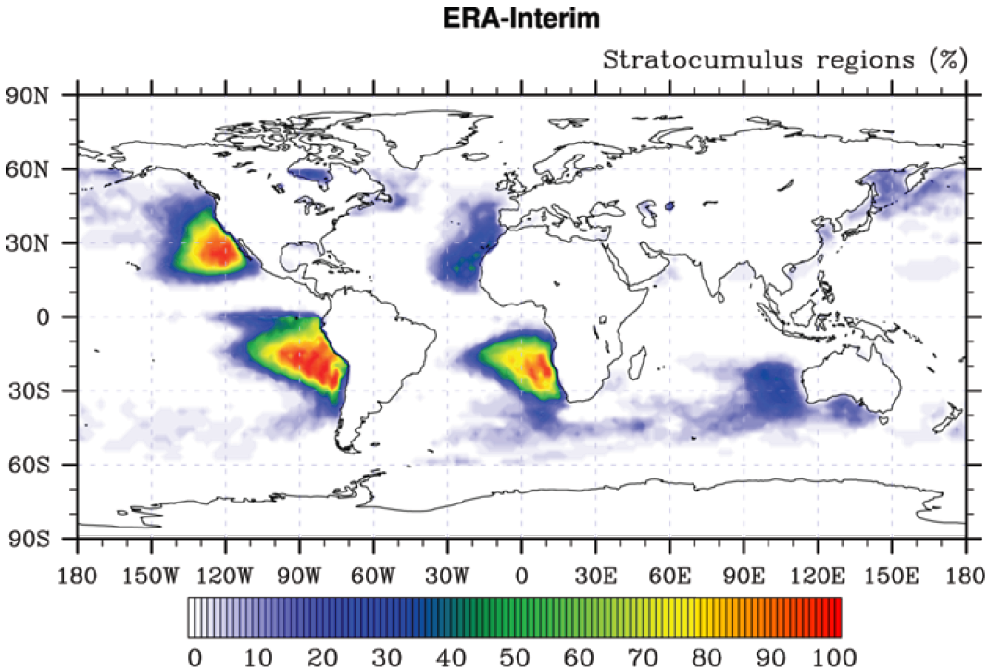
How MCB Could Work – part 1:

Slide 31
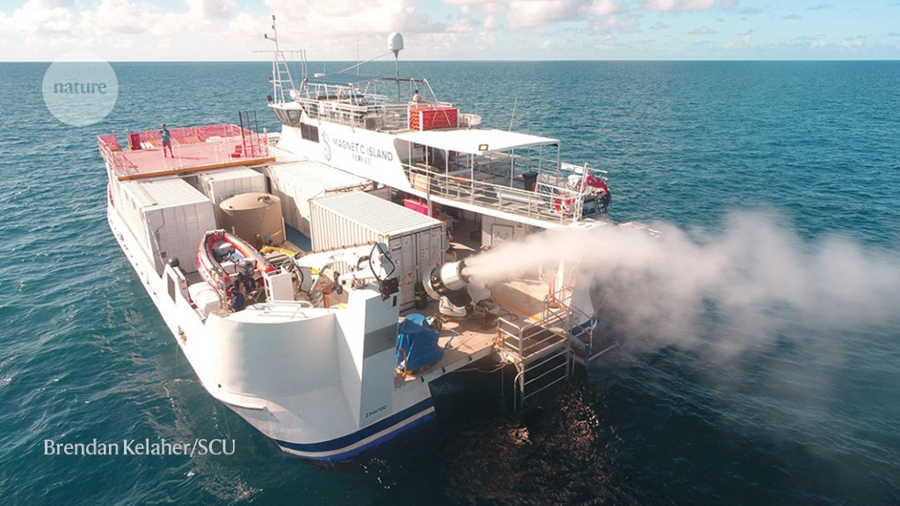
How MCB Could Work - part 2:

Slide 32
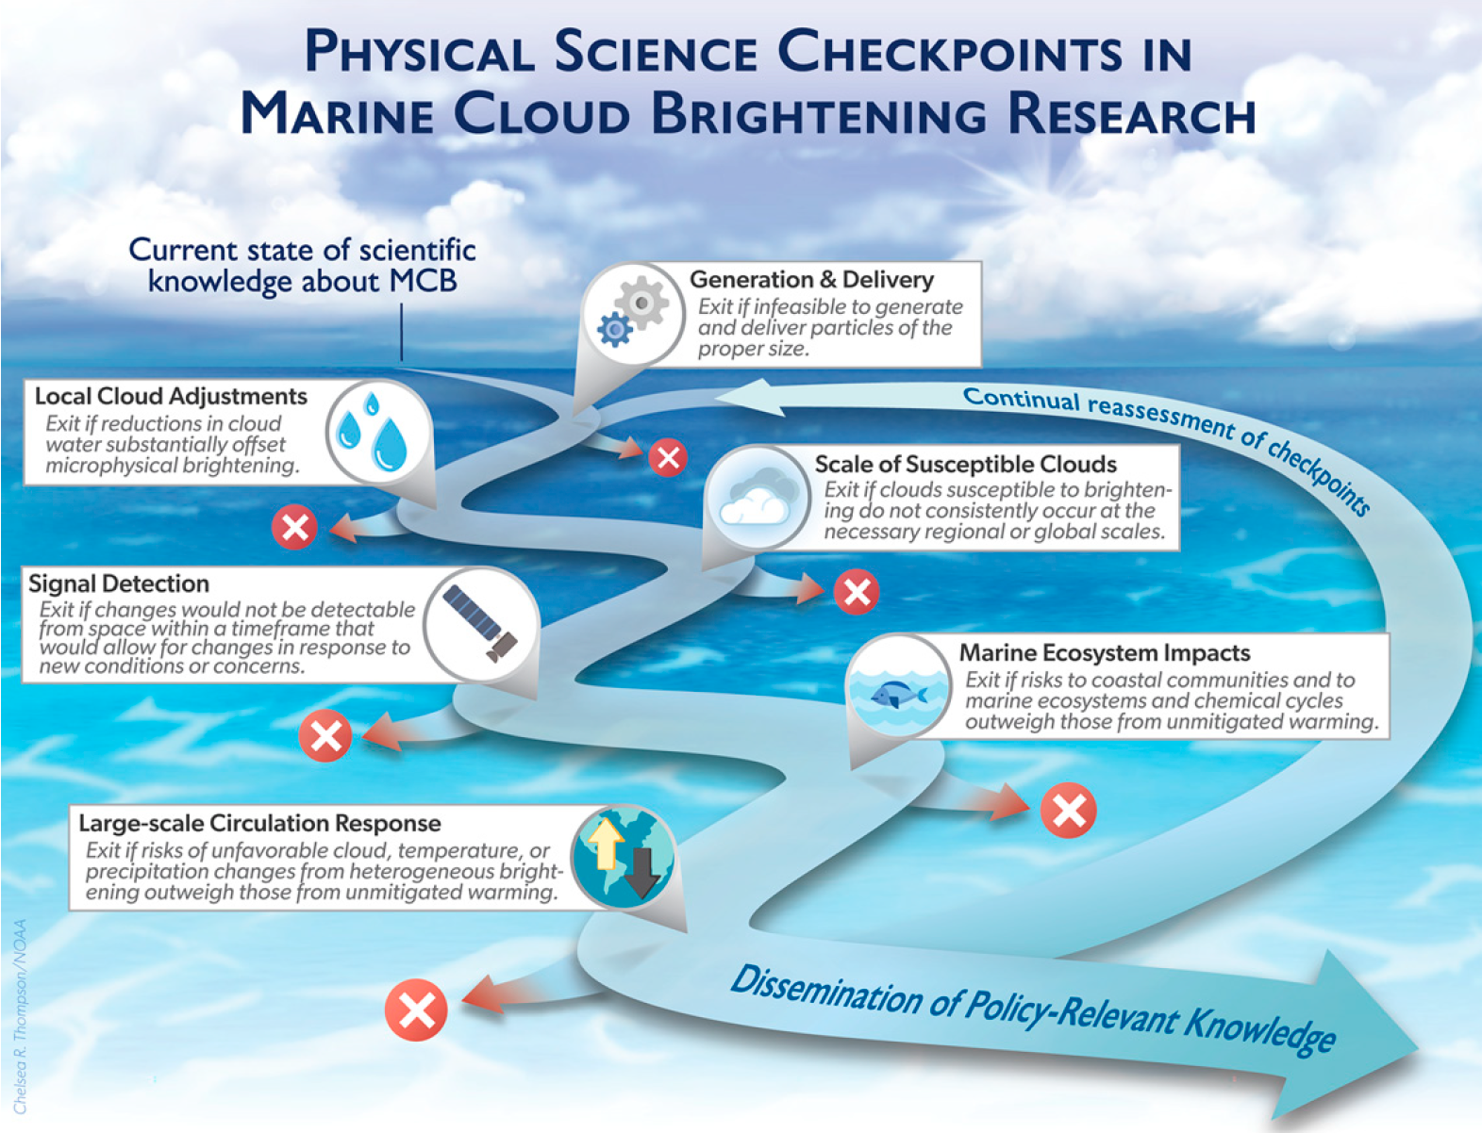
How MCB Could Work – part 3:
Diamond et al., 2022

Slide 33
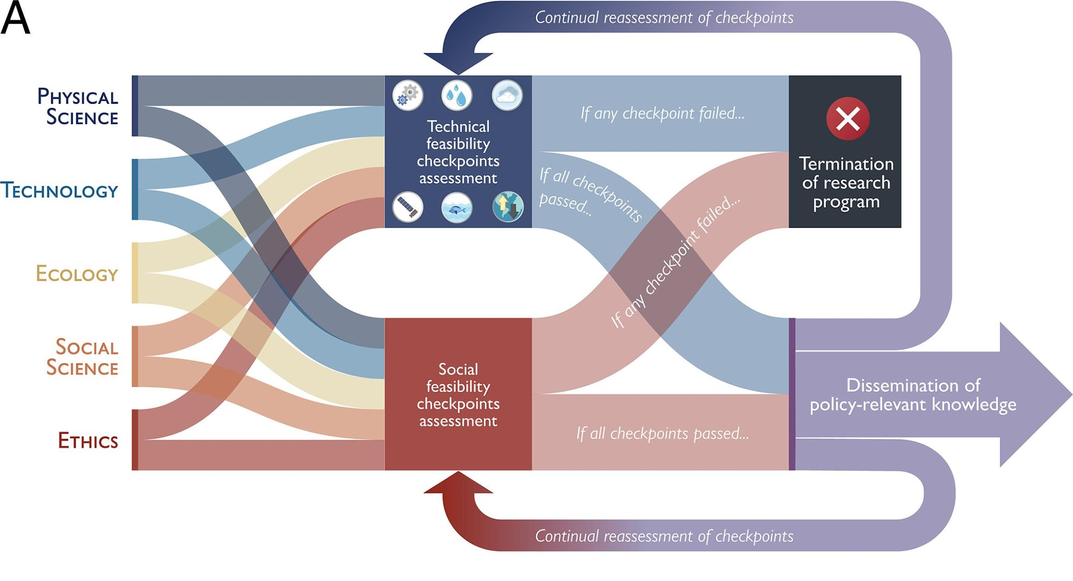
How MCB Could Work – part 4:
Diamond et al., 2022

Slide 34
Review Question 9
What are some possible limitations and risks to scaling this technology to use in the real-world?

Slide 35
Review Question 9 - answers
Limitations:
Cost
Preferred ocean environment (low clouds, low background aerosols, far from land)
Will greatly benefit from global cooperation and support
Does not address increasing atmospheric greenhouse gases nor ocean acidification
Risks:
Regional to global changes in precipitation amounts and patterns
Regional changes to atmospheric and oceanic chemistry
Impacts on biology and ecosystems
Potential for rapid change if abruptly terminated

Slide 36
Conduct a similar exercise regarding SAI with students which will help prepare them to critically evaluate their climate engineering designs
Limitations:
_____________
_____________
_____________
_____________
Risks:
_____________
_____________
_____________
_____________

Slide 37
In summary, Marine Cloud Brightening is a promising climate engineering strategy. Nonetheless, it is important that scientists and engineers continue to improve this technology and to address its limitations and risks. In the next lesson, how can you improve your climate engineering design to address its limitations and risks?
Prepare for Lesson 3

Slide 38
Questions/Comments/Thoughts/Ideas welcome!
Ben Kravitz bkravitz@iu.edu
Paul Goddard pgoddard@iu.edu
Adam Scribner

